Slide 1
OpenID Connect Working Group and OpenID Certification
May 21, 2020
Michael B. Jones
Identity Standards Architect – Microsoft

Slide 2
You’re Almost Certainly Using OpenID Connect!
Android, Apple, AOL, Deutsche Telekom, Google, GSMA Mobile Connect, Microsoft, NEC, NTT, Salesforce, Softbank, Symantec, Verizon, Yahoo! Japan all use OpenID Connect
Many other sites and apps large and small use OpenID Connect

Slide 3
Open Letters to Apple
OpenID Foundation wrote open letter to Apple about problems with Sign In with Apple in June
https://openid.net/2019/06/27/open-letter-from-the-openid-foundation-to-apple-regarding-sign-in-with-apple/
Apple has since fixed security and interop problems identified!
Standard OpenID Connect libraries can now be used in many cases
Posted a second open letter commending them on the improvements made

Slide 4
Session Management / Logout (work in progress)
Three approaches specified by the working group:
Session Management
https://openid.net/specs/openid-connect-session-1_0.html
Uses HTML5 postMessage to communicate state change messages between OP and RP iframes
Front-Channel Logout
https://openid.net/specs/openid-connect-frontchannel-1_0.html
Uses HTTP GET to load image or iframe, triggering logout (similar to SAML, WS-Federation)
Back-Channel Logout
https://openid.net/specs/openid-connect-backchannel-1_0.html
Server-to-communication not using the browser
Can be used by native applications, which have no active browser
Unfortunately, no one approach best for all use cases
All support multiple logged in sessions from OP at RP
Recent WG decision to split RP-Initiated Logout into its own spec
Is used with all three OP-Initiated Logout mechanisms
Logout certification tests now in pilot phase
WG is testing multiple implementations before making logout specs Final

Slide 5
Native SSO Specification (work in progress)
OpenID Connect Native SSO for Mobile Apps specification
https://openid.net/specs/openid-connect-native-sso-1_0.html
Enables Single Sign-On across apps by the same vendor
Assigns a device secret issued by the AS
New specification written by George Fletcher
Please review!

Slide 6
unmet_authentication_requirements Specification (work in progress)
Defines new error code unmet_authentication_requirements
https://openid.net/specs/openid-connect-unmet-authentication-requirements-1_0.html
Enables OP to signal that it failed to authenticate the End-User per the RP’s requirements
New specification written by Torsten Lodderstedt
Please review!

Slide 7
prompt=create Specification (work in progress)
Initiating User Registration via OpenID Connect specification
https://openid.net/specs/openid-connect-prompt-create-1_0.html
Requests enabling account creation during authentication
Active discussion of relationships between account creation and use of existing accounts
New specification written by George Fletcher
Please review!

Slide 8
Second Errata Set
Errata process corrects typos, etc. discovered
Makes no normative changes
Edits under way for second errata set
https://openid.net/specs/openid-connect-core-1_0-25.html is current Core errata draft

Slide 9
Use of Self-Issued OpenID Provider
OpenID Connect defines Self-Issued OpenID Provider
https://openid.net/specs/openid-connect-core-1_0.html#SelfIssued
Lets you be your own identity provider
Rather than a third party
Identity represented as asymmetric key pair controlled by you
Self-Issued OpenID Provider being used to achieve DID auth
Described at https://self-issued.info/?p=2013

Slide 10
Related Working Groups
eKYC and Identity Assurance WG
JWT format for verified claims with identity assurance information
International Government Profile (iGov) WG
OpenID Connect profile for government & high-value commercial applications
Enhanced Authentication Profile (EAP) WG
Enables integration with FIDO and other phishing-resistant authentication solutions
Mobile Operator Discovery, Registration & autheNticAtion (MODRNA) WG
Mobile operator profiles for OpenID Connect
Financial-grade API (FAPI) WG
Enables secure API access to high-value services
Used for Open Banking APIs in many jurisdictions, including the UK
Research and Education (R&E) WG
Profiles OpenID Connect to ease adoption in the Research and Education (R&E) sector

Slide 11
Federation Specification (work in progress)
OpenID Connect Federation specification
https://openid.net/specs/openid-connect-federation-1_0.html
Enables establishment and maintenance of multi-party federations using OpenID Connect
Defines hierarchical JSON-based metadata structures for federation participants
Second Implementer’s Draft status reached
Multiple interop events to occur this year
Please review and implement!

Slide 12
OpenID Connect Resources
OpenID Connect
https://openid.net/connect/
Frequently Asked Questions
https://openid.net/connect/faq/
Working Group Mailing List
https://lists.openid.net/mailman/listinfo/openid-specs-ab
OpenID Certification Program
https://openid.net/certification/
Certified OpenID Connect Implementations Featured for Developers
https://openid.net/developers/certified/
Mike Jones’ Blog
https://self-issued.info/
Nat Sakimura’s Blog
https://nat.sakimura.org/
John Bradley’s Blog
https://www.thread-safe.com/

Slide 13
What is OpenID Certification?
Enables OpenID Connect and FAPI implementations to be certified as meeting the requirements of defined conformance profiles
Goal is to make high-quality, secure, interoperable OpenID Connect implementations the norm
An OpenID Certification has two components:
Technical evidence of conformance resulting from testing
Legal statement of conformance
Certified implementations can use the “OpenID Certified” logo

Slide 14
What value does certification provide?
Technical:
Certification testing gives confidence that things will “just work”
No custom code required to integrate with implementation
Better for all parties
Relying parties explicitly asking identity providers to get certified
Business:
Enhances reputation of organization and implementation
Shows that organization is taking interop seriously
Customers may choose certified implementations over others

Slide 15
Use of Self-Certification
OpenID Certification uses self-certification
Party seeking certification does the testing
(rather than paying a 3rd party to do the testing)
Simpler, quicker, less expensive, more scalable than 3rd party certification
Results are nonetheless trustworthy because
Testing logs are made available for public scrutiny
Organization puts its reputation on the line by making a public declaration that its implementation conforms to the profile being certified to

Slide 16
How does OpenID Certification work?
Organization decides what profiles it wants to certify to
For instance, “Basic OP”, “Config OP”, and “Dynamic OP”
Runs conformance tests publicly available at https://op.certification.openid.net/ or https://rp.certification.openid.net/ or https://www.certification.openid.net/
Once all tests for a profile pass, organization submits certification request to OpenID Foundation containing:
Logs from all tests for the profile
Signed legal declaration that implementation conforms to the profile
Organization pays certification fee (for profiles not in pilot mode)
See https://openid.net/certification/fees/
OpenID Foundation verifies application is complete and grants certification
OIDF lists certification at https://openid.net/certification/

Slide 17
Can I use the certification sites for interop testing?
Yes – please do!
The OpenID Foundation is committed to keeping the conformance test sites up and available for free to all
Many projects using conformance testing for regression testing
Once everything passes, you’re ready for certification!
Test software is open source using Apache 2.0 license
Some projects have deployed private instances for internal testing
Available as a Docker container

Slide 18
OpenID Connect Certification Profiles
Now OpenID Connect certification profiles for:
Basic OP and Basic RP
Implicit OP and Implicit RP
Hybrid OP and Hybrid RP
OP Publishing and RP Using Configuration Information
Dynamic OP and Dynamic RP
Form Post Response Mode for OP and RP
Third party-initiated login for OP and RP
New: Logout OP and RP tests in pilot mode

Slide 19
New Connect Certification Profiles
Four logout profiles for OPs and RPs in pilot mode
RP-Initiated Logout
Session Management Logout
Front-Channel Logout
Back-Channel Logout

Slide 20
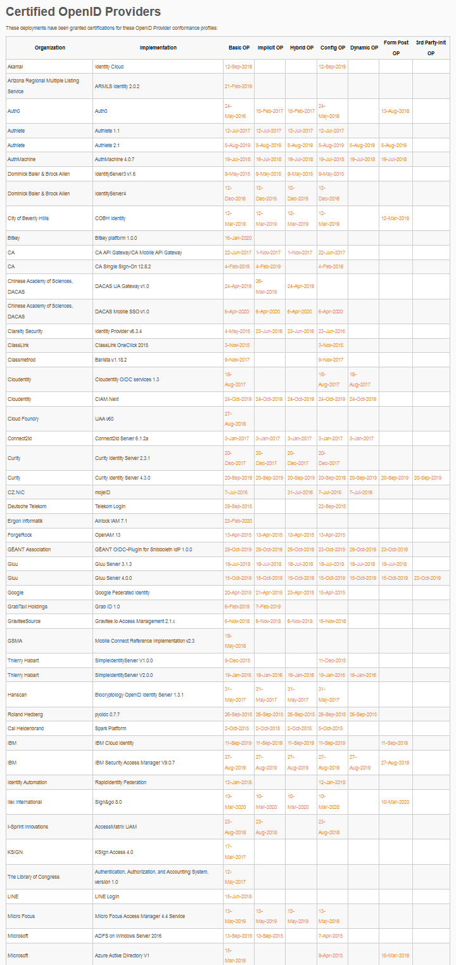
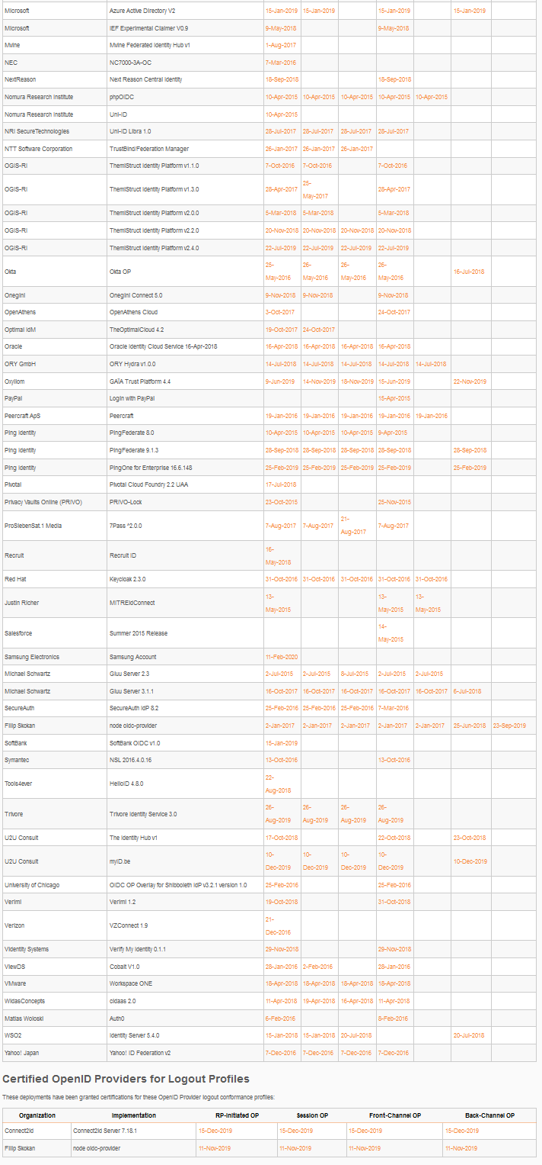
Connect OP Certifications
OpenID Provider certifications at https://openid.net/certification/#OPs
374 profiles certified for 112 implementations by 91 organizations
Recent additions:
Bitkey, Chinese Academy of Sciences, Ergon Informatik, Gluu, Ilex International, Samsung Electronics
Each entry link to zip file with test logs and signed legal statement
Test results available for public inspection

Slide 21
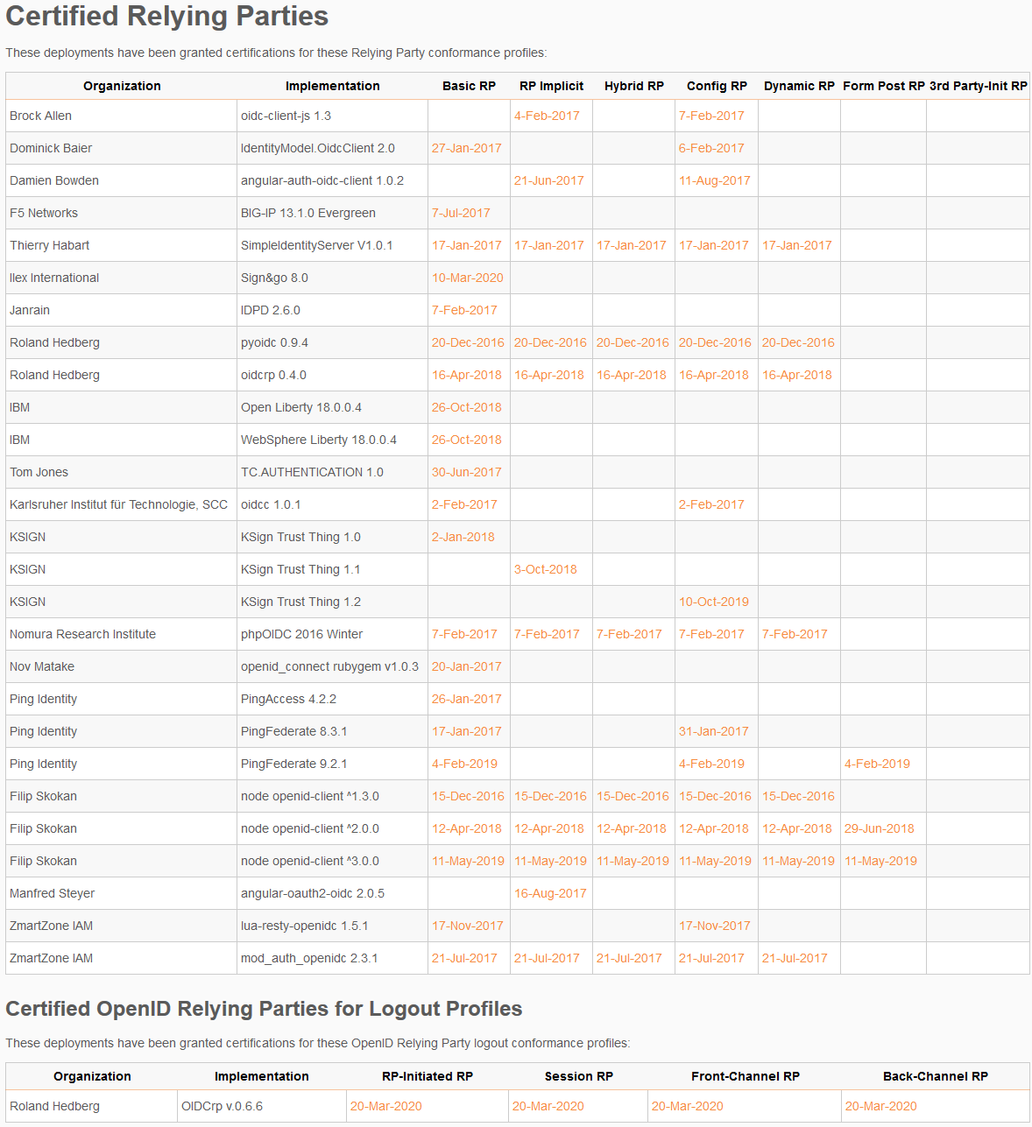
Connect RP Certifications
Relying Party certifications at https://openid.net/certification/#RPs
77 profiles certified for 30 implementations by 18 organizations
Recent additions:
Ilex International, Roland Hedberg

Slide 22
FAPI Certification Status
Financial-grade API (FAPI) implementations being certified
FAPI Part 2 OP certification launched in April 2019
18 implementations certified to date
Financial-grade API Client Initiated Backchannel Authentication Profile (FAPI-CIBA) launched in September 2019
One implementation certified to date
FAPI Part 2 RP certification tests launched in December 2019
One implementation certified to date

Slide 23
What’s next for OpenID Certification?
Connect Certification code being reimplemented in Java
Current implementation in Python
Moving to the same code base as FAPI certification
Expect migration to Java implementation later this year
News: Many Java OpenID Connect tests now ready for you to test!
Additional FAPI profiles being developed:
FAPI-CIBA RP
Certification for additional specifications is possible:
E.g., eKYC-IDA, HEART, MODRNA, iGov, EAP, R&E, etc.

Slide 24
OpenID Certification Call to Action
Certify your OpenID Connect and FAPI implementations
Help us test the Java OpenID Connect tests
Joseph Heenan will tell you how

