Slide 1
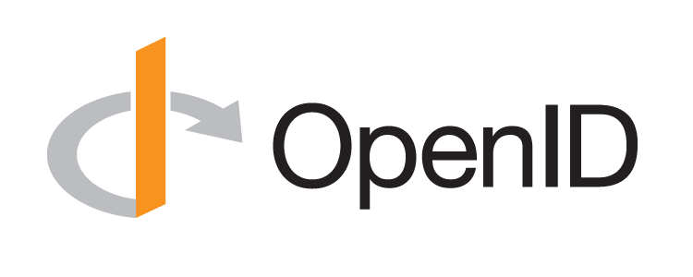
OpenID Connect Working Group
May 10, 2016
Mike Jones
Identity Standards Architect – Microsoft

Slide 2
Working Together
OpenID Connect

Slide 3
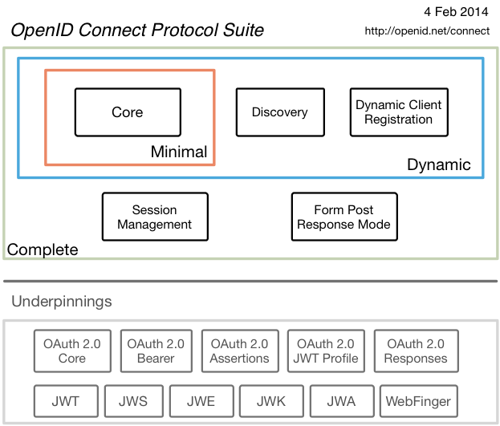
OpenID Connect

Slide 4
Topics
Most Recently Completed Specifications
Session Management / Logout
Second Errata Set
New Related Work
OpenID Connect Certification

Slide 5
Most Recently Completed Specifications (1 of 2)
OpenID 2.0 to OpenID Connect Migration
Defines how to migrate from OpenID 2.0 to OpenID Connect
Has OpenID Connect identity provider also return OpenID 2.0 identifier, enabling account migration
http://openid.net/specs/openid-connect-migration-1_0.html
Completed April 2015
Google shut down OpenID 2.0 support in April 2015
Yahoo, others also plan to replace OpenID 2.0 with OpenID Connect

Slide 6
Most Recently Completed Specifications (2 of 2)
OAuth 2.0 Form Post Response Mode
Defines how to return OAuth 2.0 Authorization Response parameters (including OpenID Connect Authentication Response parameters) using HTML form values that are auto-submitted by the User Agent using HTTP POST
A “form post” binding, like SAML and WS-Federation
An alternative to fragment encoding
http://openid.net/specs/oauth-v2-form-post-response-mode-1_0.html
Completed April 2015
In production use by Microsoft, Ping Identity

Slide 7
Session Management / Logout
Three approaches being pursued by the working group:
Session Management
http://openid.net/specs/openid-connect-session-1_0.html
Uses HTML5 postMessage to communicate state change messages between OP and RP iframes
Front-Channel Logout
http://openid.net/specs/openid-connect-frontchannel-1_0.html
Uses HTTP GET to load image or iframe, triggering logout
Similar to options in SAML, WS-Federation
Back-Channel Logout
http://openid.net/specs/openid-connect-backchannel-1_0.html
Server-to-communication not using the browser
Can be used by native applications, which have no active browser
All support multiple logged in sessions from OP at RP
Unfortunately, no one approach best for all use cases

Slide 8
Second Errata Set
Errata process corrects typos, etc. discovered
Errata process makes no normative changes
Edits under way for second errata set
See http://openid.net/specs/openid-connect-core-1_0-23.html for current Core errata draft

Slide 9
New Related Work
International Government Profile (iGov) Working Group
Developing OpenID Connect profile for government & high-value commercial applications
Enhanced Authentication Profile (EAP) Working Group
Will enable use of TLS token binding with OpenID Connect
Will enable integration with FIDO authentication

Slide 10
OpenID Certification
OpenID Connect Certification launched in April 2015
Google, Microsoft, Ping Identity, ForgeRock, PayPal, and NRI were the launch participants
Their OpenID Provider implementations were certified
Deutsche Telekom, Salesforce, Dominick Baier, and others also “tested the tests” prior to the launch
See http://openid.net/certification/ and http://openid.net/certification/faq/

Slide 11
What is OpenID Certification?
OpenID Certification enables OpenID Connect implementations to be certified as meeting requirements of defined conformance profiles
Current conformance profiles defined by the OpenID Connect working group are:
Basic OpenID Provider
Implicit OpenID Provider
Hybrid OpenID Provider
OpenID Provider Publishing Configuration Information
Dynamic OpenID Provider

Slide 12
Use of Self-Certification
OpenID Certification uses self-certification
Party seeking certification does the testing
(rather than paying a 3rd party to do the testing)
Simpler, quicker, less expensive, more scalable than 3rd party certification
Results are nonetheless trustworthy because:
Testing logs are made available for public scrutiny
Organization puts its reputation on the line by making a public declaration that its implementation conforms to the profile being certified to

Slide 13
Certification Workflow
Organization decides what profiles it wants to certify to
For instance, “Basic”, “Config”, and “Dynamic”
Runs conformance tests publicly available at http://op.certification.openid.net/
Once all test for a profile pass, org submits certification request to OIDF containing:
Logs from all tests for the profile
Signed declaration that implementation conforms to the profile
OpenID Foundation verifies application is complete and grants certification
OIDF lists certification at http://openid.net/certification/ and registers it in OIXnet at http://oixnet.org/openid-certifications/

Slide 14
Current Certifications
Listed at http://openid.net/certification/
26 implementations presently certified by 24 organizations for 80 profiles
Recent additions Spark , Auth0, NEC, SecureAuth, University of Chicago (for Shibboleth overlay!)
Each entry in table a link to zip file containing test logs and signed conformance statement
Results available for public inspection
Also see http://openid.net/2015/11/04/openid-certification-momentum/
Yours can be next!

Slide 15
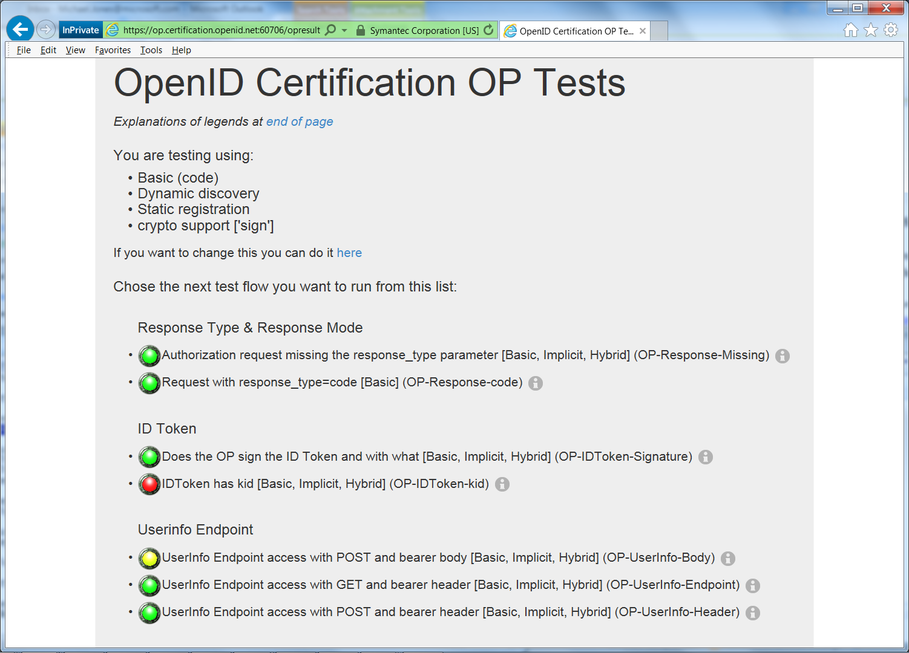
Example Testing Screen

Slide 16
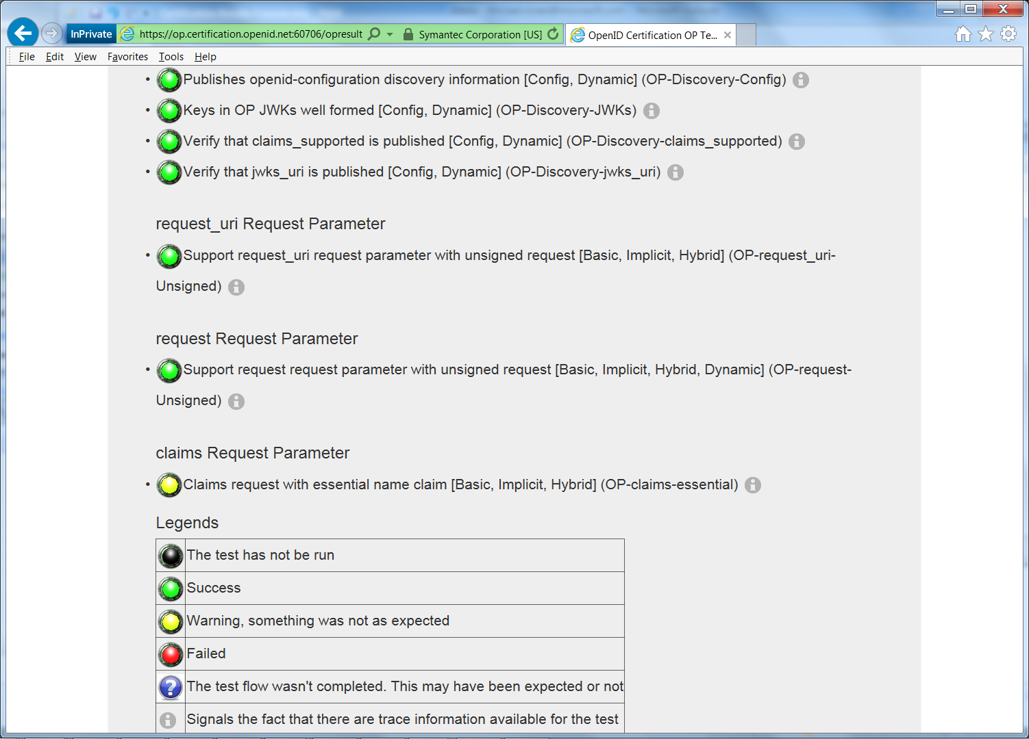
Test Screen Legend

Slide 17
How does certification relate to interop testing?
We held 5 rounds of OpenID Connect interop testing – see http://osis.idcommons.net/
Each round improved implementations and specs
By the numbers: 20 implementations, 195 members of interop list, > 1000 messages exchanged
With interop testing, by design, participants can ignore parts of the specs
Certification raises the bar:
Defines set of conformance profiles that certified implementations meet
Assures interop across full feature sets in profiles

Slide 18
OpenID Certification: How did we get here?
Establishing a successful certification program didn’t just happen
Over a man-year of work:
Creating conformance profiles
Designing and implementing testing software
Testing and refining the tests
Testing implementations and fixing bugs found
Creating the legal framework for self-certification
Putting it all in place
Special thanks to:
Roland Hedberg, Umeå, and GÉANT for the software
Don Thibeau for the simplicity of the approach
Engineers from Google, Microsoft, Ping Identity, ForgeRock, PayPal, and NRI for testing the OP tests

Slide 19
My Favorite Comment on OpenID Certification
Eve Maler – VP of Innovation at ForgeRock
“You made it as simple as possible so every interaction added value”
High praise! ☺

Slide 20
OpenID Certification: What’s Next?
Scope of OpenID Certification expanding
RP certification beginning
Your involvement wanted to test the tests!
Additional OP profiles are also planned:
Self-Issued
Refresh Token Profile
OP-Initiated Login
Front-Channel Logout
etc.

Slide 21
Call to Action
Certify your OpenID Connect OP implementations now!
Help us test the RP tests!
Join the OpenID Foundation and/or the OpenID Connect working group

Slide 22
Open Conversation
How are you using OpenID Connect?
What would you like the working group to know?

