Slide 1
OpenID Connect Working Group
September 30, 2019
Michael B. Jones
Identity Standards Architect – Microsoft

Slide 2
Working Together
OpenID Connect

Slide 3
You’re Probably Already Using OpenID Connect!
If you have an Android phone or log in at AOL, Deutsche Telekom, Google, Microsoft, NEC, NTT, Salesforce, Softbank, Symantec, Verizon, or Yahoo! Japan, you’re already using OpenID Connect
Many other sites and apps large and small also use OpenID Connect

Slide 4
What is OpenID Connect?
Simple identity layer on top of OAuth 2.0
Enables RPs to verify identity of end-user
Enables RPs to obtain basic profile info
REST/JSON interfaces → low barrier to entry
Described at https://openid.net/connect/

Slide 5
OpenID Connect Range
Spans use cases, scenarios
Internet, Enterprise, Mobile, Cloud
Spans security & privacy requirements
From non-sensitive information to highly secure
Spans sophistication of claims usage
From basic default claims to specific requested claims to collecting claims from multiple sources
Maximizes simplicity of implementations
Uses existing IETF specs: OAuth 2.0, JWT, etc.
Lets you build only the pieces you need

Slide 6
Numerous Awards
OpenID Connect won 2012 European Identity Award for Best Innovation/New Standard
http://openid.net/2012/04/18/openid-connect-wins-2012-european-identity-and-cloud-award/
OAuth 2.0 won in 2013
JWT/JOSE won in 2014
OpenID Certification program won 2018 Identity Innovation Award and 2018 European Identity Award

Slide 7
Open Letters to Apple
OpenID Foundation wrote open letter to Apple about problems with Sign In with Apple in June
https://openid.net/2019/06/27/open-letter-from-the-openid-foundation-to-apple-regarding-sign-in-with-apple/
Apple has since fixed security and interop problems identified!
Standard OpenID Connect libraries can now be used in many cases
We’re about to post a second open letter commending the improvements made
And asking them to fix some of the remaining peculiarities

Slide 8
Related Working Groups
International Government Profile (iGov) WG
Developing OpenID Connect profile for government & high-value commercial applications
Enhanced Authentication Profile (EAP) WG
Enables Token Bound ID Tokens
Enables integration with FIDO and other phishing-resistant authentication solutions
Mobile Operator Discovery, Registration & autheNticAtion (MODRNA) WG
Mobile operator profiles for OpenID Connect
Financial-grade API (FAPI) WG
Enables secure API access to high-value services
Research and Education (R&E) WG
Profiles OpenID Connect to ease adoption in the Research and Education (R&E) sector

Slide 9
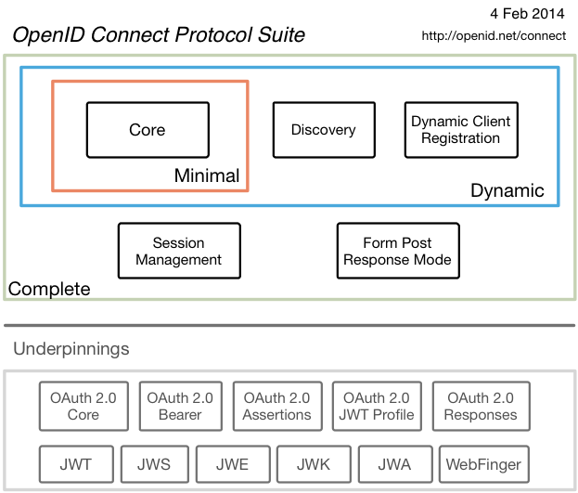
Original Overview of Specifications

Slide 10
OAuth 2.0 Form Post Response Mode (additional Final Specification)
Defines how to return OAuth 2.0 Authorization Response parameters (including OpenID Connect Authentication Response parameters) using HTML form values auto-submitted by the User Agent using HTTP POST
A “form post” binding, like SAML and WS-Federation
An alternative to fragment encoding
https://openid.net/specs/oauth-v2-form-post-response-mode-1_0.html
Completed April 2015
In production use by Microsoft, Ping Identity

Slide 11
OpenID 2.0 to OpenID Connect Migration (additional Final Specification)
Defines how to migrate from OpenID 2.0 to OpenID Connect
Has OpenID Connect identity provider also return OpenID 2.0 identifier, enabling account migration
https://openid.net/specs/openid-connect-migration-1_0.html
Completed April 2015
Google shut down OpenID 2.0 support in April 2015
Yahoo, AOL, others also plan to replace OpenID 2.0 with OpenID Connect

Slide 12
Current Work
Current OpenID Connect Specification Work:
Session Management / Logout
Federation Specification
Identity Assurance Specification
unmet_authentication_requirements Specification
Native SSO Specification
prompt=create Specification
Second Errata Set
Related Working Groups
OpenID Certification

Slide 13
Session Management / Logout
Three approaches being pursued by the working group:
Session Management
https://openid.net/specs/openid-connect-session-1_0.html
Uses HTML5 postMessage to communicate state change messages between OP and RP iframes
Front-Channel Logout
https://openid.net/specs/openid-connect-frontchannel-1_0.html
Uses HTTP GET to load image or iframe, triggering logout
Similar to options in SAML, WS-Federation
Back-Channel Logout
https://openid.net/specs/openid-connect-backchannel-1_0.html
Server-to-communication not using the browser
Can be used by native applications, which have no active browser
All support multiple logged in sessions from OP at RP
Unfortunately, no one approach best for all use cases
Certification tests being developed
WG plans to test multiple implementations before making specs Final

Slide 14
Federation Specification
OpenID Connect Federation specification
https://openid.net/specs/openid-connect-federation-1_0.html
Enables establishment and maintenance of multi-party federations using OpenID Connect
Defines hierarchical JSON-based metadata structures for federation participants
Implementer’s Draft status reached
Substantial changes since then
Come work on the spec with us this week at IIW!

Slide 15
Identity Assurance Specification
OpenID Connect for Identity Assurance
https://openid.net/specs/openid-connect-4-identity-assurance.html
Representation for verified person data
Enables legal compliance for some use cases
Currently in Implementer’s Draft review period
Please review!

Slide 16
unmet_authentication_requirements Specification
Defines new error code unmet_authentication_requirements
https://openid.net/specs/openid-connect-unmet-authentication-requirements-1_0.html
Enables OP to signal that it failed to authenticate the End-User per the RP’s requirements
New specification written being by Torsten Lodderstedt
Please review!

Slide 17
Native SSO Specification
OpenID Connect Native SSO for Mobile Apps specification
https://openid.net/specs/openid-connect-native-sso-1_0.html
Enables Single Sign-On across apps by the same vendor
Assigns a device secret issued by the AS
New specification written by George Fletcher
Please review!

Slide 18
prompt=create Specification
Initiating User Registration via OpenID Connect specification
https://openid.net/specs/openid-connect-prompt-create-1_0.html
Requests enabling account creation during authentication
Active discussion of relationships between account creation and use of existing accounts
New specification written being by George Fletcher
Please review!

Slide 19
Second Errata Set
Errata process corrects typos, etc. discovered
Makes no normative changes
Edits under way for second errata set
https://openid.net/specs/openid-connect-core-1_0-24.html is current Core errata draft

Slide 20
OpenID Certification
Enables OpenID Connect and FAPI implementations to be certified as meeting requirements of defined conformance profiles
Now OpenID Connect certification profiles for:
Basic OP and Basic RP
Implicit OP and Implicit RP
Hybrid OP and Hybrid RP
OP Publishing and RP Using Configuration Information
Dynamic OP and Dynamic RP
Form Post Response Mode for OP and RP
New: Third party-initiated login for OP and RP
New: Logout OP tests in pilot mode
FAPI OP certification launched April 2019
Financial-grade API Client Initiated Backchannel Authentication Profile (FAPI-CIBA) launched September 2019
See https://openid.net/certification/
And accompanying certification presentation!

Slide 21
Open Conversation
How are you using OpenID Connect?
What would you like the working group to know and do?

Slide 22
OpenID Connect Resources
OpenID Connect
https://openid.net/connect/
Frequently Asked Questions
https://openid.net/connect/faq/
Working Group Mailing List
http://lists.openid.net/mailman/listinfo/openid-specs-ab
OpenID Certification Program
https://openid.net/certification/
Certified OpenID Connect Implementations Featured for Developers
https://openid.net/developers/certified/
Mike Jones’ Blog
http://self-issued.info/
Nat Sakimura’s Blog
http://nat.sakimura.org/
John Bradley’s Blog
http://www.thread-safe.com/

