Slide 1
OpenID Connect Working Group
September 13, 2021
Michael B. Jones
Identity Standards Architect – Microsoft

Slide 2
Working Together
OpenID Connect

Slide 3
You’re Almost Certainly Using OpenID Connect!
Android, Apple, AOL, Deutsche Telekom, Google, GSMA Mobile Connect, KDDI, Microsoft, NEC, NTT, Orange, Salesforce, Softbank, Symantec, Telefónica, Verizon, Yahoo! Japan, etc. all use OpenID Connect
Many other sites and apps large and small use OpenID Connect
OpenID Connect is infrastructure
Not a consumer brand

Slide 4
What is OpenID Connect?
Simple identity layer on top of OAuth 2.0
Enables RPs to verify identity of end-user
Enables RPs to obtain basic profile info
REST/JSON interfaces → low barrier to entry
Described at https://openid.net/connect/

Slide 5
OpenID Connect Range
Spans use cases, scenarios
Internet, Enterprise, Mobile, Cloud, Federated, User-Centric
Spans security & privacy requirements
From non-sensitive information to highly secure
Spans sophistication of claims usage
From basic default claims to specific requested claims to collecting claims in multiple formats from multiple sources
Maximizes simplicity of implementations
Uses existing IETF specs: OAuth 2.0, JWT, etc.
Lets you build only the pieces you need

Slide 6
Numerous Awards
OpenID Connect won 2012 European Identity Award for Best Innovation/New Standard
http://openid.net/2012/04/18/openid-connect-wins-2012-european-identity-and-cloud-award/
OAuth 2.0 won in 2013
JWT/JOSE won in 2014
OpenID Certification program won 2018 Identity Innovation Award and 2018 European Identity Award

Slide 7
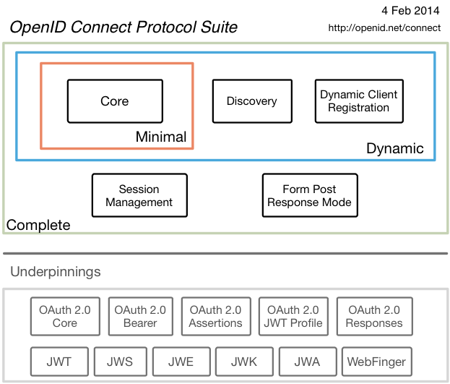
Overview of Original Specifications

Slide 8
Exciting time for OpenID Connect!
More happening than at any time since original specs created
I’ll give you a taste of the exciting work happening…

Slide 9
Federation Specification
OpenID Connect Federation specification
https://openid.net/specs/openid-connect-federation-1_0.html
Enables establishment and maintenance of multi-party federations using OpenID Connect
Applying lessons learned from large-scale SAML federations
Defines hierarchical JSON-based metadata structures for federation participants
Three interop events were held in 2020
Specification updated based on implementation feedback
New Implementer’s Draft, then Final status anticipated

Slide 10
Self-Issued OpenID Provider V2
OpenID Connect Core defined Self-Issued OpenID Provider (SIOP)
https://openid.net/specs/openid-connect-core-1_0.html#SelfIssued
Lets you be your own identity provider
Rather than a third party
Being used with ISO Mobile Driver’s Licenses (mDL)
Enables presentation without “calling home” to the issuer
Self-Issued OpenID Provider (SIOP) V2 now being defined
https://openid.net/specs/openid-connect-self-issued-v2-1_0.html
Can be use for DID auth, JWT claims, Verifiable Credentials, etc.
Working towards Implementer’s Draft status

Slide 11
OpenID Connect for Verifiable Presentations
Enables presentation of claims as W3C Verifiable Presentations
https://openid.net/specs/openid-connect-4-verifiable-presentations-1_0.html
Can be used both with third-party and self-issued OPs
VPs can be returned in ID Token, UserInfo, and new VP Token
Integration point with DIF Presentation Exchange
Please review new draft just published

Slide 12
Claims Aggregation Specification
Enables RPs to request and Claims Providers to return aggregated claims through OPs
https://openid.net/specs/openid-connect-claims-aggregation-1_0.html
Defines full life-cycle of aggregated claims and roles of entities involved
Supports multiple claims schemas
JWT Aggregated and Distributed Claims
W3C Verifiable Credentials objects
Please review new draft just published

Slide 13
prompt=create Specification
Initiates user account registration via OpenID Connect
https://openid.net/specs/openid-connect-prompt-create-1_0.html
Requests enabling account creation during authentication
Please review new draft just published

Slide 14
unmet_authentication_requirements Specification
Defines new error code unmet_authentication_requirements
https://openid.net/specs/openid-connect-unmet-authentication-requirements-1_0.html
Enables OP to signal that it failed to authenticate the End-User per the RP’s requirements
Has been stable since initial publication
Recent WG decision to advance to Final status

Slide 15
Native SSO Specification
OpenID Connect Native SSO for Mobile Apps
https://openid.net/specs/openid-connect-native-sso-1_0.html
Enables Single Sign-On (SSO) across apps by the same vendor
Assigns a device secret issued by the OP
Deployed by AOL
Seeking feedback on applicability to others’ use cases

Slide 16
OP-Initiated Logout
Enables OP to request that RPs log out end-user’s sessions with the OP
Three approaches specified by the working group:
Session Management
https://openid.net/specs/openid-connect-session-1_0.html
Uses HTML5 postMessage to communicate state changes between OP and RP iframes
Front-Channel Logout
https://openid.net/specs/openid-connect-frontchannel-1_0.html
Uses HTTP GET to load image or iframe, triggering logout (similar to SAML, WS-Federation)
Back-Channel Logout
https://openid.net/specs/openid-connect-backchannel-1_0.html
Server-to-communication not using the browser (so can be used by native applications)
All support multiple logged-in sessions from OP at RP
Session Management & Front-Channel Logout affected by browser privacy changes
All can be used with RP-Initiated Logout

Slide 17
RP-Initiated Logout
Enables RP to request that OP log out end-user
https://openid.net/specs/openid-connect-rpinitiated-1_0.html
Content recently split out of Session Management spec
Not affected by browser privacy changes
(unlike some of the OP-Initiated Logout methods)
Updates pending to add client_id and logout_hint parameters

Slide 18
Second Errata Set
Errata process corrects typos, etc. discovered
Makes no normative changes
Edits under way for second errata set
https://openid.net/specs/openid-connect-core-1_0-27.html is current Core errata draft

Slide 19
Portable Identifiers Under Discussion
Current subject identifiers are OP-specific
WG discussing identifiers that you can move between OPs
Related to MODRNA Account Porting work
Potentially both for self-issued OPs and third-party OPs
W3C DIDs are one such possible identifier type

Slide 20
CIBA Core is Now Final (Related Work)
OpenID Connect Client-Initiated Backchannel Authentication (CIBA) Core
https://openid.net/specs/openid-client-initiated-backchannel-authentication-core-1_0.html
Authentication flow with direct Relying Party to OpenID Provider communication without redirects through browser
Product of the MODRNA working group
Used by FAPI CIBA Profile

Slide 21
Related W3C Federated Identity Group
New W3C Federated Identity Community Group
https://www.w3.org/community/fed-id/
Incubating Web features supporting federated identity and preventing untransparent, uncontrollable tracking on the Web
For instance, new features may be needed to enable logout when browsers disable support for third-party cookies
Informed by discussions in Connect WG Browser Behaviors calls

Slide 22
Related OpenID Working Groups
Mobile Operator Discovery, Registration & autheNticAtion (MODRNA) WG
Mobile operator profiles for OpenID Connect
Financial-grade API (FAPI) WG
Enables secure API access to high-value services
Used for Open Banking in jurisdictions including UK, Australia, and Brazil
eKYC and Identity Assurance WG
Defines JWT format for verified claims with identity assurance information
Research and Education (R&E) WG
Profiles to ease Connect adoption in Research and Education (R&E) sector

Slide 23
OpenID Certification
Enables OpenID Connect and FAPI implementations to be certified as meeting the requirements of defined conformance profiles
Goal is to make high-quality, secure, interoperable OpenID Connect and FAPI implementations the norm
An OpenID Certification has two components:
Technical evidence of conformance resulting from testing
Legal statement of conformance
See https://openid.net/certification/
Certification requests now very frequent
The program is now also financially self-sustaining

Slide 24
OpenID Connect Resources
OpenID Connect Description
https://openid.net/connect/
Frequently Asked Questions
https://openid.net/connect/faq/
OpenID Connect Working Group
https://openid.net/wg/connect/
OpenID Certification Program
https://openid.net/certification/
Certified OpenID Connect Implementations Featured for Developers
https://openid.net/developers/certified/
Mike Jones’ Blog
https://self-issued.info/

