Slide 1

Introduction to OpenID Connect
November 3, 2026
Michael B. Jones
Self-Issued Consulting

Slide 2
















Working Together
OpenID Connect

Slide 3
What is OpenID Connect?
Simple identity layer on top of OAuth 2.0
Enables Relying Parties (RPs) to verify identity of end-user
Enables RPs to obtain basic profile info
REST/JSON interfaces → low barrier to entry
Described at https://openid.net/connect/

Slide 4
You’re Almost Certainly Using OpenID Connect!
Android, AOL, Apple, AT&T, Auth0, Deutsche Telekom, ForgeRock, Google, GrabTaxi, GSMA Mobile Connect, IBM, KDDI, Microsoft, NEC, NRI, NTT, Okta, Oracle, Orange, Ping Identity, Red Hat, Salesforce, Softbank, Symantec, Telefónica, Verizon, Yahoo, Yahoo! Japan, all use OpenID Connect
  Many other sites and apps large and small use OpenID Connect
OpenID Connect is infrastructure
  Not a consumer brand

Slide 5
OpenID Connect Range
Spans use cases, scenarios
  Internet, Enterprise, Mobile, Cloud, Federated, User-Centric
Spans security & privacy requirements
  From non-sensitive information to highly secure
Spans sophistication of claims usage
  From basic default claims to specific requested claims to collecting claims in multiple formats from multiple sources
Maximizes simplicity of implementations
  Uses existing IETF specs: OAuth 2.0, JSON Web Token (JWT), etc.
  Lets you build only the pieces you need

Slide 6

Numerous Awards
OpenID Connect won 2012 European Identity Award for Best Innovation/New Standard
  https://openid.net/2012/04/18/openid-connect-wins-2012-european-identity-and-cloud-award/
OAuth 2.0 won in 2013
JSON Web Token (JWT) & JOSE won in 2014
OpenID Certification program won
2018 Identity Innovation Award
OpenID Certification program won
2018 European Identity Award

Slide 7
Presentation Overview
Introduction
Design Philosophy
Timeline
A Look Under the Covers
Overview of OpenID Connect Specs
More OpenID Connect and Related Specs
OpenID Certification
Resources

Slide 8

Design Philosophy
Keep Simple Things Simple
Make Complex Things Possible

Slide 9
Keep Simple Things Simple
UserInfo Endpoint for simple claims about user
Designed to work well on mobile phones

Slide 10
How We Made It Simple
Built on OAuth 2.0
Uses JavaScript Object Notation (JSON)
Lets you build only the pieces that you need
Goal: Easy implementation on all modern development platforms

Slide 11
Make Complex Things Possible
Encrypted Claims
Aggregated Claims
Distributed Claims

Slide 12
Key Differences from OpenID 2.0
Support for native client applications
Identifiers using e-mail address format
UserInfo Endpoint for simple claims about user
Designed to work well on mobile phones
Uses JSON/REST, rather than XML
Support for encryption and higher LOAs
Support for distributed and aggregated claims
Support for session management, including logout
Support for self-issued identity providers

Slide 13
OpenID Connect Timeline
Artifact Binding working group formed, March 2010
Major design issues closed at IIW, May 2011
  Result branded “OpenID Connect”
5 rounds of interop testing between 2011 and 2013
  Specifications refined after each round of interop testing
Won Best New Standard award at EIC, April 2012
Final specifications approved, February 2014
Errata Set 1 approved, November 2014
OpenID Connect Certification launched, April 2015
OpenID Federation work begun, July 2016
OpenID Certification program won awards in March 2018 and April 2018
Logout specifications became Final, September 2022
Numerous extension specs under way, including for Verifiable Credentials, 2019-present
Errata Set 2 approved, December 2023
OpenID Connect specs published as ISO PAS specifications, October 2024
OpenID Federation specification became final, February 2026

Slide 14
A Look Under the Covers
ID Token
Claims Requests
UserInfo Claims
Example Protocol Messages

Slide 15
ID Token
JSON Web Token (JWT) representing logged-in session
Claims:
  iss – Issuer
  sub – Identifier for subject (user)
  aud – Audience for ID Token
  iat – Time token was issued
  exp – Expiration time
  nonce – Mitigates replay attacks

Slide 16
ID Token Claims Example
  {
  "iss": "https://server.example.com",
  "sub": "248289761001",
  "aud": "0acf77d4-b486-4c99-bd76-074ed6a64ddf",
  "iat": 1311280970,
  "exp": 1311281970,
  "nonce": "n-0S6_WzA2Mj"
  }

Slide 17
Claims Requests
Basic requests made using OAuth scopes:
  openid – Declares request is for OpenID Connect
  profile – Requests default profile info
  email – Requests email address & verification status
  address – Requests postal address
  phone – Requests phone number & verification status
  offline_access – Requests Refresh Token issuance
Requests for individual claims can be made using JSON “claims” request parameter

Slide 18
UserInfo Claims
sub
name
given_name
family_name
middle_name
nickname
preferred_username
profile
picture
website
gender
birthdate
locale
zoneinfo
updated_at
email
email_verified
phone_number
phone_number_verified
address

Slide 19
UserInfo Response Example
  {
  "sub": "248289761001",
  "name": "Jane Doe",
  "given_name": "Jane",
  "family_name": "Doe",
  "email": "janedoe@example.com",
  "email_verified": true,
  "picture": "https://example.com/janedoe/me.jpg"
  }

Slide 20
Authorization Request Example
  https://server.example.com/authorize
  ?response_type=id_token%20token
  &client_id=0acf77d4-b486-4c99-bd76-074ed6a64ddf
  &redirect_uri=https%3A%2F%2Fclient.example.com%2Fcb
  &scope=openid%20profile
  &state=af0ifjsldkj
  &nonce=n-0S6_WzA2Mj

Slide 21
Authorization Response Example
  HTTP/1.1 302 Found
  Location: https://client.example.com/cb
  #access_token=mF_9.B5f-4.1JqM
  &token_type=bearer
  &id_token=eyJhbGzI1NiJ9.eyJz9Glnw9J.F9-V4IvQ0Z
  &expires_in=3600
  &state=af0ifjsldkj

Slide 22
UserInfo Request Example
  GET /userinfo HTTP/1.1
  Host: server.example.com
  Authorization: Bearer mF_9.B5f-4.1JqM

Slide 23
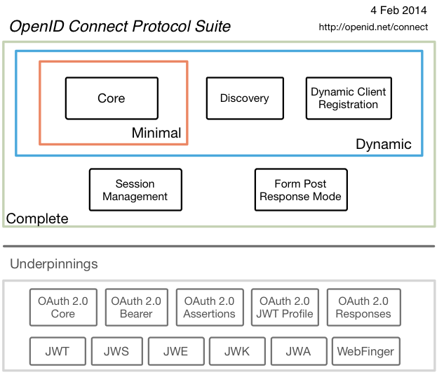
Original Overview of Specifications

Slide 24
Celebrating Ten Years of OpenID Connect
OpenID Connect specifications were approved in February 2014
Three celebrations were held
  January 2024 at Japan OpenID Summit in Tokyo
  May 2024 at Identiverse in Las Vegas
  June 2024 at EIC in Berlin
Presentations from first celebration published at https://self-issued.info/?p=2481
During the celebrations, we are shared our perspectives on
  How we developed OpenID Connect
  Why it succeeded
  Lessons we learned along the way
Lessons learned
  “Keep simple things simple”
  Repeated interop testing and incorporating resulting feedback from developers was critical
  Certification enables an ecosystem of interoperable implementations

Slide 25
OpenID 2.0 to OpenID Connect Migration
Defines how to migrate from OpenID 2.0 to OpenID Connect
  Has OpenID Connect identity provider also return OpenID 2.0 identifier, enabling account migration
https://openid.net/specs/openid-connect-migration-1_0.html
Completed April 2015
Google shut down OpenID 2.0 support in April 2015
AOL, Yahoo, others replaced OpenID 2.0 with OpenID Connect
Approach may inform migration from SAML to OpenID Connect

Slide 26
OAuth 2.0 Form Post Response Mode
Defines how to return OAuth 2.0 Authorization Response parameters (including OpenID Connect Authentication Response parameters) using HTML form values auto-submitted by the User Agent using HTTP POST
A “form post” binding, like SAML and WS-Federation
  An alternative to fragment encoding
https://openid.net/specs/oauth-v2-form-post-response-mode-1_0.html
Completed April 2015
In production use by Microsoft, Ping Identity, others

Slide 27
RP-Initiated Logout
Enables RP to request that OP log out end-user
  https://openid.net/specs/openid-connect-rpinitiated-1_0.html
  Content recently split out of Session Management spec
Can be used with all OP-Initiated Logout methods
Not affected by browser privacy changes
  (unlike some of the OP-Initiated Logout methods)
Final Specification as of September 2022

Slide 28
OP-Initiated Logout
Enables OP to request that RPs log out end-user’s sessions with the OP
Three approaches specified by the working group:
  Session Management
    https://openid.net/specs/openid-connect-session-1_0.html
    Uses HTML5 postMessage to communicate state changes between OP and RP iframes
  Front-Channel Logout
    https://openid.net/specs/openid-connect-frontchannel-1_0.html
    Uses HTTP GET to load image or iframe, triggering logout (similar to SAML, WS-Federation)
  Back-Channel Logout
    https://openid.net/specs/openid-connect-backchannel-1_0.html
    Server-to-communication not using the browser (so can be used by native applications)
All support multiple logged-in sessions from OP at RP
Session Management & Front-Channel Logout affected by browser privacy changes
Final Specifications as of September 2022

Slide 29
Unmet Authentication Requirements Specification
OpenID Connect Core Error Code unmet_authentication_requirements
  https://openid.net/specs/openid-connect-unmet-authentication-requirements-1_0.html
Defines unmet_authentication_requirements error code
Enables OP to signal that it failed to authenticate the End-User per the RP’s requirements
Became Final in November 2022

Slide 30
OpenID Connect User Registration Specification
Initiating User Registration via OpenID Connect specification
  https://openid.net/specs/openid-connect-prompt-create-1_0.html
Defines prompt=create request parameter
Requests enabling account creation during authentication
Became Final in December 2022

Slide 31
OpenID Connect ISO Specifications
OpenID Connect specifications published as ISO PAS specs, October 2024
Enables use of OpenID Connect in jurisdictions requiring specs by treaty organizations
ISO/IEC 26131:2024 — Information technology — OpenID connect — OpenID connect core 1.0 incorporating errata set 2
ISO/IEC 26132:2024 — Information technology — OpenID connect — OpenID connect discovery 1.0 incorporating errata set 2
ISO/IEC 26133:2024 — Information technology — OpenID connect — OpenID connect dynamic client registration 1.0 incorporating errata set 2
ISO/IEC 26134:2024 — Information technology — OpenID connect — OpenID connect RP-initiated logout 1.0
ISO/IEC 26135:2024 — Information technology — OpenID connect — OpenID connect session management 1.0
ISO/IEC 26136:2024 — Information technology — OpenID connect — OpenID connect front-channel logout 1.0
ISO/IEC 26137:2024 — Information technology — OpenID connect — OpenID connect back-channel logout 1.0 incorporating errata set 1
ISO/IEC 26138:2024 — Information technology — OpenID connect — OAuth 2.0 multiple response type encoding practices
ISO/IEC 26139:2024 — Information technology — OpenID connect — OAuth 2.0 form post response mode

Slide 32
Exciting time for OpenID Connect!
More happening than at any time since original specs created
I’ll give you a taste of the exciting work happening…

Slide 33
OpenID Federation Specification
https://openid.net/specs/openid-federation-1_0.html
Enables trust establishment and maintenance of multilateral federations
  Applying lessons learned from large-scale SAML federations
Renamed from “OpenID Connect Federation” to reflect broader role
  Use with protocols of your choice, including OpenID Connect, wallets, etc.
In production use in Italy, Australia, Sweden
Production deployment by eduGAIN planned
Some certification tests written
  https://openid.net/certification/federation_testing/
Security analysis performed 2024 – second analysis started April 2026
Recent interops in Stockholm, April 2025 & Amsterdam, February 2026
Became Final February 2026

Slide 34
Vulnerability in JWT Audience for AS (1)
Found by University of Stuttgart researchers during 2024 OpenID Federation security analysis
Described in public disclosure
  https://openid.net/notice-of-a-security-vulnerability/
Fixes being applied to affected specifications
  OpenID Federation fixed
  OpenID Connect Core fixed in errata in progress
  FAPI 2.0 fixed
  FAPI 1.0 errata in progress
  CIBA Core errata in progress
  Several OAuth specs being updated by rfc7523bis specification

Slide 35
Vulnerability in JWT Audience for AS (2)
Fix requires that audience value of JWTs sent to the authorization server be solely the authorization server issuer identifier
Previously, audience values were all over the map, providing ambiguity that attackers could exploit
For instance, this was the PAR [RFC 9126] audience text:
  Due to historical reasons, there is potential ambiguity regarding the appropriate audience value to use when employing JWT client assertion-based authentication (defined in Section 2.2 of [RFC7523] with private_key_jwt or client_secret_jwt authentication method names per Section 9 of [OIDC]). To address that ambiguity, the issuer identifier URL of the authorization server according to [RFC8414] SHOULD be used as the value of the audience. In order to facilitate interoperability, the authorization server MUST accept its issuer identifier, token endpoint URL, or pushed authorization request endpoint URL as values that identify it as an intended audience.

Slide 36
Second Federation Security Analysis
Security analysis of Final OpenID Federation 1.0 specification began April 2026
  By University of Stuttgart security researchers
  Updates the formal model used in analysis to match final spec
  Will verify that audience security vulnerability fixed
  Will verify that Federation Identity and Metadata Integrity achievable

Slide 37
Protocol-Specific Federation Profiles
OpenID Federation for OpenID Connect 1.1
  Extracted OpenID Connect profile from OpenID Federation 1.0
  Exactly equivalent to what’s in 1.0, but editorially separated
  Became final in May 2026
OpenID Federation for Wallet Architectures 1.0
  Based on Italian EUDI Wallet deployment
  Defines entity type identifiers
    openid_wallet_provider
    openid_credential_issuer
    openid_credential_verifier
  Progressing towards Implementer’s Draft status

Slide 38
Federation Extensions in Progress
OpenID Federation Extended Subordinate Listing
  Extends OpenID Federation to facilitate listings of large numbers of subordinates
  Used in Australia
OpenID Federation Subordinate Events Endpoint
  Specifies a mechanism for Trust Anchors and Intermediates to publish historical events related to their Immediate Subordinates
  Used in Italy
OpenID Federation Entity Collection
  Defines an endpoint to retrieve a filterable list of all resolvable entities in a (sub-)federation. Useful for populating the set of IdPs in a Federation for discovery user interfaces.

Slide 39
OpenID Connect Relying Party Metadata Choices
https://openid.net/specs/openid-connect-rp-metadata-choices-1_0.html
Lets RPs declare all supported metadata parameters to OPs
  In existing OpenID Connect Dynamic Client Registration spec, only one value expressed for each choice
Became final in March 2026
Used by OpenID Federation specs

Slide 40
Native Single-Sign-On for Mobile Apps
OpenID Connect Native SSO for Mobile Apps specification
  https://openid.net/specs/openid-connect-native-sso-1_0.html
Enables Single Sign-On across apps by the same vendor
Assigns a device secret issued by the Authorization Server
Deployed by AOL
Second Implementer’s Draft approved October 2025
Updates being considered to replace reuse of ID Token

Slide 41
OpenID Connect Claims Aggregation
https://openid.net/specs/openid-connect-claims-aggregation-1_0.html
Enables RPs to request and Claims Providers to return aggregated claims through OPs
Reviews wanted

Slide 42
OpenID Connect Key Binding
https://openid.net/specs/openid-connect-key-binding-1_0.html
Specifies how to bind public key to OpenID Connect ID Token
Became Implementer’s Draft in September 2026

Slide 43
OpenID Provider Commands
https://openid.net/specs/openid-provider-commands-1_0.html
Complements OpenID Connect by introducing set of Commands for OP to manage end-user Account at RP

Slide 44
OpenID Connect Enterprise Extensions
https://openid.net/specs/openid-connect-enterprise-extensions-1_0.html
Specifies common or desirable extensions to OpenID Connect

Slide 45
OpenID Connect Ephemeral Subject Identifier
https://openid.net/specs/openid-connect-ephemeral-subject-identifier-1_0.html
Specifies an ephemeral subject identifier type that prevents correlation of the subject identifier across multiple visits
Became Final in October 2026

Slide 46
Related OpenID Working Groups
Mobile Operator Discovery, Registration, & autheNticAtion (MODRNA)
  Mobile operator profiles for OpenID Connect
Financial-grade API (FAPI)
  FAPI used for Open Finance in jurisdictions including UK, Australia, Brazil, Saudia Arabia, Norway, Germany, Japan, Canada, & more to come…
eKYC and Identity Assurance (eKYC-IDA)
  Defines JWT format for verified claims with identity assurance information
Digital Credentials Protocols (DCP)
  Developing OpenID for Verifiable Credentials (OpenID4VC) specs

Slide 47
OpenID for Verifiable Credentials
(Related Work Transferred to DCP WG)
Family of specs enabling use of identities that you hold
Uses the three-party Issuer/Holder/Verifier model
  An Issuer creates a Verifiable Credential for you to hold
  You hold it in a Wallet
  You present it to a Verifier, possibly redacting some claims
Credential format agnostic
  Can be used w/ W3C VCs, ISO Mobile Driving Licenses (mDL), SD-JWTs, etc.
Good privacy properties
  Issuer doesn’t know when/where you’re using the credential
See https://openid.net/openid4vc/

Slide 48
Identity Assurance Specification
(Related Work Transferred to eKYC-IDA)
OpenID Connect for Identity Assurance
  https://openid.net/specs/openid-connect-4-identity-assurance-1_0.html
JWT representation for verified person data
  Including information about the identity verification performed
  Enables legal compliance for some use cases
Moved to eKYC and Identity Assurance working group in 2019
Became Final in October 2024

Slide 49
CIBA Core
(Related Work in MODRNA WG)
OpenID Connect Client-Initiated Backchannel Authentication (CIBA) Core
  https://openid.net/specs/openid-client-initiated-backchannel-authentication-core-1_0.html
Authentication flow with direct Relying Party to OpenID Provider communication without redirects through browser
Used by FAPI CIBA Profile
Errata 1 draft published with security fix
Became Final in September 2021

Slide 50

What is OpenID Certification?
Enables OpenID Connect (and other spec) implementations to be certified as meeting requirements of defined conformance profiles
  Goal is to make high-quality, secure, interoperable implementations the norm
An OpenID Certification has two components:
  Technical evidence of conformance resulting from testing
  Legal statement of conformance
Certified implementations can use the
“OpenID Certified” logo
5,197 total certifications to date!

Slide 51
What value does certification provide?
Technical
  Certification testing gives confidence that things will “just work”
  No custom code required to integrate with implementation
  Better for all parties
  Relying parties explicitly asking identity providers to get certified
Business
  Enhances reputation of organization and implementation
  Shows that organization is taking interop seriously
  Customers may choose certified implementations over others

Slide 52
OpenID Connect Certification Profiles
Authentication (Login)
  Basic Flow
  Implicit Flows
  Hybrid Flows
  Third Party-Initiated Login Flow
Discovery (OP Metadata)
Dynamic Client Registration (RP Metadata)
Form Post Response Mode
Logout
  RP-Initiated Logout
  Session Management
  Front-Channel Logout
  Back-Channel Logout

Slide 53
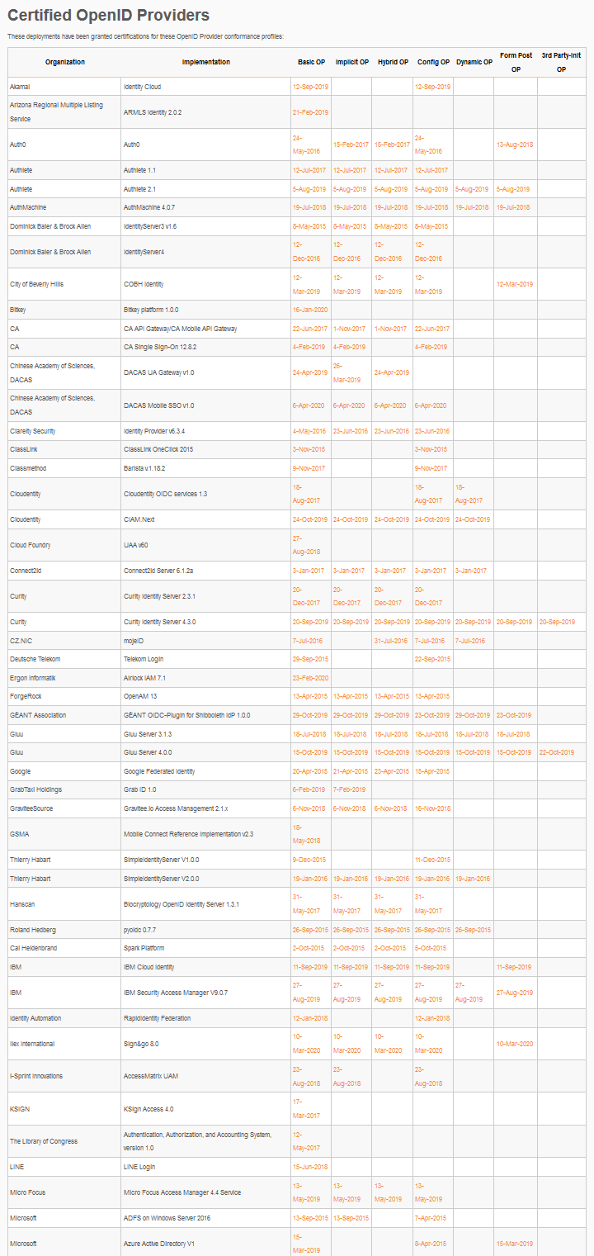
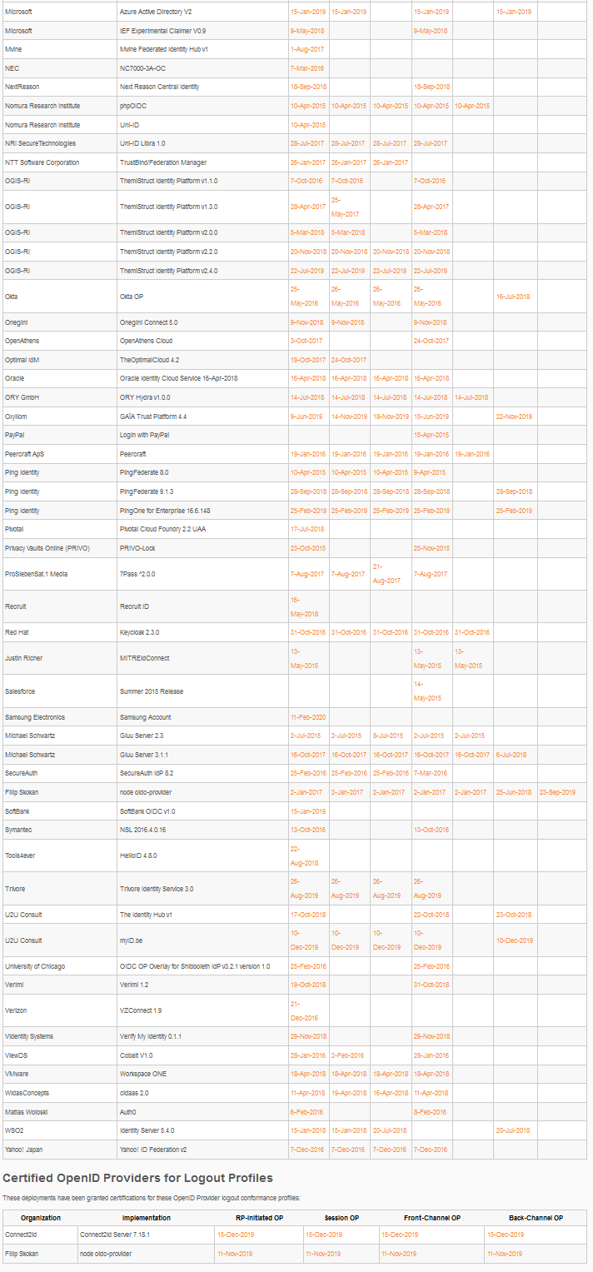
OpenID Connect OP Certifications
OpenID Provider certifications at https://openid.net/certification/#OPs
  763 profiles certified to date for
  216 deployments
Recent certifications
  Abblix, Authentik Security, Avion Software, Broadcom, issuerd, Mobile-ID Technologies, NazoAuth, Pocket ID, QRAuth, Seventh Sense Artificial Intelligence, Sudomimus, Thomas Meadow, Tinyauth, Vouch.sh, Xuku, YongQi Tan/Nazo Auth
Each entry link to zip file with test logs and signed legal statement
  Test results available for public inspection

Slide 54
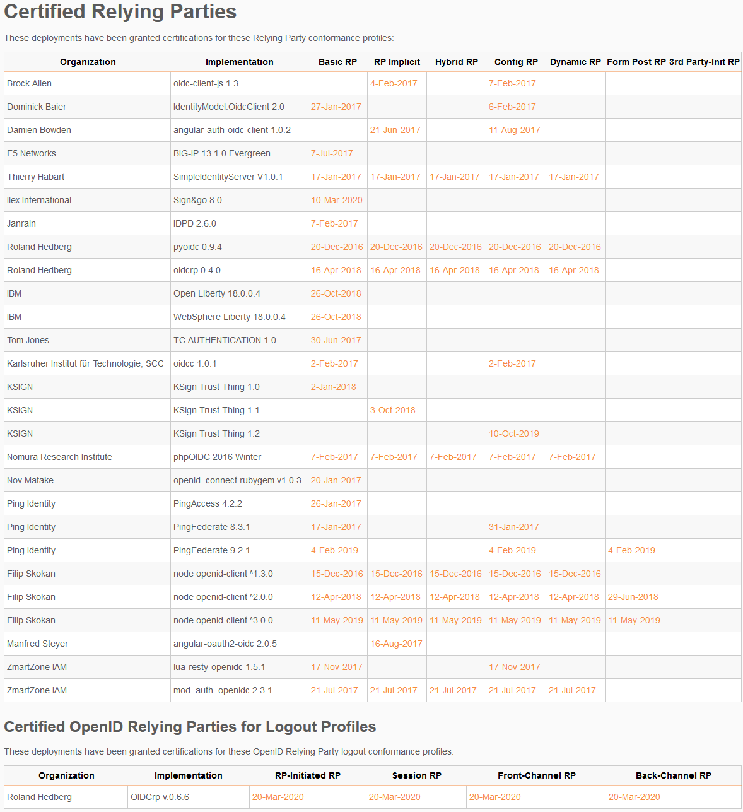
OpenID Connect RP Certifications
Relying Party certifications at https://openid.net/certification/#RPs
  122 profiles certified to date for
  51 deployments
Recent certifications
  Gary Coady, Xuku, Yuta Hoshina, https://github.com/jamescrowley321/py-identity-model

Slide 55
Use of Self-Certification
OpenID Certification uses self-certification
  Party seeking certification does the testing
  (rather than paying a 3rd party to do the testing)
Simpler, quicker, less expensive, more scalable than 3rd party certification
Results are nonetheless trustworthy because
  Testing logs are made available for public scrutiny
  Organization puts its reputation on the line by making a public declaration that its implementation conforms to the profile being certified to

Slide 56
How does OpenID Certification work?
Organization decides what profiles it wants to certify to
  For instance, “Basic OP”, “Config OP”, and “Dynamic OP”
Runs conformance tests publicly available at https://www.certification.openid.net/
Once all tests for a profile pass, organization submits certification request to OpenID Foundation containing:
  Logs from all tests for the profile
  Signed legal declaration that implementation conforms to the profile
Organization pays certification fee (for profiles not in pilot mode)
OpenID Foundation verifies application is complete and grants certification
OIDF lists certification at https://openid.net/certification/

Slide 57
What does certification cost?
Not a profit center for the OpenID Foundation
  Fees there to help cover costs of operating certification program
Member price
  $700
Non-member price
  $3500
New profiles in pilot mode are available to members for free
Costs described at https://openid.net/certification/fees/

Slide 58
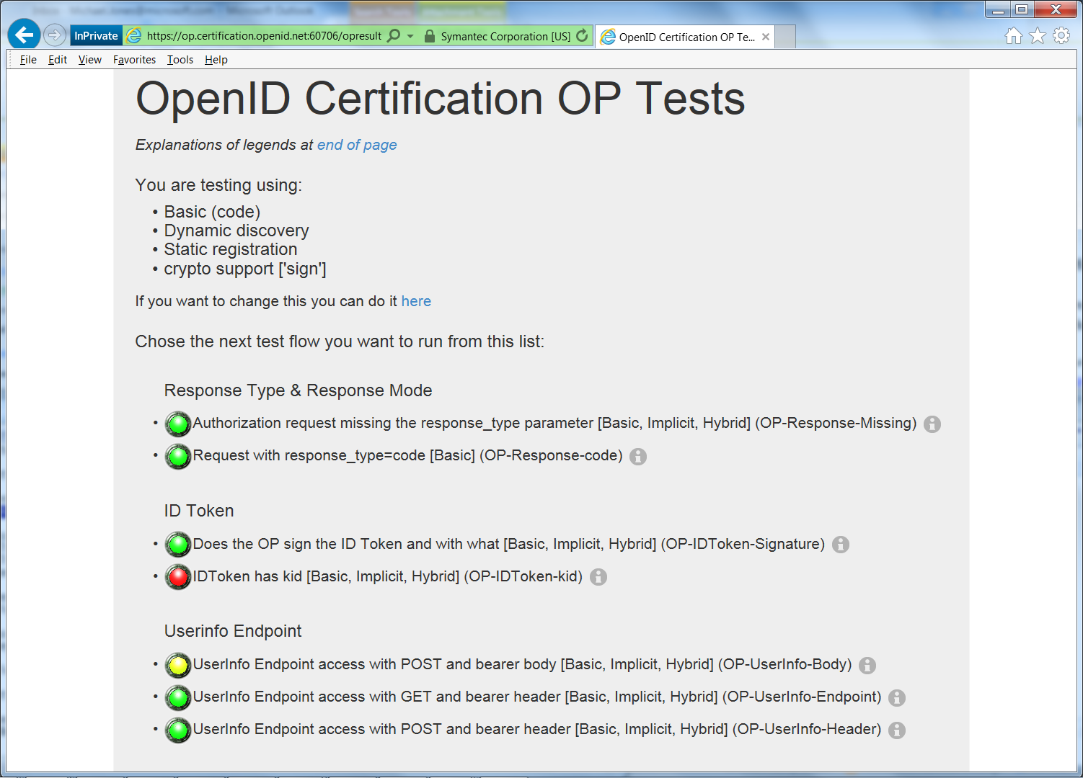
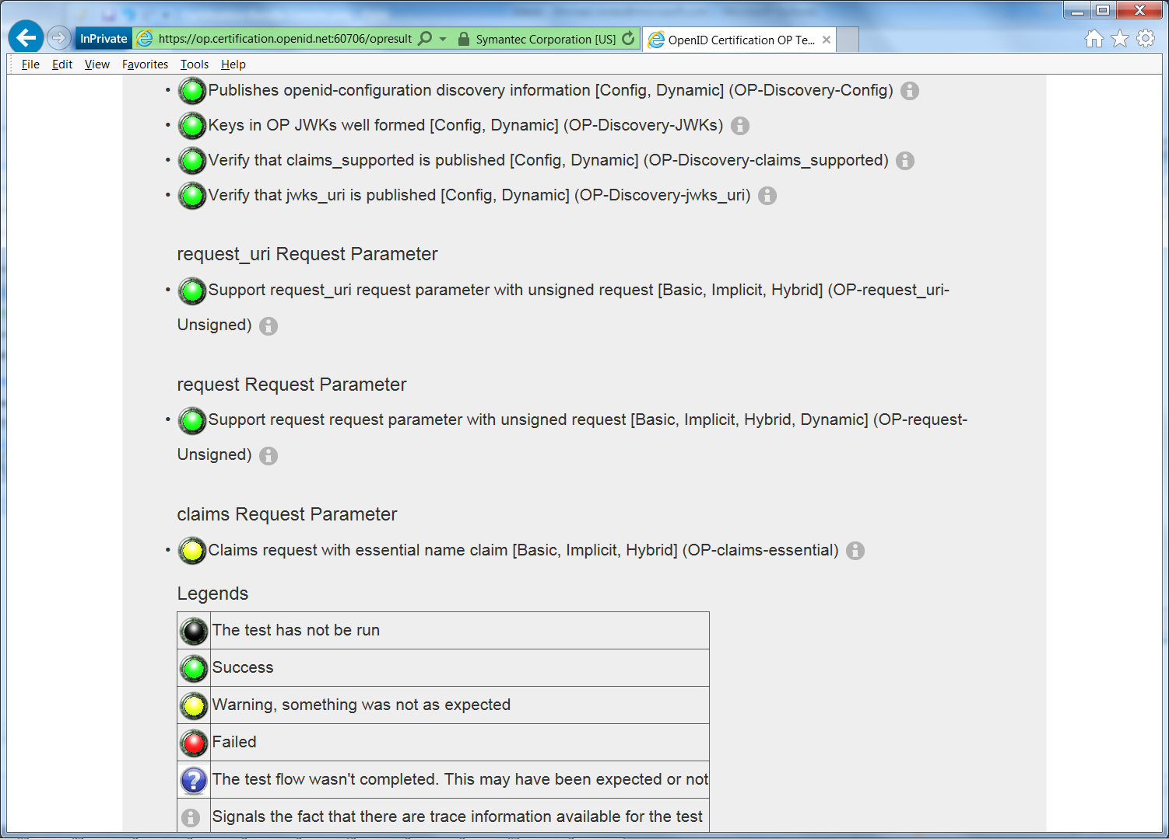
Example Testing Screen

Slide 59
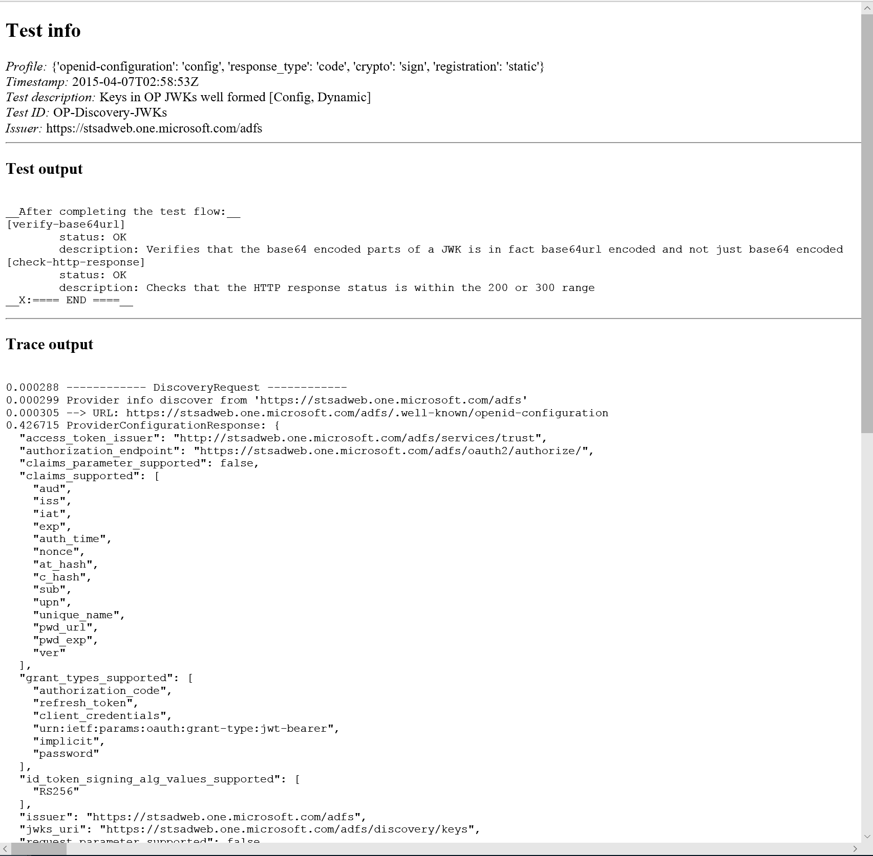
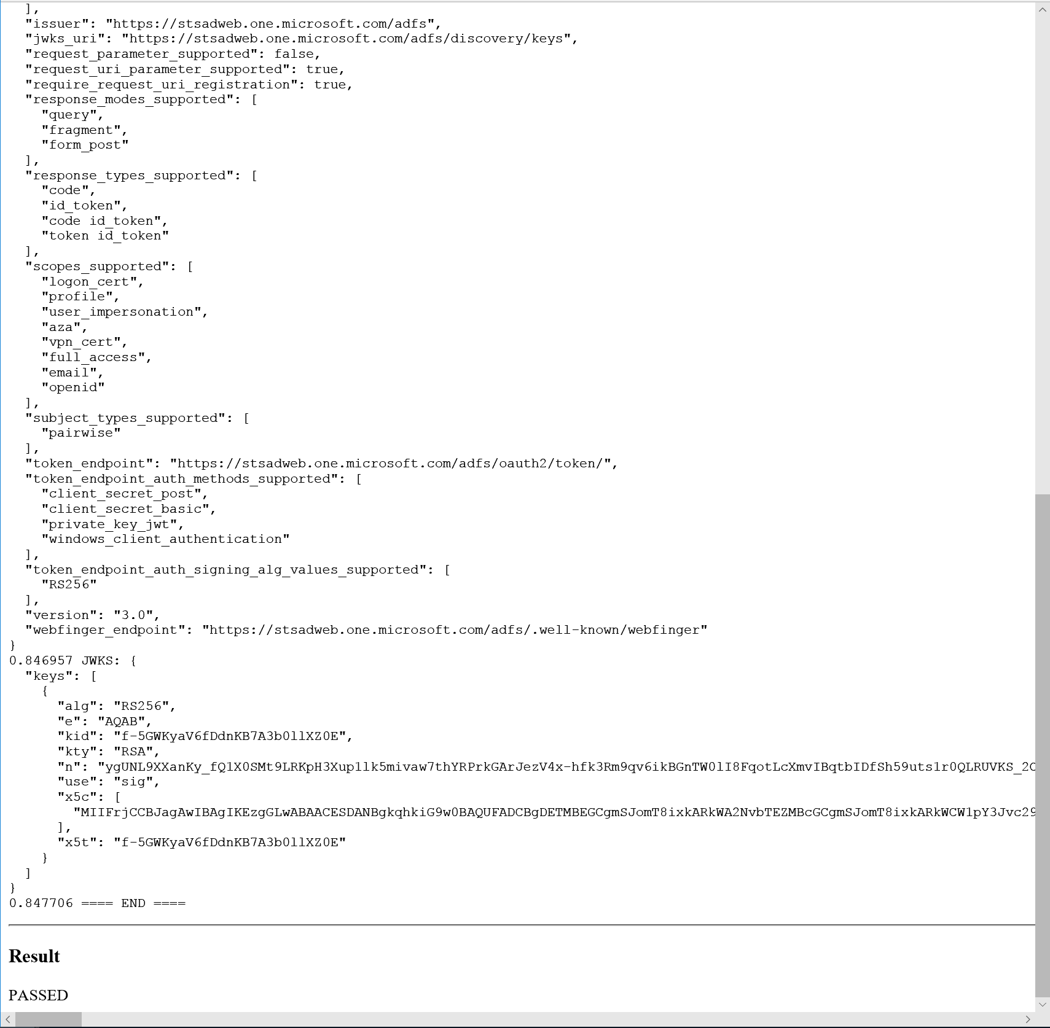
Log from a Conformance Test

Slide 60
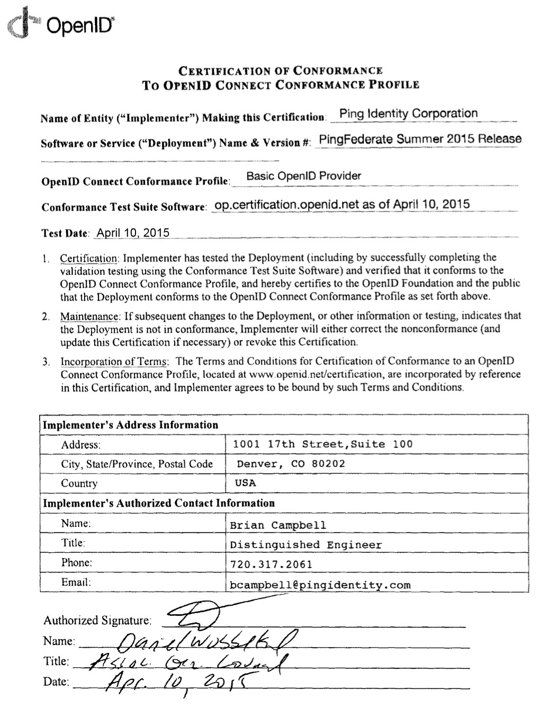
Certification of Conformance
Legal statement by certifier stating:
  Who is certifying
  What software
  When tested
  Profile tested
Commits reputation of certifying organization to validity of results

Slide 61
How does certification relate to interop testing?
OpenID Connect held 5 rounds of interop testing – see http://osis.idcommons.net/
  Starting over a decade ago!
  Each round improved implementations and specs
  By the numbers: 20 implementations, 195 members of interop list, > 1000 messages exchanged
Multiple interop testing rounds for OpenID Federation
  Recent interops in Stockhom in 2025 and Amsterdam in 2026
With interop testing, by design, participants can ignore parts of the specs
Certification raises the bar:
  Defines set of conformance profiles that certified implementations meet
  Assures interop across full feature sets in profiles

Slide 62
Can I use the OpenID Certification site for interop testing?
Yes – please do!
The OpenID Foundation is committed to keeping the conformance test sites up and available for free to all
Many projects using conformance testing for regression testing
  Once everything passes, you’re ready for certification!
Test software is open source using Apache 2.0 license
  Some projects have deployed private instances for internal testing
  Available as a Docker container

Slide 63
Favorite Comments on OpenID Certification
Eve Maler – VP of Innovation at ForgeRock
  “You made it as simple as possible so every interaction added value.”
Jaromír Talíř – CZ.NIC
  “We used and still are using certification platform mainly as testing tool for our IdP. Thanks to this tool, we have fixed enormous number of bugs in our platform an even some bugs in the underlying library.”
Brian Campbell – Distinguished Engineer at Ping Identity
  “The process has allowed us to tighten up our implementation and improve on the already solid interoperability of our offerings in the OpenID Connect ecosystem.”
William Denniss – Google
  “We have built the RP tests into the continuous-integration testing pipeline for AppAuth.”

Slide 64
What’s new for OpenID Certification?
Certification program has been financially self-supporting for several years!
  Open Banking certifications from Brazil and other places got us there
OpenID4VC certification tests
eKYC-IDA certification tests
Shared Signals certification tests
OpenID Federation certification tests (with more to come)

Slide 65
OpenID Certification Call to Action
Test your OpenID Connect, OpenID Federation, FAPI, OpenID4VC, and Shared Signals implementations now
  And once you pass the tests, certify!
Join the OpenID Foundation and the OpenID Connect working group

Slide 66
Future Work Items
Providing guidance for transition to post-quantum cryptography
  Blog post https://openid.net/post-quantum-openid-connect/
  OpenID Slack channel #interest-group-pqc-readiness
Providing guidance for transition from SAML to OpenID Connect
  OpenID Slack channel #interest-group-saml-to-oidc-readiness

Slide 67
OpenID Connect Resources
OpenID Connect
  https://openid.net/connect/
Frequently Asked Questions
  https://openid.net/connect/faq/
OpenID Connect Working Group and Specifications Pages
  https://openid.net/wg/connect/
  https://openid.net/wg/connect/specifications/
OpenID Certification Program
  https://openid.net/certification/
Certified OpenID Connect Implementations
  https://openid.net/developers/certified/
OpenID Federation Implementations
  https://openid.net/developers/openid-federation-implementations/
Mike Jones’ Blog
  https://self-issued.info/

Slide 68
Your Turn!
How are you using OpenID Connect?
What would you like the working group to know or do?
Slides will be posted at https://self-issued.info/

Slide 69
Backup Slides

Slide 70
Aggregated Claims
Data Source
Data Source
Signed Claims
Identity Provider
Claim Values
Relying
Party

Slide 71
Distributed Claims
Data Source
Data Source
Signed Claims
Identity Provider
Claim Refs
Relying
Party

