Slide 1
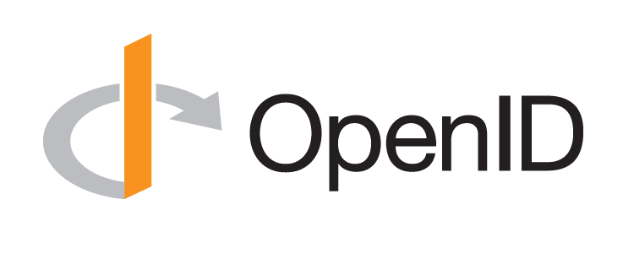
Introduction to OpenID Connect
October 21, 2025
Michael B. Jones
Self-Issued Consulting

Slide 2
















Working Together
OpenID Connect

Slide 3
What is OpenID Connect?
Simple identity layer on top of OAuth 2.0
Enables Relying Parties (RPs) to verify identity of end-user
Enables RPs to obtain basic profile info
REST/JSON interfaces → low barrier to entry
Described at https://openid.net/connect/

Slide 4
You’re Almost Certainly Using OpenID Connect!
Android, AOL, Apple, AT&T, Auth0, Deutsche Telekom, ForgeRock, Google, GrabTaxi, GSMA Mobile Connect, IBM, KDDI, Microsoft, NEC, NRI, NTT, Okta, Oracle, Orange, Ping Identity, Red Hat, Salesforce, Softbank, Symantec, Telefónica, Verizon, Yahoo, Yahoo! Japan, all use OpenID Connect
Many other sites and apps large and small use OpenID Connect
OpenID Connect is infrastructure
Not a consumer brand

Slide 5
OpenID Connect Range
Spans use cases, scenarios
Internet, Enterprise, Mobile, Cloud, Federated, User-Centric
Spans security & privacy requirements
From non-sensitive information to highly secure
Spans sophistication of claims usage
From basic default claims to specific requested claims to collecting claims in multiple formats from multiple sources
Maximizes simplicity of implementations
Uses existing IETF specs: OAuth 2.0, JSON Web Token (JWT), etc.
Lets you build only the pieces you need

Slide 6

Numerous Awards
OpenID Connect won 2012 European Identity Award for Best Innovation/New Standard
https://openid.net/2012/04/18/openid-connect-wins-2012-european-identity-and-cloud-award/
OAuth 2.0 won in 2013
JSON Web Token (JWT) & JOSE won in 2014
OpenID Certification program won 2018 Identity Innovation Award
OpenID Certification program won 2018 European Identity Award

Slide 7
Presentation Overview
Introduction
Design Philosophy
Timeline
A Look Under the Covers
Overview of OpenID Connect Specs
More OpenID Connect Specs
OpenID Certification
Resources

Slide 8

Design Philosophy
Keep Simple Things Simple
Make Complex Things Possible

Slide 9
Keep Simple Things Simple
UserInfo Endpoint for simple claims about user
Designed to work well on mobile phones

Slide 10
How We Made It Simple
Built on OAuth 2.0
Uses JavaScript Object Notation (JSON)
Lets you build only the pieces that you need
Goal: Easy implementation on all modern development platforms

Slide 11
Make Complex Things Possible
Encrypted Claims
Aggregated Claims
Distributed Claims

Slide 12
Key Differences from OpenID 2.0
Support for native client applications
Identifiers using e-mail address format
UserInfo Endpoint for simple claims about user
Designed to work well on mobile phones
Uses JSON/REST, rather than XML
Support for encryption and higher LOAs
Support for distributed and aggregated claims
Support for session management, including logout
Support for self-issued identity providers

Slide 13
OpenID Connect Timeline
Artifact Binding working group formed, March 2010
Major design issues closed at IIW, May 2011
Result branded “OpenID Connect”
5 rounds of interop testing between 2011 and 2013
Specifications refined after each round of interop testing
Won Best New Standard award at EIC, April 2012
Final specifications approved, February 2014
Errata Set 1 approved, November 2014
OpenID Connect Certification launched, April 2015
OpenID Federation work begun, July 2016
OpenID Certification program won awards in March 2018 and April 2018
Logout specifications became Final, September 2022
Numerous extension specs under way, including for Verifiable Credentials, 2019-present
Errata Set 2 approved, December 2023
OpenID Connect specs published as ISO PAS specifications, October 2024
Errata Set 3 draft published in January 2025 with audience value security fix

Slide 14
A Look Under the Covers
ID Token
Claims Requests
UserInfo Claims
Example Protocol Messages

Slide 15
ID Token
JSON Web Token (JWT) representing logged-in session
Claims:
iss – Issuer
sub – Identifier for subject (user)
aud – Audience for ID Token
iat – Time token was issued
exp – Expiration time
nonce – Mitigates replay attacks

Slide 16
ID Token Claims Example
{
"iss": "https://server.example.com",
"sub": "248289761001",
"aud": "0acf77d4-b486-4c99-bd76-074ed6a64ddf",
"iat": 1311280970,
"exp": 1311281970,
"nonce": "n-0S6_WzA2Mj"
}

Slide 17
Claims Requests
Basic requests made using OAuth scopes:
openid – Declares request is for OpenID Connect
profile – Requests default profile info
email – Requests email address & verification status
address – Requests postal address
phone – Requests phone number & verification status
offline_access – Requests Refresh Token issuance
Requests for individual claims can be made using JSON “claims” request parameter

Slide 18
UserInfo Claims
sub
name
given_name
family_name
middle_name
nickname
preferred_username
profile
picture
website
gender
birthdate
locale
zoneinfo
updated_at
email
email_verified
phone_number
phone_number_verified
address

Slide 19
UserInfo Response Example
{
"sub": "248289761001",
"name": "Jane Doe",
"given_name": "Jane",
"family_name": "Doe",
"email": "janedoe@example.com",
"email_verified": true,
"picture": "https://example.com/janedoe/me.jpg"
}

Slide 20
Authorization Request Example
https://server.example.com/authorize
?response_type=id_token%20token
&client_id=0acf77d4-b486-4c99-bd76-074ed6a64ddf
&redirect_uri=https%3A%2F%2Fclient.example.com%2Fcb
&scope=openid%20profile
&state=af0ifjsldkj
&nonce=n-0S6_WzA2Mj

Slide 21
Authorization Response Example
HTTP/1.1 302 Found
Location: https://client.example.com/cb
#access_token=mF_9.B5f-4.1JqM
&token_type=bearer
&id_token=eyJhbGzI1NiJ9.eyJz9Glnw9J.F9-V4IvQ0Z
&expires_in=3600
&state=af0ifjsldkj

Slide 22
UserInfo Request Example
GET /userinfo HTTP/1.1
Host: server.example.com
Authorization: Bearer mF_9.B5f-4.1JqM

Slide 23
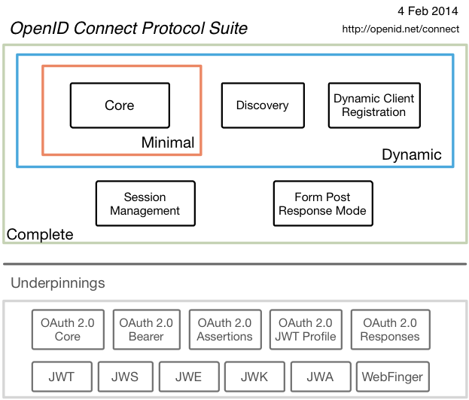
Original Overview of Specifications

Slide 24
Celebrating Ten Years of OpenID Connect
OpenID Connect specifications were approved in February 2014
Three celebrations were held
January 2024 at Japan OpenID Summit in Tokyo
May 2024 at Identiverse in Las Vegas
June 2024 at EIC in Berlin
Presentations from first celebration published at https://self-issued.info/?p=2481
During the celebrations, we are shared our perspectives on
How we developed OpenID Connect
Why it succeeded
Lessons we learned along the way
Lessons learned
“Keep simple things simple”
Repeated interop testing and incorporating resulting feedback from developers was critical
Certification enables an ecosystem of interoperable implementations

Slide 25
OpenID 2.0 to OpenID Connect Migration
Defines how to migrate from OpenID 2.0 to OpenID Connect
Has OpenID Connect identity provider also return OpenID 2.0 identifier, enabling account migration
https://openid.net/specs/openid-connect-migration-1_0.html
Completed April 2015
Google shut down OpenID 2.0 support in April 2015
AOL, Yahoo, others have replaced OpenID 2.0 with OpenID Connect

Slide 26
OAuth 2.0 Form Post Response Mode
Defines how to return OAuth 2.0 Authorization Response parameters (including OpenID Connect Authentication Response parameters) using HTML form values auto-submitted by the User Agent using HTTP POST
A “form post” binding, like SAML and WS-Federation
An alternative to fragment encoding
https://openid.net/specs/oauth-v2-form-post-response-mode-1_0.html
Completed April 2015
In production use by Microsoft, Ping Identity, others

Slide 27
RP-Initiated Logout
Enables RP to request that OP log out end-user
https://openid.net/specs/openid-connect-rpinitiated-1_0.html
Content recently split out of Session Management spec
Can be used with all OP-Initiated Logout methods
Not affected by browser privacy changes
(unlike some of the OP-Initiated Logout methods)
Final Specification as of September 2022

Slide 28
OP-Initiated Logout
Enables OP to request that RPs log out end-user’s sessions with the OP
Three approaches specified by the working group:
Session Management
https://openid.net/specs/openid-connect-session-1_0.html
Uses HTML5 postMessage to communicate state changes between OP and RP iframes
Front-Channel Logout
https://openid.net/specs/openid-connect-frontchannel-1_0.html
Uses HTTP GET to load image or iframe, triggering logout (similar to SAML, WS-Federation)
Back-Channel Logout
https://openid.net/specs/openid-connect-backchannel-1_0.html
Server-to-communication not using the browser (so can be used by native applications)
All support multiple logged-in sessions from OP at RP
Session Management & Front-Channel Logout affected by browser privacy changes
Final Specifications as of September 2022

Slide 29
unmet_authentication_requirements Specification
OpenID Connect Core Error Code unmet_authentication_requirements
https://openid.net/specs/openid-connect-unmet-authentication-requirements-1_0.html
Defines unmet_authentication_requirements error code
Enables OP to signal that it failed to authenticate the End-User per the RP’s requirements
Became Final in November 2022

Slide 30
prompt=create Specification
Initiating User Registration via OpenID Connect specification
https://openid.net/specs/openid-connect-prompt-create-1_0.html
Requests enabling account creation during authentication
Became Final in December 2022

Slide 31
OpenID Connect ISO Specifications
OpenID Connect specifications published as ISO PAS specs, October 2024
Enables use of OpenID Connect in jurisdictions requiring specs by treaty organizations
ISO/IEC 26131:2024 — Information technology — OpenID connect — OpenID connect core 1.0 incorporating errata set 2
ISO/IEC 26132:2024 — Information technology — OpenID connect — OpenID connect discovery 1.0 incorporating errata set 2
ISO/IEC 26133:2024 — Information technology — OpenID connect — OpenID connect dynamic client registration 1.0 incorporating errata set 2
ISO/IEC 26134:2024 — Information technology — OpenID connect — OpenID connect RP-initiated logout 1.0
ISO/IEC 26135:2024 — Information technology — OpenID connect — OpenID connect session management 1.0
ISO/IEC 26136:2024 — Information technology — OpenID connect — OpenID connect front-channel logout 1.0
ISO/IEC 26137:2024 — Information technology — OpenID connect — OpenID connect back-channel logout 1.0 incorporating errata set 1
ISO/IEC 26138:2024 — Information technology — OpenID connect — OAuth 2.0 multiple response type encoding practices
ISO/IEC 26139:2024 — Information technology — OpenID connect — OAuth 2.0 form post response mode

Slide 32
Exciting time for OpenID Connect!
More happening than at any time since original specs created
I’ll give you a taste of the exciting work happening…

Slide 33
OpenID Federation Specification
https://openid.net/specs/openid-federation-1_0.html
Enables trust establishment and maintenance of multilateral federations
Applying lessons learned from large-scale SAML federations
Renamed from “OpenID Connect Federation” to reflect broader role
Can be used with ecosystems of your choice, including OpenID Connect, wallets, etc.
In production use in Italy, Australia, Sweden
Certification tests being written
https://openid.net/certification/federation_testing/
Security analysis performed preparing for Final status
In-person interop event being held in Stockholm at SUNET in April 2025
30 attendees from 15 countries with 14 implementations
Plan to take 1.0 to Final status this year

Slide 34
Vulnerability in JWT Audience for AS (1)
Found by University of Stuttgart researchers during OpenID Federation security analysis
Described in public disclosure
https://openid.net/notice-of-a-security-vulnerability/
OpenID Federation fixed
OpenID Connect Core errata in progress
FAPI 2.0 fixed
FAPI 1.0 errata in progress
CIBA Core errata in progress
Several OAuth specs being updated by rfc7523bis specification

Slide 35
Vulnerability in JWT Audience for AS (2)
Fix is requiring that audience value of JWTs sent to the authorization server be solely the authorization server issuer identifier
Previously, audience values were all over the map, providing ambiguity that attackers could exploit
For instance, this was the PAR [RFC 9126] audience text:
Due to historical reasons, there is potential ambiguity regarding the appropriate audience value to use when employing JWT client assertion-based authentication (defined in Section 2.2 of [RFC7523] with private_key_jwt or client_secret_jwt authentication method names per Section 9 of [OIDC]). To address that ambiguity, the issuer identifier URL of the authorization server according to [RFC8414] SHOULD be used as the value of the audience. In order to facilitate interoperability, the authorization server MUST accept its issuer identifier, token endpoint URL, or pushed authorization request endpoint URL as values that identify it as an intended audience.

Slide 36
OpenID Federation Extended Subordinate Listing
https://openid.net/specs/openid-federation-extended-listing-1_0.html
Extends OpenID Federation to provide efficient methods to interact with potentially large number of participating Entities
Motivated by open finance use cases in Australia, etc.
Implementations and feedback wanted!

Slide 37
OpenID Federation Wallet Architectures
https://openid.net/specs/openid-federation-wallet-1_0.html
Defines entity types for trust establishment for wallet ecosystems with OpenID Federation
openid_wallet_provider
openid_credential_issuer
openid_credential_verifier
Implementations and feedback wanted!

Slide 38
OpenID Connect Relying Party Metadata Choices
https://openid.net/specs/openid-connect-rp-metadata-choices-1_0.html
Lets RPs declare all supported metadata parameters to OPs
In existing OpenID Connect Dynamic Client Registration spec, only one value expressed for each choice
Used by OpenID Federation
First Implementer’s Draft approved in July 2025
Updated since to use token_endpoint_auth_methods_supported for all Authorization Server endpoints

Slide 39
Native Single-Sign-On for Mobile Apps
OpenID Connect Native SSO for Mobile Apps specification
https://openid.net/specs/openid-connect-native-sso-1_0.html
Enables Single Sign-On across apps by the same vendor
Assigns a device secret issued by the Authorization Server
Deployed by AOL
Second Implementer’s Draft approved October 2025
Updates being considered to replace reuse of ID Token

Slide 40
OpenID Connect Claims Aggregation
https://openid.net/specs/openid-connect-claims-aggregation-1_0.html
Enables RPs to request and Claims Providers to return aggregated claims through OPs
Functional overlap with OpenID4VC specs removed in May
Reviews wanted

Slide 41
OpenID Provider Commands
https://openid.net/specs/openid-provider-commands-1_0.html
Complements OpenID Connect by introducing set of Commands for OP to manage end-user Account at RP
Adopted by working group in March 2025

Slide 42
OpenID Connect Enterprise Extensions
https://openid.net/specs/openid-connect-enterprise-extensions-1_0.html
Specifies common or desirable extensions to OpenID Connect
Adopted by working group in June 2025

Slide 43
OpenID Connect Ephemeral Subject Identifier
https://openid.net/specs/openid-connect-ephemeral-subject-identifier-1_0.html
Specifies an ephemeral subject identifier type that prevents correlation of the subject identifier across multiple visits
Adopted by working group in June 2025
Reviews requested

Slide 44
OpenID Connect Key Binding
https://github.com/openid/connect-key-binding
Specifies how to bind public key to OpenID Connect ID Token
Adopted by working group in October 2025
Publication to openid.net/specs/ expected this week

Slide 45
Related OpenID Working Groups
Mobile Operator Discovery, Registration, & autheNticAtion (MODRNA)
Mobile operator profiles for OpenID Connect
Financial-grade API (FAPI)
FAPI used for Open Finance in jurisdictions including UK, Australia, Brazil, Saudia Arabia, Norway, Germany, Japan, Canada, & more to come…
eKYC and Identity Assurance (eKYC-IDA)
Defines JWT format for verified claims with identity assurance information
Digital Credentials Protocols (DCP)
Future home of OpenID for Verifiable Credentials (OpenID4VC) specs

Slide 46
OpenID for Verifiable Credentials (Related Work Transferred to DCP WG)
Family of specs enabling use of identities that you hold
Uses the three-party Issuer/Holder/Verifier model
An Issuer creates a Verifiable Credential for you to hold
You hold it in a Wallet
You present it to a Verifier, possibly redacting some claims
Credential format agnostic
Can be used w/ W3C VCs, ISO Mobile Driving Licenses (mDL), SD-JWTs, etc.
Good privacy properties
Issuer doesn’t know when/where you’re using the credential
See https://openid.net/openid4vc/

Slide 47
Identity Assurance Specification (Related Work in eKYC-IDA WG)
OpenID Connect for Identity Assurance
https://openid.net/specs/openid-connect-4-identity-assurance-1_0.html
JWT representation for verified person data
Including information about the identity verification performed
Enables legal compliance for some use cases
Moved to eKYC and Identity Assurance working group in 2019
Became Final in October 2024

Slide 48
CIBA Core (Related Work in MODRNA WG)
OpenID Connect Client-Initiated Backchannel Authentication (CIBA) Core
https://openid.net/specs/openid-client-initiated-backchannel-authentication-core-1_0.html
Authentication flow with direct Relying Party to OpenID Provider communication without redirects through browser
Used by FAPI CIBA Profile
Errata 1 draft published with security fix
Became Final in September 2021

Slide 49

What is OpenID Certification?
Enables OpenID Connect (and FAPI) implementations to be certified as meeting the requirements of defined conformance profiles
Goal is to make high-quality, secure, interoperable implementations the norm
An OpenID Certification has two components:
Technical evidence of conformance resulting from testing
Legal statement of conformance
Certified implementations can use the “OpenID Certified” logo
4,357 total certifications to date!

Slide 50
What value does certification provide?
Technical
Certification testing gives confidence that things will “just work”
No custom code required to integrate with implementation
Better for all parties
Relying parties explicitly asking identity providers to get certified
Business
Enhances reputation of organization and implementation
Shows that organization is taking interop seriously
Customers may choose certified implementations over others

Slide 51
OpenID Connect Certification Profiles
Authentication
Basic Flow
Implicit Flows
Hybrid Flows
Third Party-Initiated Login Flow
Discovery (OP Metadata)
Dynamic Client Registration (RP Metadata)
Form Post Response Mode
Logout
RP-Initiated Logout
Session Management
Front-Channel Logout
Back-Channel Logout

Slide 52
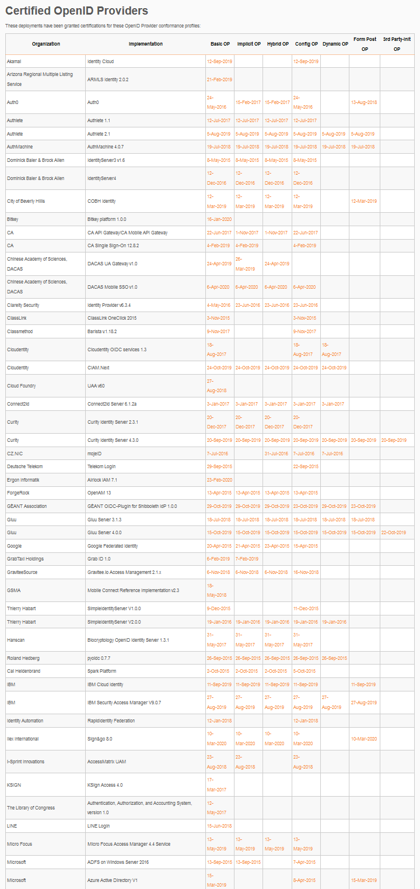
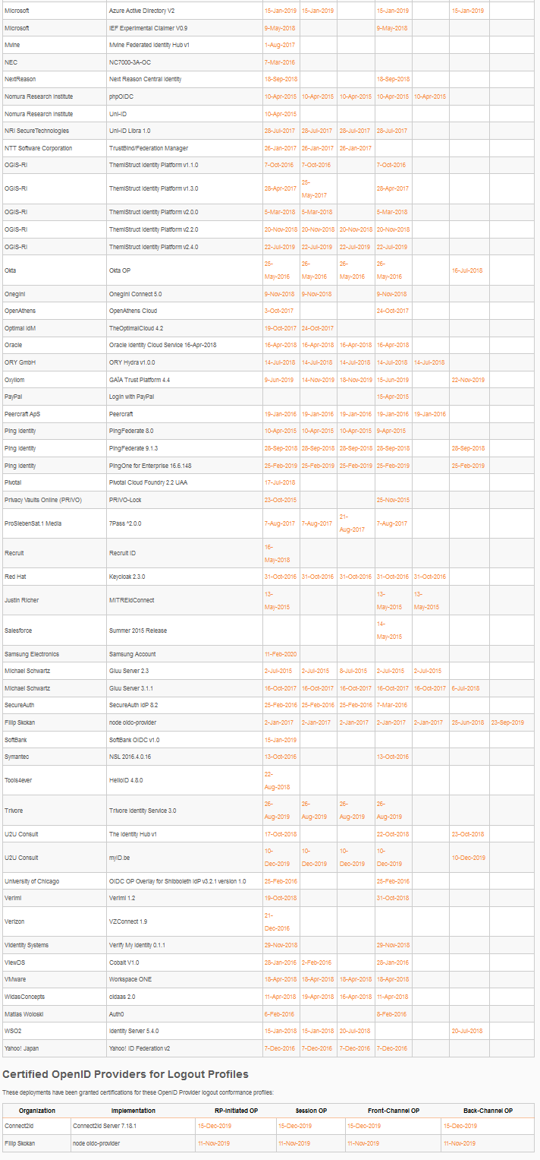
OpenID Connect OP Certifications
OpenID Provider certifications at https://openid.net/certification/#OPs
666 profiles certified to date for 187 deployments
Recent certifications
Authcube, Authelina, Banco de Credito del Peru, Hopae, Luiky Vasconcelos, Nevis Security AG, Skillmine Technology Consulting, Yaal Coop
Each entry link to zip file with test logs and signed legal statement
Test results available for public inspection

Slide 53
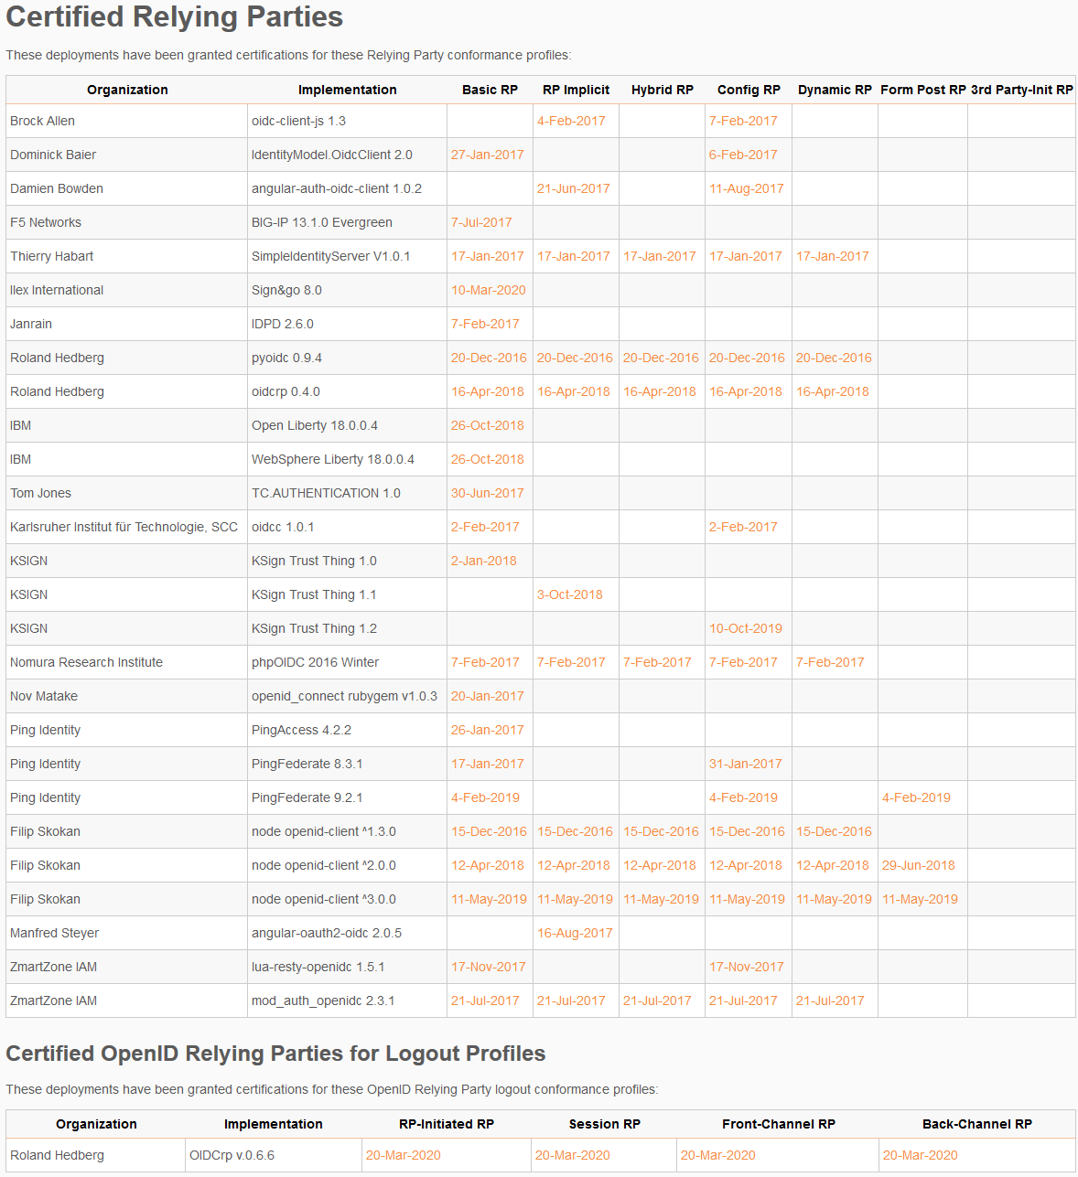
OpenID Connect RP Certifications
Relying Party certifications at https://openid.net/certification/#RPs
107 profiles certified to date for 46 deployments
Recent certifications
Ahmed Fwela, Arcon Techsolutions

Slide 54
Use of Self-Certification
OpenID Certification uses self-certification
Party seeking certification does the testing
(rather than paying a 3rd party to do the testing)
Simpler, quicker, less expensive, more scalable than 3rd party certification
Results are nonetheless trustworthy because
Testing logs are made available for public scrutiny
Organization puts its reputation on the line by making a public declaration that its implementation conforms to the profile being certified to

Slide 55
How does OpenID Certification work?
Organization decides what profiles it wants to certify to
For instance, “Basic OP”, “Config OP”, and “Dynamic OP”
Runs conformance tests publicly available at https://www.certification.openid.net/
Once all tests for a profile pass, organization submits certification request to OpenID Foundation containing:
Logs from all tests for the profile
Signed legal declaration that implementation conforms to the profile
Organization pays certification fee (for profiles not in pilot mode)
OpenID Foundation verifies application is complete and grants certification
OIDF lists certification at https://openid.net/certification/

Slide 56
What does certification cost?
Not a profit center for the OpenID Foundation
Fees there to help cover costs of operating certification program
Member price
$700
Non-member price
$3500
New profiles in pilot mode are available to members for free
Costs described at https://openid.net/certification/fees/

Slide 57
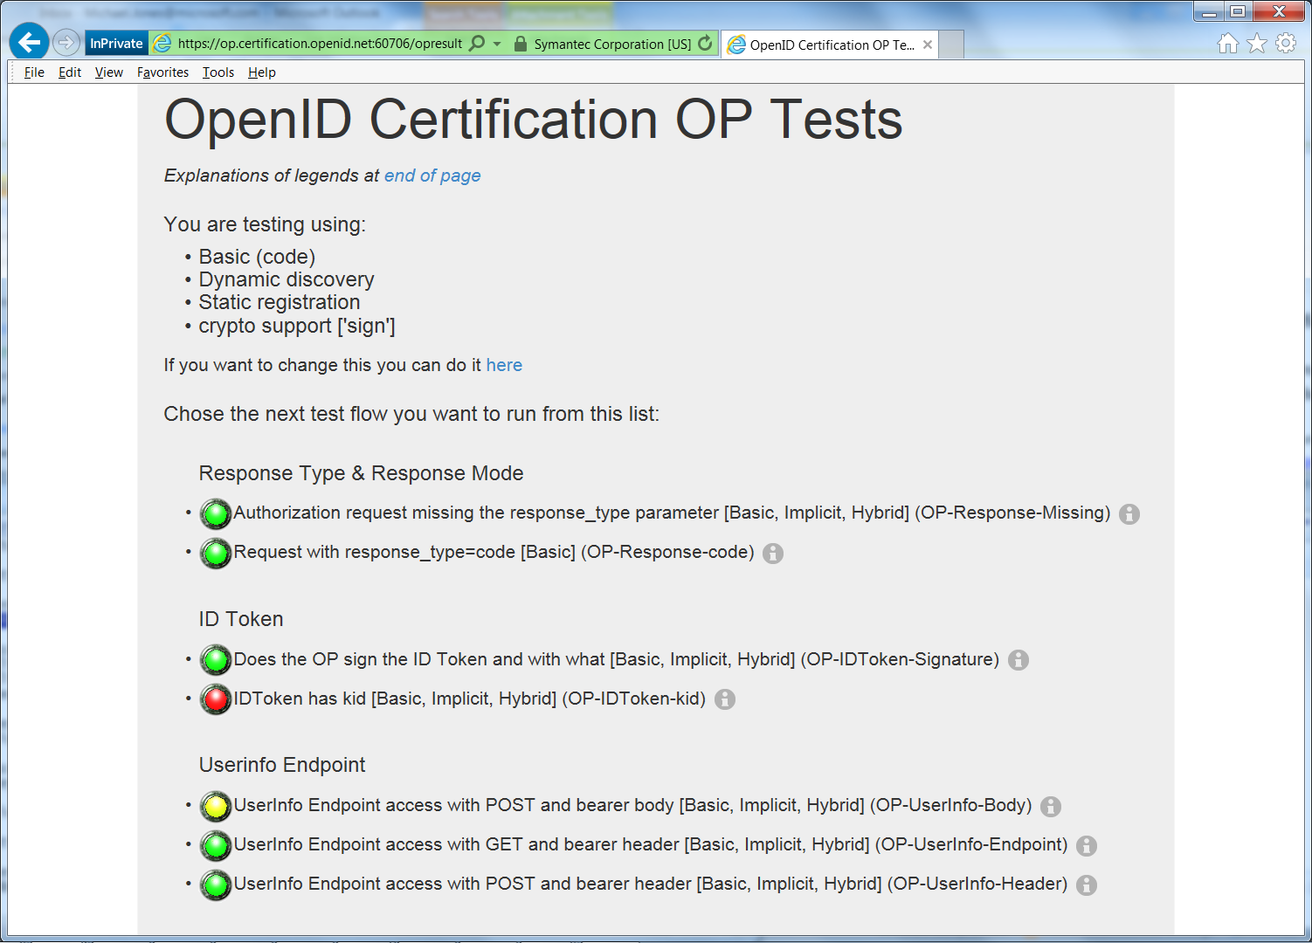
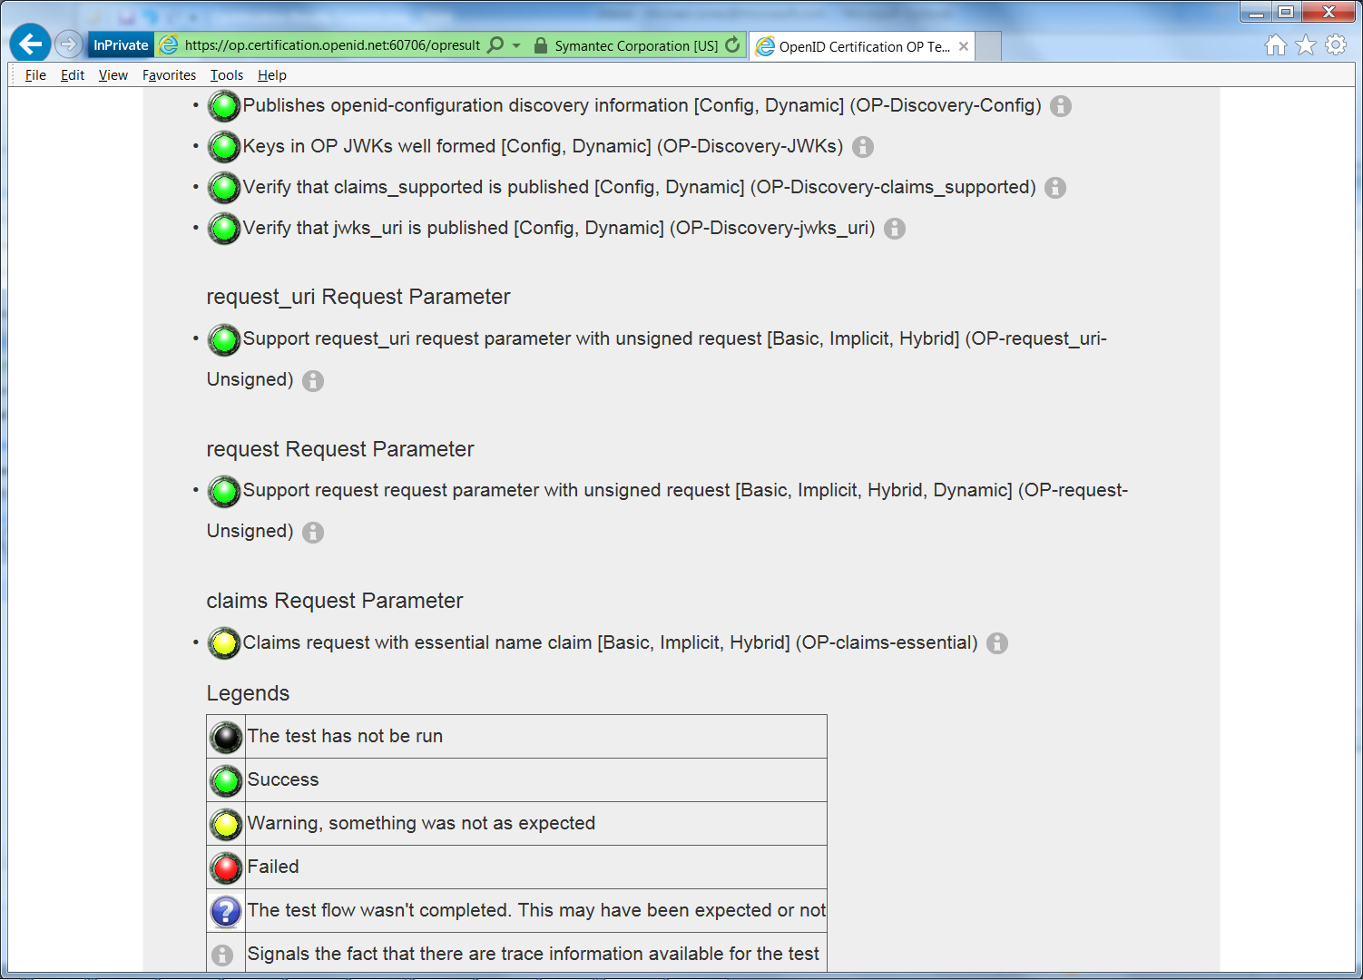
Example Testing Screen

Slide 58
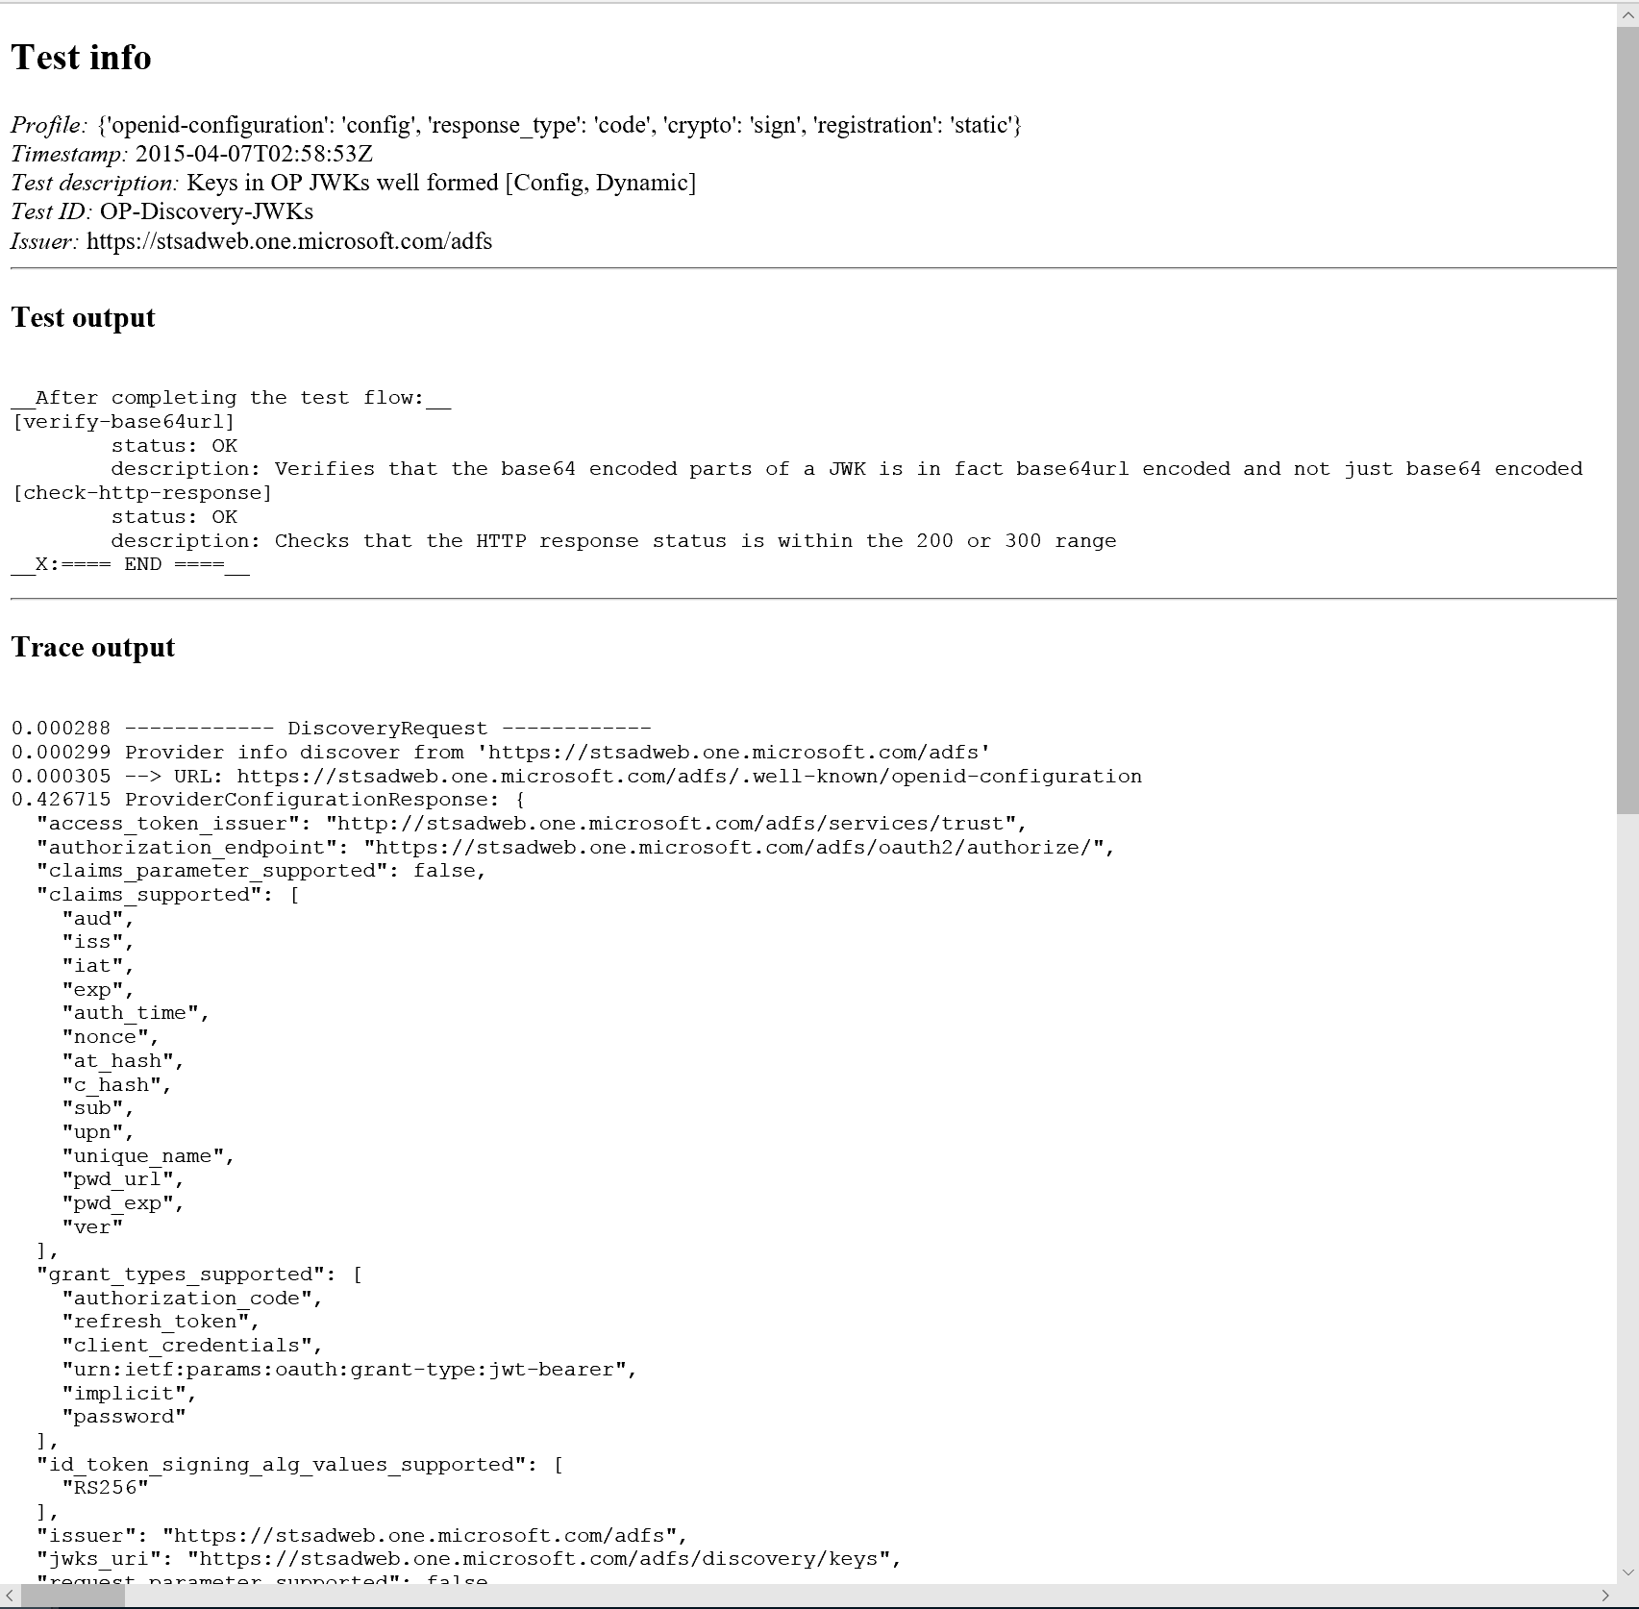
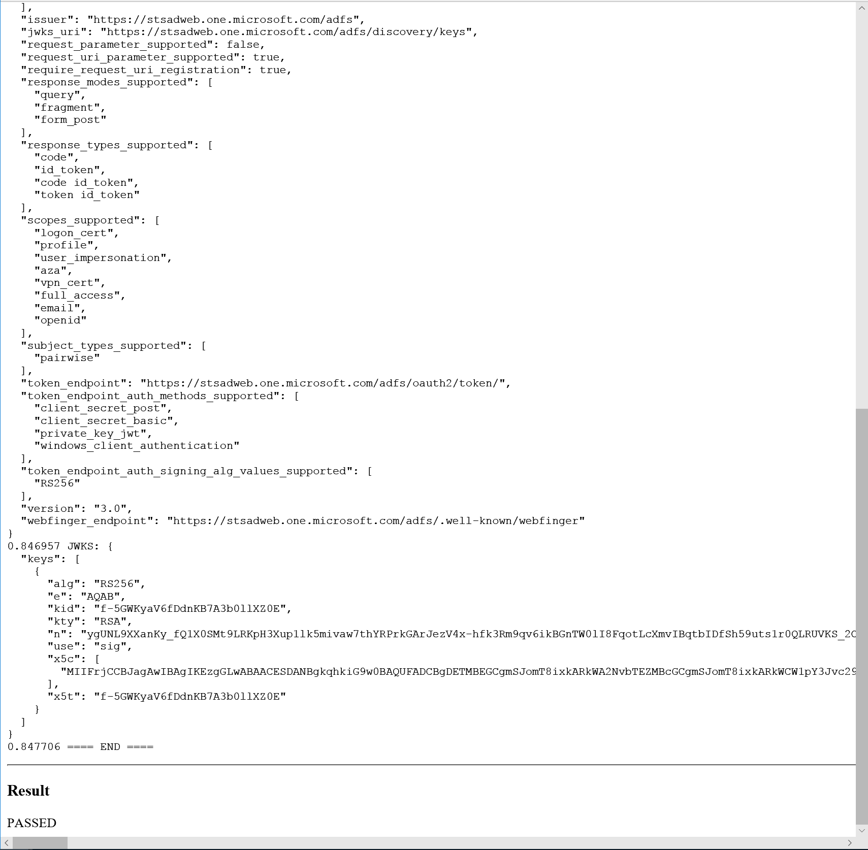
Log from a Conformance Test

Slide 59
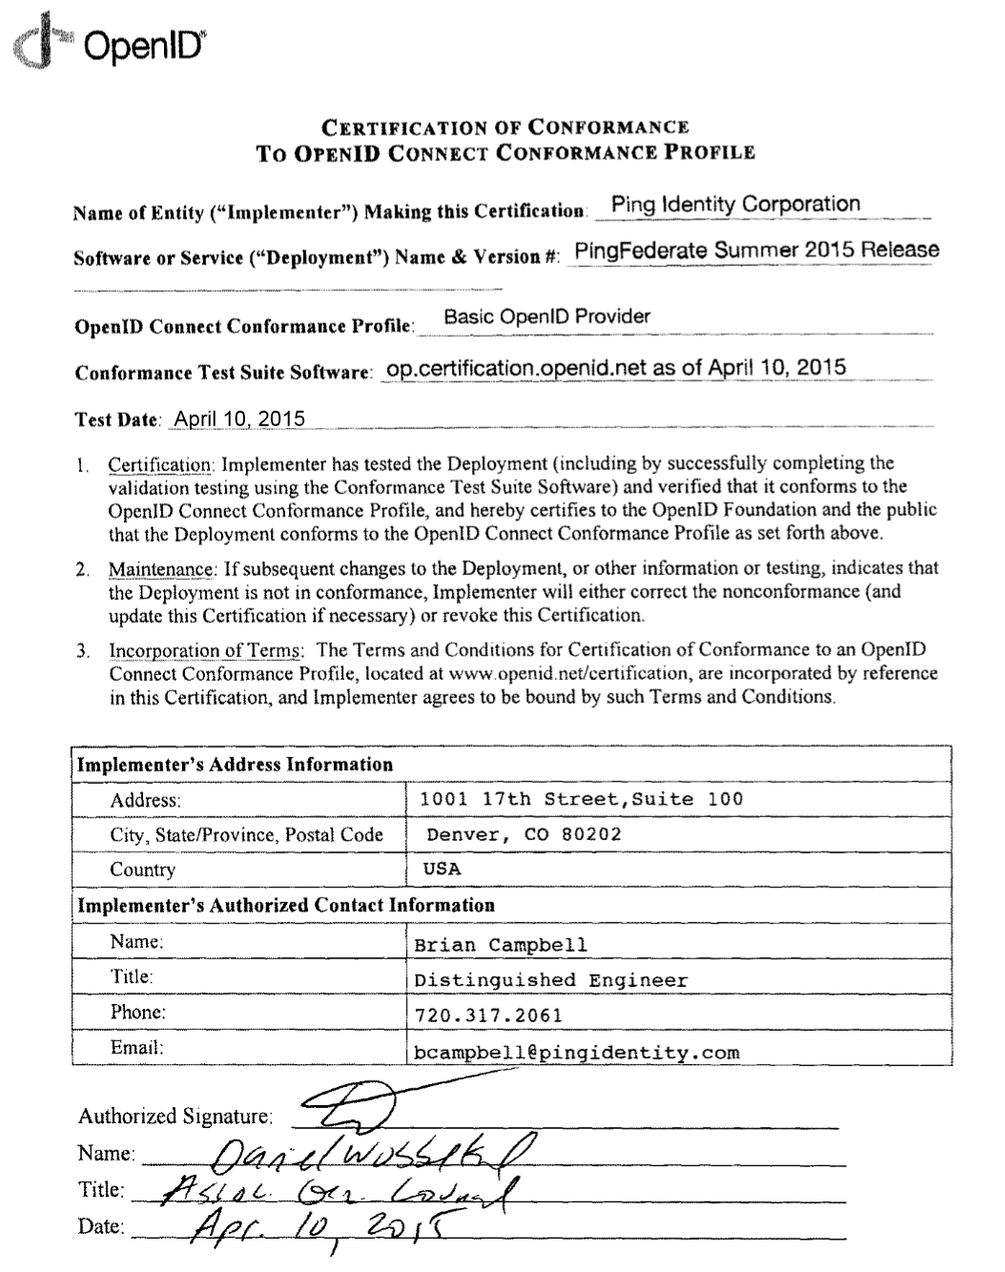
Certification of Conformance
Legal statement by certifier stating:
Who is certifying
What software
When tested
Profile tested
Commits reputation of certifying organization to validity of results

Slide 60
How does certification relate to interop testing?
OpenID Connect held 5 rounds of interop testing – see http://osis.idcommons.net/
Starting over a decade ago!
Each round improved implementations and specs
By the numbers: 20 implementations, 195 members of interop list, > 1000 messages exchanged
Multiple interop testing rounds for OpenID Federation
Next will be in Stockholm hosted by SUNET at the end of this month
With interop testing, by design, participants can ignore parts of the specs
Certification raises the bar:
Defines set of conformance profiles that certified implementations meet
Assures interop across full feature sets in profiles

Slide 61
Can I use the OpenID Certification site for interop testing?
Yes – please do!
The OpenID Foundation is committed to keeping the conformance test sites up and available for free to all
Many projects using conformance testing for regression testing
Once everything passes, you’re ready for certification!
Test software is open source using Apache 2.0 license
Some projects have deployed private instances for internal testing
Available as a Docker container

Slide 62
Favorite Comments on OpenID Certification
Eve Maler – VP of Innovation at ForgeRock
“You made it as simple as possible so every interaction added value.”
Jaromír Talíř – CZ.NIC
“We used and still are using certification platform mainly as testing tool for our IdP. Thanks to this tool, we have fixed enormous number of bugs in our platform an even some bugs in the underlying library.”
Brian Campbell – Distinguished Engineer at Ping Identity
“The process has allowed us to tighten up our implementation and improve on the already solid interoperability of our offerings in the OpenID Connect ecosystem.”
William Denniss – Google
“We have built the RP tests into the continuous-integration testing pipeline for AppAuth.”

Slide 63
What’s new for OpenID Certification?
Certification program is now financially self-supporting!
Open Banking certifications from Brazil and other places got us there
OpenID4VC certification tests started
eKYC-IDA certification tests started
Shared Signals certification tests started
OpenID Federation certification tests started

Slide 64
OpenID Certification Call to Action
Test your OpenID Connect, FAPI, OpenID4VC, OpenID Federation, and Shared Signals implementations now
And once you’re ready, certify!
Join the OpenID Foundation and/or the OpenID Connect working group

Slide 65
OpenID Connect Resources
OpenID Connect
https://openid.net/connect/
Frequently Asked Questions
https://openid.net/connect/faq/
OpenID Connect Working Group and Specifications Pages
https://openid.net/wg/connect/
https://openid.net/wg/connect/specifications/
OpenID Certification Program
https://openid.net/certification/
Certified OpenID Connect Implementations Featured for Developers
https://openid.net/developers/certified/
Mike Jones’ Blog
https://self-issued.info/

Slide 66
Your Turn!
How are you using OpenID Connect?
What would you like the working group to know or do?
Slides will be posted at https://self-issued.info/

Slide 67
Backup Slides

Slide 68
Aggregated Claims
Data Source
Data Source
Signed Claims
Identity Provider
Claim Values
Relying
Party

Slide 69
Distributed Claims
Data Source
Data Source
Signed Claims
Identity Provider
Claim Refs
Relying
Party

