Slide 1
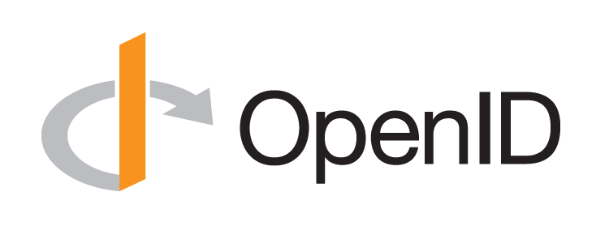
Introduction to OpenID Connect
October 20, 2020
Michael B. Jones
Identity Standards Architect – Microsoft

Slide 2
















Working Together
OpenID Connect

Slide 3
What is OpenID Connect?
Simple identity layer on top of OAuth 2.0
Enables Relying Parties (RPs) to verify identity of end-user
Enables RPs to obtain basic profile info
REST/JSON interfaces → low barrier to entry
Described at https://openid.net/connect/

Slide 4
You’re Probably Already Using OpenID Connect!
If you have an Android phone or log in at Apple, AOL, Deutsche Telekom, Google, Microsoft, NEC, NTT, Salesforce, Softbank, Symantec, Verizon, or Yahoo! Japan, you’re already using OpenID Connect
  Many other sites and apps large and small also use OpenID Connect

Slide 5
OpenID Connect Range
Spans use cases, scenarios
  Internet, Enterprise, Mobile, Cloud
Spans security & privacy requirements
  From non-sensitive information to highly secure
Spans sophistication of claims usage
  From basic default claims to specific requested claims to collecting claims from multiple sources
Maximizes simplicity of implementations
  Uses existing IETF specs: OAuth 2.0, JWT, etc.
  Lets you build only the pieces you need

Slide 6

Numerous Awards
OpenID Connect won 2012 European Identity Award for Best Innovation/New Standard
  https://openid.net/2012/04/18/openid-connect-wins-2012-european-identity-and-cloud-award/
OAuth 2.0 won in 2013
JSON Web Token (JWT) & JOSE won in 2014
OpenID Certification program won
2018 Identity Innovation Award
OpenID Certification program won
2018 European Identity Award

Slide 7
Presentation Overview
Introduction
Design Philosophy
Timeline
A Look Under the Covers
Overview of OpenID Connect Specs
More OpenID Connect Specs
OpenID Certification
Resources

Slide 8
Design Philosophy
Keep Simple Things Simple
Make Complex Things Possible

Slide 9
Keep Simple Things Simple
UserInfo endpoint for simple claims about user
Designed to work well on mobile phones

Slide 10
How We Made It Simple
Built on OAuth 2.0
Uses JavaScript Object Notation (JSON)
You can build only the pieces that you need
Goal: Easy implementation on all modern development platforms

Slide 11
Make Complex Things Possible
Encrypted Claims
Aggregated Claims
Distributed Claims

Slide 12
Key Differences from OpenID 2.0
Support for native client applications
Identifiers using e-mail address format
UserInfo endpoint for simple claims about user
Designed to work well on mobile phones
Uses JSON/REST, rather than XML
Support for encryption and higher LOAs
Support for distributed and aggregated claims
Support for session management, including logout
Support for self-issued identity providers

Slide 13
OpenID Connect Timeline
Artifact Binding working group formed, March 2010
Major design issues closed at IIW, May 2011
  Result branded “OpenID Connect”
5 rounds of interop testing between 2011 and 2013
  Specifications refined after each round of interop testing
Won Best New Standard award at EIC, April 2012
Final specifications approved, February 2014
Errata set 1 approved November 2014
Form Post Response Mode spec approved, April 2015
OpenID 2.0 to Connect Migration spec approved, April 2015
OpenID Provider Certification launched, April 2015
OpenID Federation spec work begun, July 2016
Relying Party Certification launched, December 2016
Logout Implementer’s Drafts approved, March 2017
OpenID Certification program won awards in March 2018 and April 2018
Numerous extension specifications being worked on, 2019-2020

Slide 14
A Look Under the Covers
ID Token
Claims Requests
UserInfo Claims
Example Protocol Messages

Slide 15
ID Token
JWT representing logged-in session
Claims:
  iss – Issuer
  sub – Identifier for subject (user)
  aud – Audience for ID Token
  iat – Time token was issued
  exp – Expiration time
  nonce – Mitigates replay attacks

Slide 16
ID Token Claims Example
  {
  "iss": "https://server.example.com",
  "sub": "248289761001",
  "aud": "0acf77d4-b486-4c99-bd76-074ed6a64ddf",
  "iat": 1311280970,
  "exp": 1311281970,
  "nonce": "n-0S6_WzA2Mj"
  }

Slide 17
Claims Requests
Basic requests made using OAuth scopes:
  openid – Declares request is for OpenID Connect
  profile – Requests default profile info
  email – Requests email address & verification status
  address – Requests postal address
  phone – Requests phone number & verification status
  offline_access – Requests Refresh Token issuance
Requests for individual claims can be made using JSON “claims” request parameter

Slide 18
UserInfo Claims
sub
name
given_name
family_name
middle_name
nickname
preferred_username
profile
picture
website
gender
birthdate
locale
zoneinfo
updated_at
email
email_verified
phone_number
phone_number_verified
address

Slide 19
UserInfo Response Example
  {
  "sub": "248289761001",
  "name": "Jane Doe",
  "given_name": "Jane",
  "family_name": "Doe",
  "email": "janedoe@example.com",
  "email_verified": true,
  "picture": "https://example.com/janedoe/me.jpg"
  }

Slide 20
Authorization Request Example
  https://server.example.com/authorize
  ?response_type=id_token%20token
  &client_id=0acf77d4-b486-4c99-bd76-074ed6a64ddf
  &redirect_uri=https%3A%2F%2Fclient.example.com%2Fcb
  &scope=openid%20profile
  &state=af0ifjsldkj
  &nonce=n-0S6_WzA2Mj

Slide 21
Authorization Response Example
  HTTP/1.1 302 Found
  Location: https://client.example.com/cb
  #access_token=mF_9.B5f-4.1JqM
  &token_type=bearer
  &id_token=eyJhbGzI1NiJ9.eyJz9Glnw9J.F9-V4IvQ0Z
  &expires_in=3600
  &state=af0ifjsldkj

Slide 22
UserInfo Request Example
  GET /userinfo HTTP/1.1
  Host: server.example.com
  Authorization: Bearer mF_9.B5f-4.1JqM

Slide 23
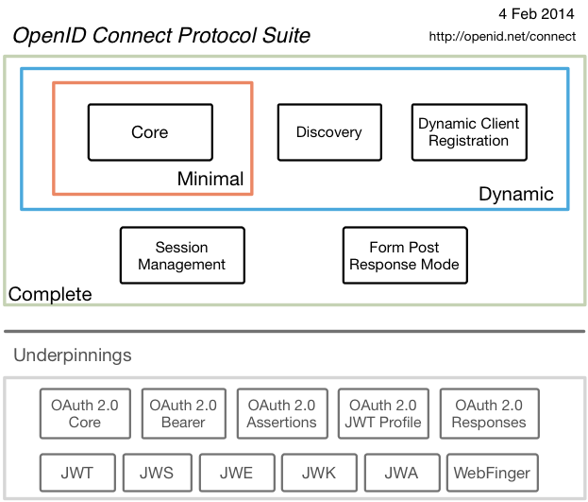
Original Overview of Specifications

Slide 24
Additional Final Specifications (1 of 2)
OpenID 2.0 to OpenID Connect Migration
  Defines how to migrate from OpenID 2.0 to OpenID Connect
    Has OpenID Connect identity provider also return OpenID 2.0 identifier, enabling account migration
  https://openid.net/specs/openid-connect-migration-1_0.html
  Completed April 2015
  Google shut down OpenID 2.0 support in April 2015
  AOL, Yahoo, others have replaced OpenID 2.0 with OpenID Connect

Slide 25
Additional Final Specifications (2 of 2)
OAuth 2.0 Form Post Response Mode
  Defines how to return OAuth 2.0 Authorization Response parameters (including OpenID Connect Authentication Response parameters) using HTML form values auto-submitted by the User Agent using HTTP POST
  A “form post” binding, like SAML and WS-Federation
    An alternative to fragment encoding
  https://openid.net/specs/oauth-v2-form-post-response-mode-1_0.html
  Completed April 2015
  In production use by Microsoft, Ping Identity

Slide 26
Session Management / Logout
(work in progress)
Three approaches specified by the working group:
  Session Management
    https://openid.net/specs/openid-connect-session-1_0.html
    Uses HTML5 postMessage to communicate state change messages between OP and RP iframes
  Front-Channel Logout
    https://openid.net/specs/openid-connect-frontchannel-1_0.html
    Uses HTTP GET to load image or iframe, triggering logout (similar to SAML, WS-Federation)
  Back-Channel Logout
    https://openid.net/specs/openid-connect-backchannel-1_0.html
    Server-to-communication not using the browser
    Can be used by native applications, which have no active browser
Unfortunately, no one approach best for all use cases
All support multiple logged in sessions from OP at RP
All three can be used with RP-Initiated Logout
  https://openid.net/specs/openid-connect-rpinitiated-1_0.html
Logout certification tests now in production mode
  WG is gathering data from multiple implementations before making logout specs Final

Slide 27
Federation Specification
(work in progress)
OpenID Connect Federation specification
  https://openid.net/specs/openid-connect-federation-1_0.html
Enables establishment and maintenance of multi-party federations using OpenID Connect
Defines hierarchical JSON-based metadata structures for federation participants
Second Implementer’s Draft status reached
Multiple interop events being held this year
Please review and implement!

Slide 28
Identity Assurance Specification
(work in progress)
OpenID Connect for Identity Assurance
  https://openid.net/specs/openid-connect-4-identity-assurance-1_0.html
JWT representation for verified person data
  Including information about the identity verification performed
  Enables legal compliance for some use cases
Moved to new eKYC and Identity Assurance working group
Now at second Implementer’s Draft status
  Please review!

Slide 29
Native SSO Specification
(work in progress)
OpenID Connect Native SSO for Mobile Apps specification
  https://openid.net/specs/openid-connect-native-sso-1_0.html
Enables Single Sign-On across apps by the same vendor
Assigns a device secret issued by the AS
New specification written by George Fletcher
  Please review!

Slide 30
Self-Issued OpenID Provider
OpenID Connect defines Self-Issued OpenID Provider
  https://openid.net/specs/openid-connect-core-1_0.html#SelfIssued
Lets you be your own identity provider
  Rather than a third party
Identity represented as asymmetric key pair controlled by you
Self-Issued OpenID Provider being used to achieve DID auth
  Described at https://self-issued.info/?p=2013
WG defining extensions to SIOP using URI as subject
  Please participate!

Slide 31
Related Working Groups
International Government Profile (iGov) WG
  OpenID Connect profile for government & high-value commercial applications
Enhanced Authentication Profile (EAP) WG
  Enables integration with FIDO and other phishing-resistant authentication solutions
Mobile Operator Discovery, Registration & autheNticAtion (MODRNA) WG
  Mobile operator profiles for OpenID Connect
Financial-grade API (FAPI) WG
  Enables secure API access to high-value services
  Used for Open Banking APIs in many jurisdictions, including the UK
Research and Education (R&E) WG
  Profiles OpenID Connect to ease adoption in the Research and Education (R&E) sector
eKYC and Identity Assurance WG
  JWT format for verified claims with identity assurance information

Slide 32

What is OpenID Certification?
Enables OpenID Connect and FAPI implementations to be certified as meeting the requirements of defined conformance profiles
  Goal is to make high-quality, secure, interoperable OpenID Connect implementations the norm
An OpenID Certification has two components:
  Technical evidence of conformance resulting from testing
  Legal statement of conformance
Certified implementations can
use the “OpenID Certified” logo

Slide 33
What value does certification provide?
Technical:
  Certification testing gives confidence that things will “just work”
  No custom code required to integrate with implementation
  Better for all parties
  Relying parties explicitly asking identity providers to get certified
Business:
  Enhances reputation of organization and implementation
  Shows that organization is taking interop seriously
  Customers may choose certified implementations over others

Slide 34
OpenID Connect Certification Profiles
Now OpenID Connect certification profiles for:
  Basic OP and Basic RP
  Implicit OP and Implicit RP
  Hybrid OP and Hybrid RP
  OP Publishing and RP Using Configuration Information
  Dynamic OP and Dynamic RP
  Form Post Response Mode for OP and RP
  Third party-initiated login for OP and RP
  New: Four profiles for Logout OP and RP now in production mode

Slide 35
New Connect Certification Profiles
Four logout profiles for OPs and RPs in production mode
  RP-Initiated Logout
  Session Management Logout
  Front-Channel Logout
  Back-Channel Logout

Slide 36
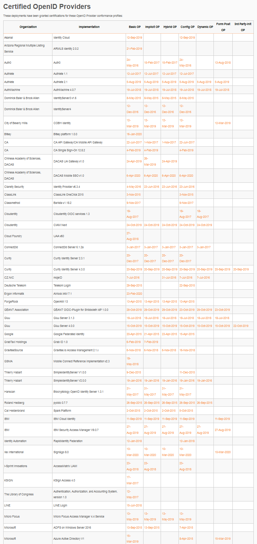
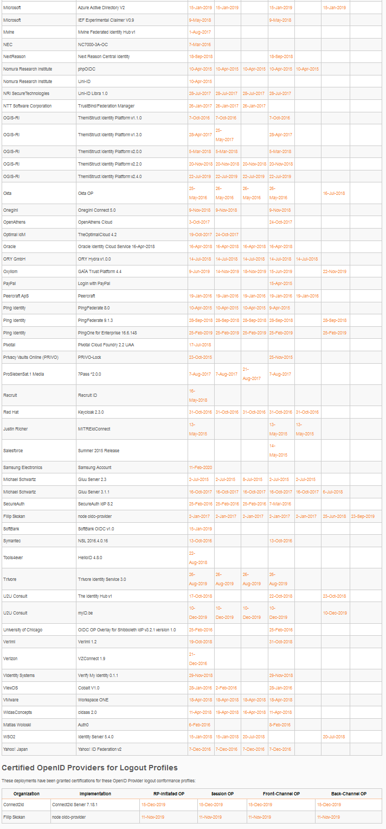
Connect OP Certifications
OpenID Provider certifications at https://openid.net/certification/#OPs
  374 profiles certified for
  112 implementations by
  91 organizations
Recent additions:
  Bitkey, Chinese Academy of Sciences, Ergon Informatik, Gluu, Ilex International, Samsung Electronics
Each entry link to zip file with test logs and signed legal statement
  Test results available for public inspection

Slide 37
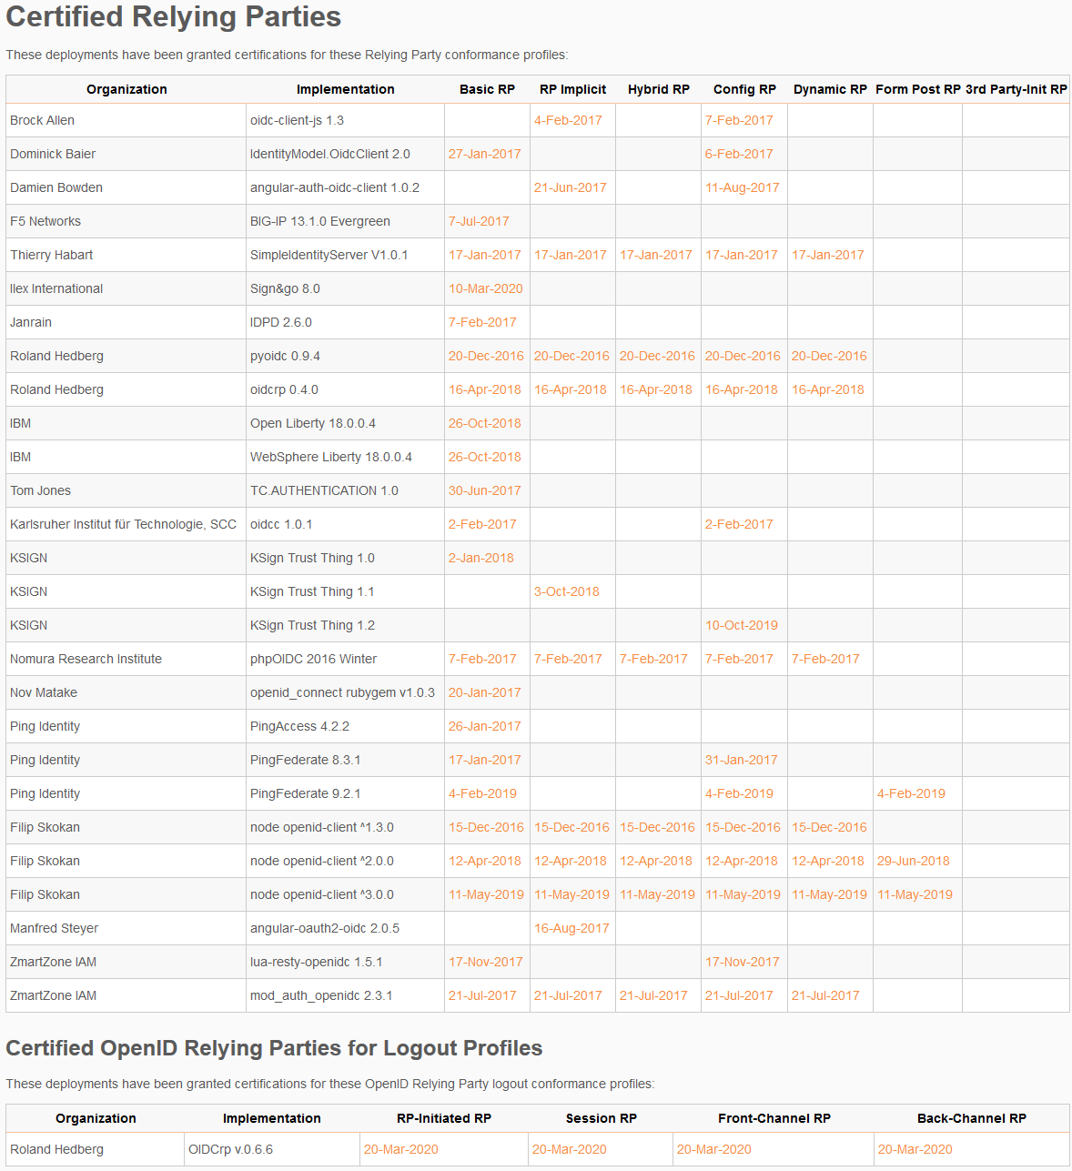
Connect RP Certifications
Relying Party certifications at https://openid.net/certification/#RPs
  77 profiles certified for
  30 implementations by
  18 organizations
Recent additions:
  Ilex International, Roland Hedberg

Slide 38
A Very International Effort
European programmers developed and operate the certification test suites:
  Roland Hedberg, Sweden
  Joseph Heenan, UK
  Serkan Özkan, Turkey
  Tomas Pazderka, Czech Republic
  Filip Skokan, Czech Republic
  Hans Zandbelt, Netherlands
OpenID Connect leadership also very international:
  Nat Sakimura, Japan
  John Bradley, Chile
  Michael Jones, United States

Slide 39
Use of Self-Certification
OpenID Certification uses self-certification
  Party seeking certification does the testing
  (rather than paying a 3rd party to do the testing)
Simpler, quicker, less expensive, more scalable than 3rd party certification
Results are nonetheless trustworthy because
  Testing logs are made available for public scrutiny
  Organization puts its reputation on the line by making a public declaration that its implementation conforms to the profile being certified to

Slide 40
How does OpenID Certification work?
Organization decides what profiles it wants to certify to
  For instance, “Basic OP”, “Config OP”, and “Dynamic OP”
Runs conformance tests publicly available at https://www.certification.openid.net/
Once all tests for a profile pass, organization submits certification request to OpenID Foundation containing:
  Logs from all tests for the profile
  Signed legal declaration that implementation conforms to the profile
Organization pays certification fee (for profiles not in pilot mode)
OpenID Foundation verifies application is complete and grants certification
OIDF lists certification at https://openid.net/certification/

Slide 41
What does certification cost?
Not a profit center for the OpenID Foundation
  Fees there to help cover costs of operating certification program
Member price
  $500
Non-member price
  $2500
New profiles in pilot mode are available to members for free
Costs described at https://openid.net/certification/fees/

Slide 42
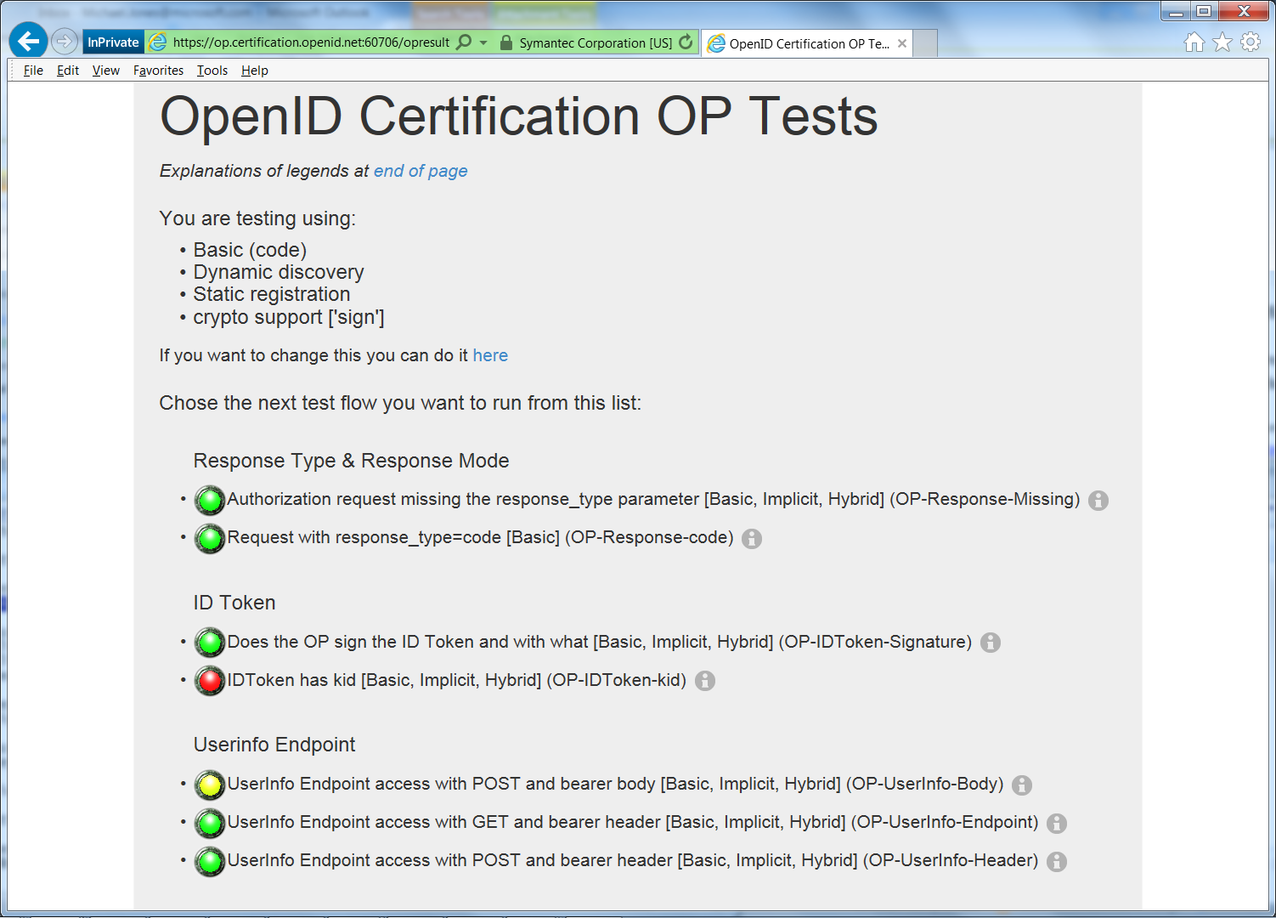
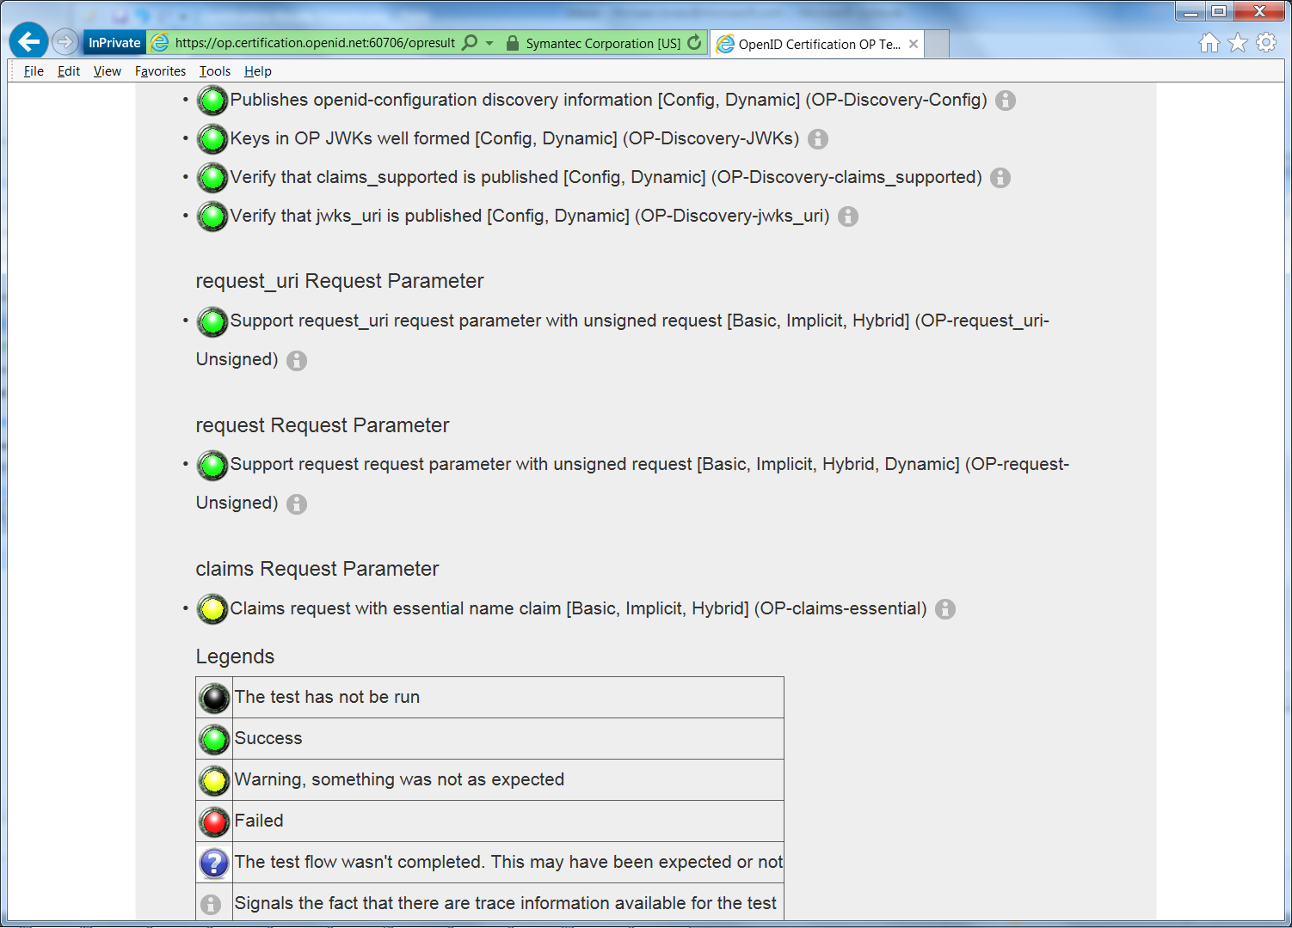
Example Testing Screen

Slide 43
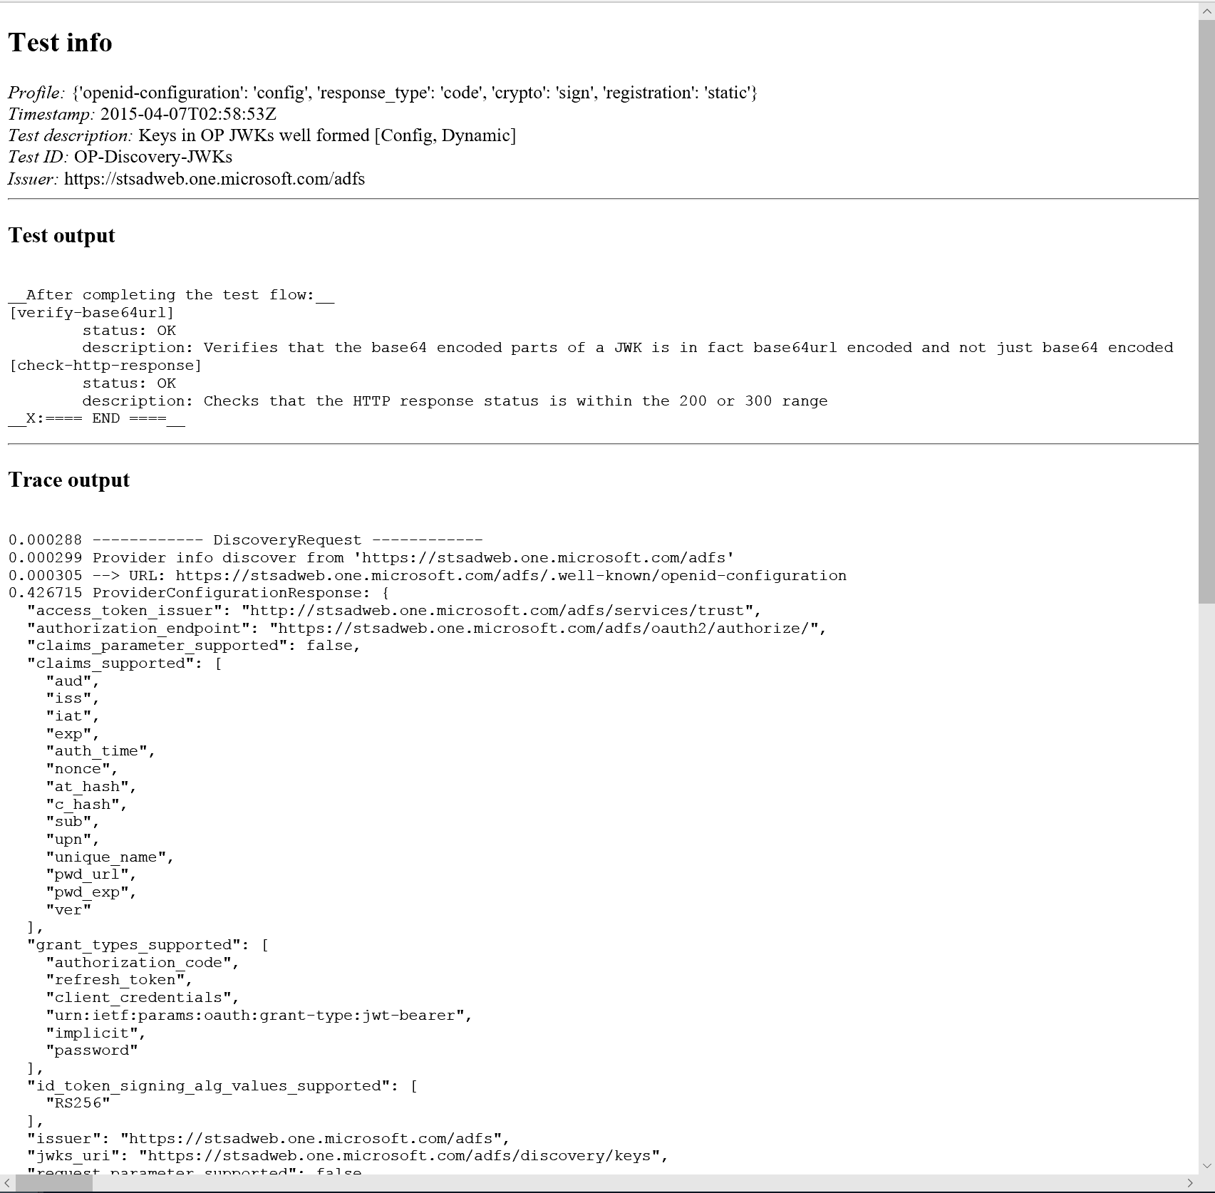
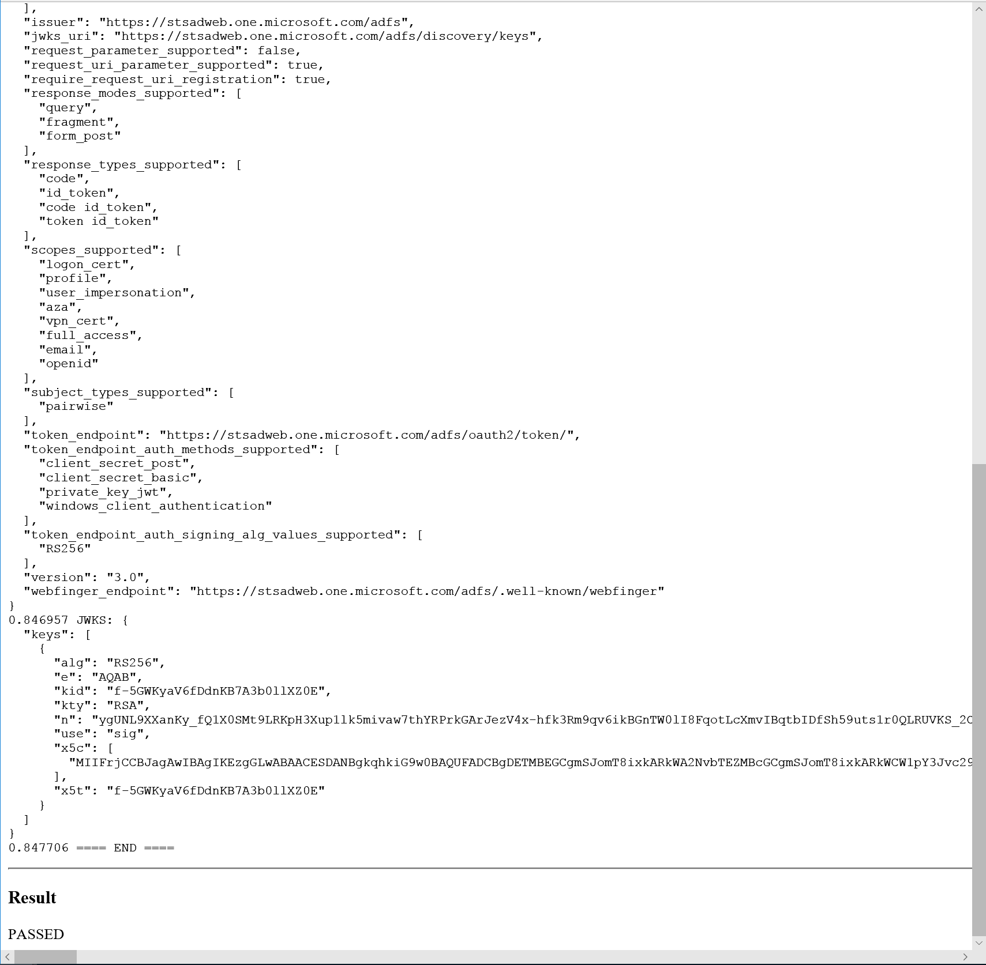
Log from a Conformance Test

Slide 44
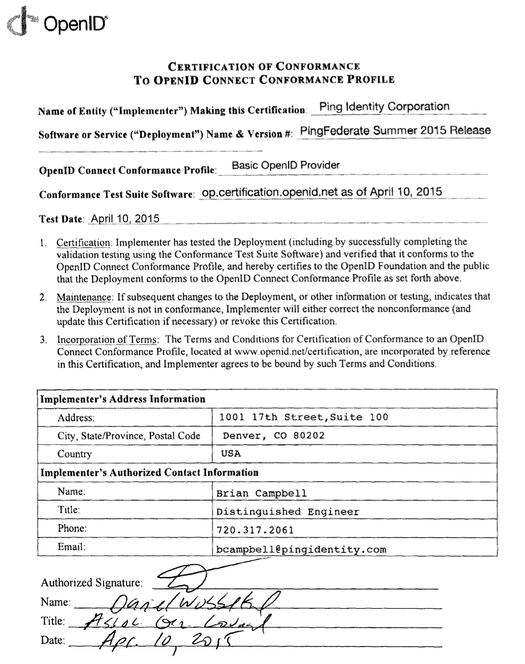
Certification of Conformance
Legal statement by certifier stating:
  Who is certifying
  What software
  When tested
  Profile tested
Commits reputation of certifying organization to validity of results

Slide 45
How does certification relate to interop testing?
OpenID Connect held 5 rounds of interop testing – see http://osis.idcommons.net/
  Each round improved implementations and specs
  By the numbers: 20 implementations, 195 members of interop list, > 1000 messages exchanged
Interop testing now happening for OpenID Connect Federation
With interop testing, by design, participants can ignore parts of the specs
Certification raises the bar:
  Defines set of conformance profiles that certified implementations meet
  Assures interop across full feature sets in profiles

Slide 46
Can I use the certification site for interop testing?
Yes – please do!
The OpenID Foundation is committed to keeping the conformance test sites up and available for free to all
Many projects using conformance testing for regression testing
  Once everything passes, you’re ready for certification!
Test software is open source using Apache 2.0 license
  Some projects have deployed private instances for internal testing
  Available as a Docker container

Slide 47
Favorite Comments on OpenID Certification
Eve Maler – VP of Innovation at ForgeRock
  “You made it as simple as possible so every interaction added value.”
Jaromír Talíř – CZ.NIC
  “We used and still are using certification platform mainly as testing tool for our IdP. Thanks to this tool, we have fixed enormous number of bugs in our platform an even some bugs in the underlying library.”
Brian Campbell – Distinguished Engineer at Ping Identity
  “The process has allowed us to tighten up our implementation and improve on the already solid interoperability of our offerings in the OpenID Connect ecosystem.”
William Denniss – Google
  “We have built the RP tests into the continuous-integration testing pipeline for AppAuth.”

Slide 48
FAPI Certification Status
Financial-grade API (FAPI) implementations now being certified
FAPI Part 2 OP certification launched in April 2019
  18 implementations certified to date
Financial-grade API Client Initiated Backchannel Authentication Profile (FAPI-CIBA) launched in September 2019
  One implementation certified to date
FAPI Part 2 RP certification tests launched in December 2019
  One implementation certified to date

Slide 49
What’s next for OpenID Certification?
Connect Certification code was reimplemented in Java
  Now in the same code base as FAPI certification
  Migration to new implementation occurred at end of August, 2020
Additional FAPI profiles being developed:
  FAPI-CIBA RP
Certification for additional specifications is anticipated:
  E.g., eKYC-IDA, HEART, MODRNA, iGov, EAP, R&E, etc.

Slide 50
OpenID Certification Call to Action
Certify your OpenID Connect and FAPI implementations now
Help us test the new tests
  Especially, test your Logout implementations and provide feedback
Join the OpenID Foundation and/or the OpenID Connect working group

Slide 51
OpenID Connect Resources
OpenID Connect
  https://openid.net/connect/
Frequently Asked Questions
  https://openid.net/connect/faq/
Working Group Mailing List
  https://lists.openid.net/mailman/listinfo/openid-specs-ab
OpenID Certification Program
  https://openid.net/certification/
Certified OpenID Connect Implementations Featured for Developers
  https://openid.net/developers/certified/
Mike Jones’ Blog
  https://self-issued.info/
Nat Sakimura’s Blog
  https://nat.sakimura.org/
John Bradley’s Blog
  https://www.thread-safe.com/

Slide 52
Open Conversation
How are you using OpenID Connect?
What would you like the working group to know or do?
Slides will be posted at https://self-issued.info/

Slide 53
Backup Slides

Slide 54
Aggregated Claims
Data Source
Data Source
Signed Claims
Identity Provider
Claim Values
Relying
Party

Slide 55
Distributed Claims
Data Source
Data Source
Signed Claims
Identity Provider
Claim Refs
Relying
Party

