Slide 1
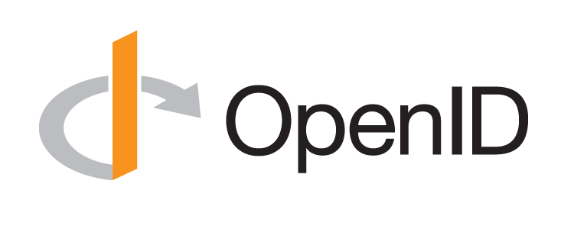
Introduction to OpenID Connect
October 17, 2017
Michael B. Jones
Identity Standards Architect – Microsoft

Slide 2
















Working Together
OpenID Connect

Slide 3
What is OpenID Connect?
Simple identity layer on top of OAuth 2.0
Enables RPs to verify identity of end-user
Enables RPs to obtain basic profile info
REST/JSON interfaces → low barrier to entry
Described at http://openid.net/connect/

Slide 4
You’re Probably Already Using OpenID Connect!
If you log in at AOL, Deutsche Telekom, Google, Microsoft, mixi, NEC, NTT, Salesforce, Softbank, Symantec, Verizon, or Yahoo! Japan or have an Android phone, you’re already using OpenID Connect
  Many other sites and apps large and small also use OpenID Connect

Slide 5
OpenID Connect Range
Spans use cases, scenarios
  Internet, Enterprise, Mobile, Cloud
Spans security & privacy requirements
  From non-sensitive information to highly secure
Spans sophistication of claims usage
  From basic default claims to specific requested claims to collecting claims from multiple sources
Maximizes simplicity of implementations
  Uses existing IETF specs: OAuth 2.0, JWT, etc.
  Lets you build only the pieces you need

Slide 6
Presentation Overview
Introduction
Design Philosophy
Timeline
A Look Under the Covers
Overview of OpenID Connect Specs
More Connect Specs
OpenID Certification
Resources

Slide 7
Design Philosophy
Keep Simple Things Simple
Make Complex Things Possible

Slide 8
Simple Things Simple
UserInfo endpoint for simple claims about user
Designed to work well on mobile phones

Slide 9
How We Made It Simple
Built on OAuth 2.0
Uses JavaScript Object Notation (JSON)
You can build only the pieces that you need
Goal: Easy implementation on all modern development platforms

Slide 10
Complex Things Possible
Encrypted Claims
Aggregated Claims
Distributed Claims

Slide 11
Key Diffs from OpenID 2.0
Support for native client applications
Identifiers using e-mail address format
UserInfo endpoint for simple claims about user
Designed to work well on mobile phones
Uses JSON/REST, rather than XML
Support for encryption and higher LOAs
Support for distributed and aggregated claims
Support for session management, including logout
Support for self-issued identity providers

Slide 12
OpenID Connect Timeline
Artifact Binding working group formed, Mar 2010
Major design issues closed at IIW, May 2011
  Result branded “OpenID Connect”
Functionally complete specs, Jul 2011
5 rounds of interop testing between 2011 and 2013
  Specifications refined after each round of interop testing
Won Best New Standard award at EIC, April 2012
Final specifications approved, February 2014
Errata set 1 approved November 2014
Form Post Response Mode spec approved April 2015
OpenID 2.0 to Connect Migration spec approved April 2015
OpenID Provider Certification launched April 2015
Relying Party Certification launched December 2016
Logout Implementer’s Drafts approved March 2017

Slide 13
A Look Under the Covers
ID Token
Claims Requests
UserInfo Claims
Example Protocol Messages

Slide 14
ID Token
JWT representing logged-in session
Claims:
  iss – Issuer
  sub – Identifier for subject (user)
  aud – Audience for ID Token
  iat – Time token was issued
  exp – Expiration time
  nonce – Mitigates replay attacks

Slide 15
ID Token Claims Example
  {
  "iss": "https://server.example.com",
  "sub": "248289761001",
  "aud": "0acf77d4-b486-4c99-bd76-074ed6a64ddf",
  "iat": 1311280970,
  "exp": 1311281970,
  "nonce": "n-0S6_WzA2Mj"
  }

Slide 16
Claims Requests
Basic requests made using OAuth scopes:
  openid – Declares request is for OpenID Connect
  profile – Requests default profile info
  email – Requests email address & verification status
  address – Requests postal address
  phone – Requests phone number & verification status
  offline_access – Requests Refresh Token issuance
Requests for individual claims can be made using JSON “claims” request parameter

Slide 17
UserInfo Claims
sub
name
given_name
family_name
middle_name
nickname
preferred_username
profile
picture
website
gender
birthdate
locale
zoneinfo
updated_at
email
email_verified
phone_number
phone_number_verified
address

Slide 18
UserInfo Claims Example
  {
  "sub": "248289761001",
  "name": "Jane Doe",
  "given_name": "Jane",
  "family_name": "Doe",
  "email": "janedoe@example.com",
  "email_verified": true,
  "picture": "http://example.com/janedoe/me.jpg"
  }

Slide 19
Authorization Request Example
  https://server.example.com/authorize
  ?response_type=id_token%20token
  &client_id=0acf77d4-b486-4c99-bd76-074ed6a64ddf
  &redirect_uri=https%3A%2F%2Fclient.example.com%2Fcb
  &scope=openid%20profile
  &state=af0ifjsldkj
  &nonce=n-0S6_WzA2Mj

Slide 20
Authorization Response Example
  HTTP/1.1 302 Found
  Location: https://client.example.com/cb
  #access_token=mF_9.B5f-4.1JqM
  &token_type=bearer
  &id_token=eyJhbGzI1NiJ9.eyJz9Glnw9J.F9-V4IvQ0Z
  &expires_in=3600
  &state=af0ifjsldkj

Slide 21
UserInfo Request Example
  GET /userinfo HTTP/1.1
  Host: server.example.com
  Authorization: Bearer mF_9.B5f-4.1JqM

Slide 22
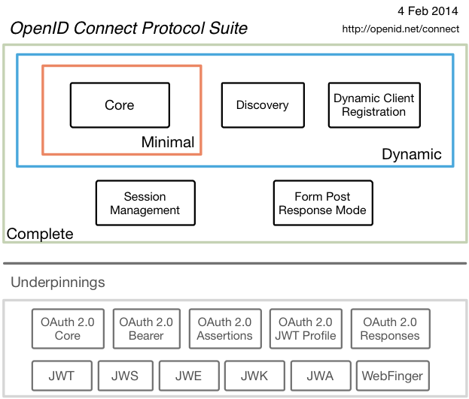
Connect Specs Overview

Slide 23
Additional Final Specifications (1 of 2)
OpenID 2.0 to OpenID Connect Migration
  Defines how to migrate from OpenID 2.0 to OpenID Connect
    Has OpenID Connect identity provider also return OpenID 2.0 identifier, enabling account migration
  http://openid.net/specs/openid-connect-migration-1_0.html
  Completed April 2015
  Google shut down OpenID 2.0 support in April 2015
  Yahoo, others also plan to replace OpenID 2.0 with OpenID Connect

Slide 24
Additional Final Specifications (2 of 2)
OAuth 2.0 Form Post Response Mode
  Defines how to return OAuth 2.0 Authorization Response parameters (including OpenID Connect Authentication Response parameters) using HTML form values that are auto-submitted by the User Agent using HTTP POST
  A “form post” binding, like SAML and WS-Federation
    An alternative to fragment encoding
  http://openid.net/specs/oauth-v2-form-post-response-mode-1_0.html
  Completed April 2015
  In production use by Microsoft, Ping Identity

Slide 25
Federation Specification (work in progress)
Roland Hedberg created OpenID Connect Federation specification
  http://openid.net/specs/openid-connect-federation-1_0.html
Enables establishment and maintenance of multi-party federations using OpenID Connect
Defines hierarchical JSON-based metadata structures for federation participants

Slide 26
Session Management / Logout (work in progress)
Three approaches being pursued by the working group:
  Session Management
    http://openid.net/specs/openid-connect-session-1_0.html
    Uses HTML5 postMessage to communicate state change messages between OP and RP iframes
  Front-Channel Logout
    http://openid.net/specs/openid-connect-frontchannel-1_0.html
    Uses HTTP GET to load image or iframe, triggering logout
    Similar to options in SAML, WS-Federation
  Back-Channel Logout
    http://openid.net/specs/openid-connect-backchannel-1_0.html
    Server-to-communication not using the browser
    Can be used by native applications, which have no active browser
All support multiple logged in sessions from OP at RP
Unfortunately, no one approach best for all use cases
All became Implementer’s Drafts in March 2017

Slide 27

What is OpenID Certification?
OpenID Certification enables OpenID Connect implementations to be certified as meeting the requirements of defined conformance profiles
An OpenID Certification has two components:
  Technical evidence of conformance resulting from testing
  Legal statement of conformance
Certified implementations can
use the “OpenID Certified” logo

Slide 28
What value does certification provide?
Technical:
  Certification testing gives confidence that things will “just work”
  No custom code required to integrate with implementation
  Better for all parties
  Relying parties explicitly asking identity providers to get certified
Business:
  Enhances reputation of organization and implementation
  Shows that organization is taking interop seriously
  Customers may choose certified implementations over others

Slide 29
Conformance Profiles
Five conformance profiles of OpenID Providers:
  Basic OpenID Provider
  Implicit OpenID Provider
  Hybrid OpenID Provider
  OpenID Provider Publishing Configuration Information
  Dynamic OpenID Provider
Five corresponding conformance profiles of OpenID Relying Parties:
  Basic Relying Party
  Implicit Relying Party
  Hybrid Relying Party
  Relying Party Publishing Configuration Information
  Dynamic Relying Party

Slide 30
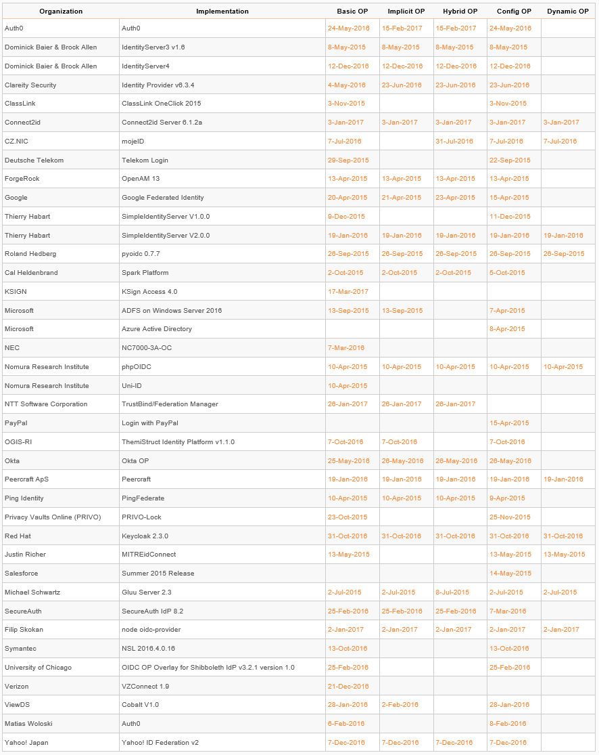
Who has achieved OP Certification?
OpenID Provider certifications at http://openid.net/certification/#OPs
124 profiles certified for
39 implementations by
36 organizations
Recent additions:
  Dominick Baier & Brock Allen, Connect2ID, KSIGN, NTT Software, OGIS-RI, Red Hat, Filip Skokan, Symantec, Verizon, Yahoo! Japan
Each entry in table a link to zip file containing test logs and signed legal statement of conformance
  Test results available for public inspection

Slide 31
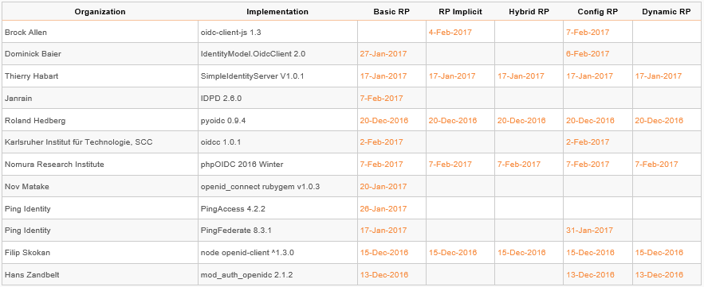
Who has achieved RP Certification?
RP Certification launched in December 2016
Relying Party certifications at http://openid.net/certification/#RPs
34 profiles certified for
12 implementations by
11 organizations
To date:
  Brock Allen, Dominick Baier, Thierry Habart, Janrain, Roland Hedberg, KIT SCC, NRI, Nov Matake, Ping Identity, Filip Skokan, Hans Zandbelt

Slide 32
How does OpenID Certification work?
Organization decides what profiles it wants to certify to
  For instance, “Basic OP”, “Config OP”, and “Dynamic OP”
Runs conformance tests publicly available at http://op.certification.openid.net/ or http://rp.certification.openid.net/
Once all tests for a profile pass, organization submits certification request to OpenID Foundation containing:
  Logs from all tests for the profile
  Signed legal declaration that implementation conforms to the profile
Organization pays certification fee (for profiles not in pilot mode)
OpenID Foundation verifies application is complete and grants certification
OIDF lists certification at http://openid.net/certification/ and registers it in OIXnet at http://oixnet.org/openid-certifications/

Slide 33
What does certification cost?
Not a profit center for the OpenID Foundation
  Fees there to help cover costs of operating certification program
Member price
  $200 per new deployment
Non-member price
  $999 per new deployment
  $499 per new deployment of an already-certified implementation
Covers as many profiles as you submit within calendar year
New profiles in pilot mode are available to members for free
Costs described at http://openid.net/certification/fees/

Slide 34
What’s next for OpenID Certification?
Additional profiles being developed:
  Form Post Response Mode
  Refresh Token Behaviors
  Session Management, Front-Channel Logout, Back-Channel Logout
  OP-Initiated Login
Additional documentation being produced
  By Roland Hedberg and Hans Zandbelt
Certification for additional specifications is anticipated:
  E.g., HEART, MODRNA, iGov, EAP, FAPI, etc.

Slide 35
OpenID Certification
Call to Action
Certify your OpenID Connect implementations
Help us test the soon-to-come new profiles
Join the OpenID Foundation and/or the OpenID Connect working group

Slide 36
OpenID Connect Resources
OpenID Connect
  http://openid.net/connect/
Frequently Asked Questions
  http://openid.net/connect/faq/
Working Group Mailing List
  http://lists.openid.net/mailman/listinfo/openid-specs-ab
OpenID Certification Program
  http://openid.net/certification/
Certified OpenID Connect Implementations Featured for Developers
  http://openid.net/developers/certified/
Mike Jones’ Blog
  http://self-issued.info/
Nat Sakimura’s Blog
  http://nat.sakimura.org/
John Bradley’s Blog
  http://www.thread-safe.com/

Slide 37
Open Conversation
How are you using OpenID Connect?
What would you like the working group to know?

Slide 38
Backup Slides

Slide 39
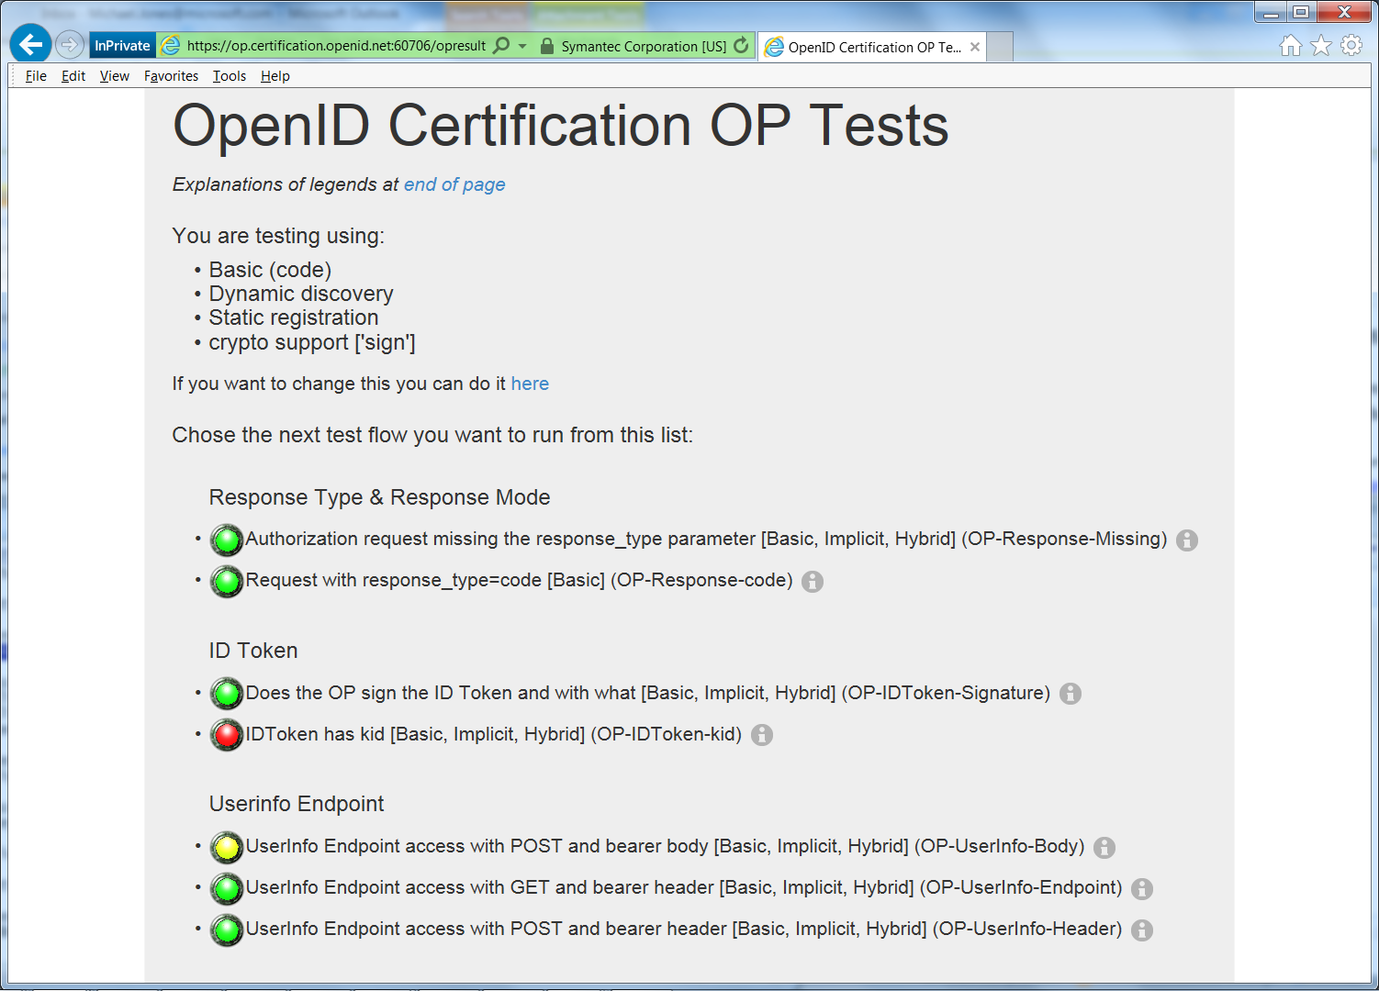
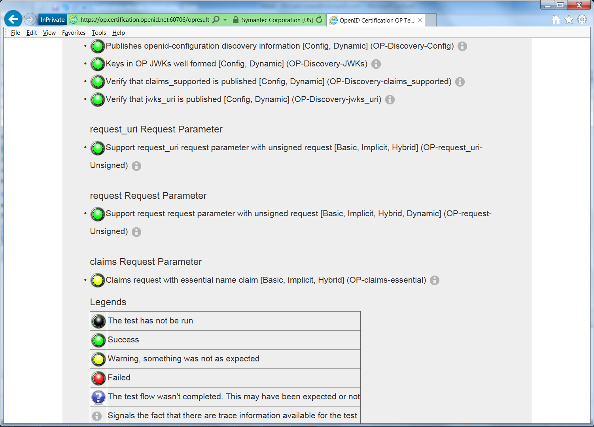
Example Testing Screen

Slide 40
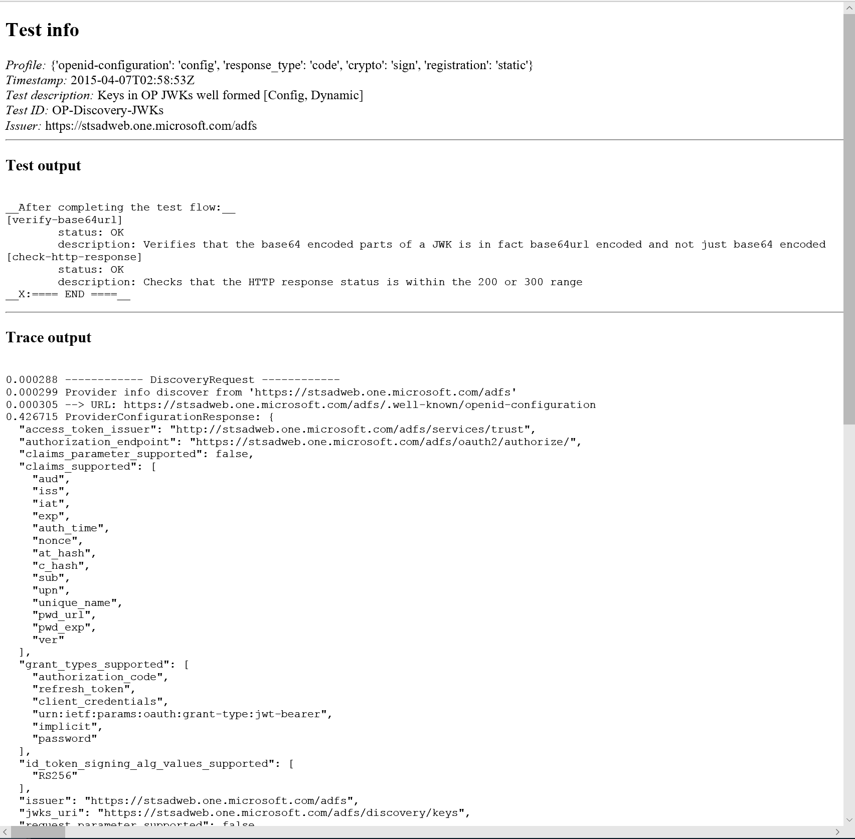
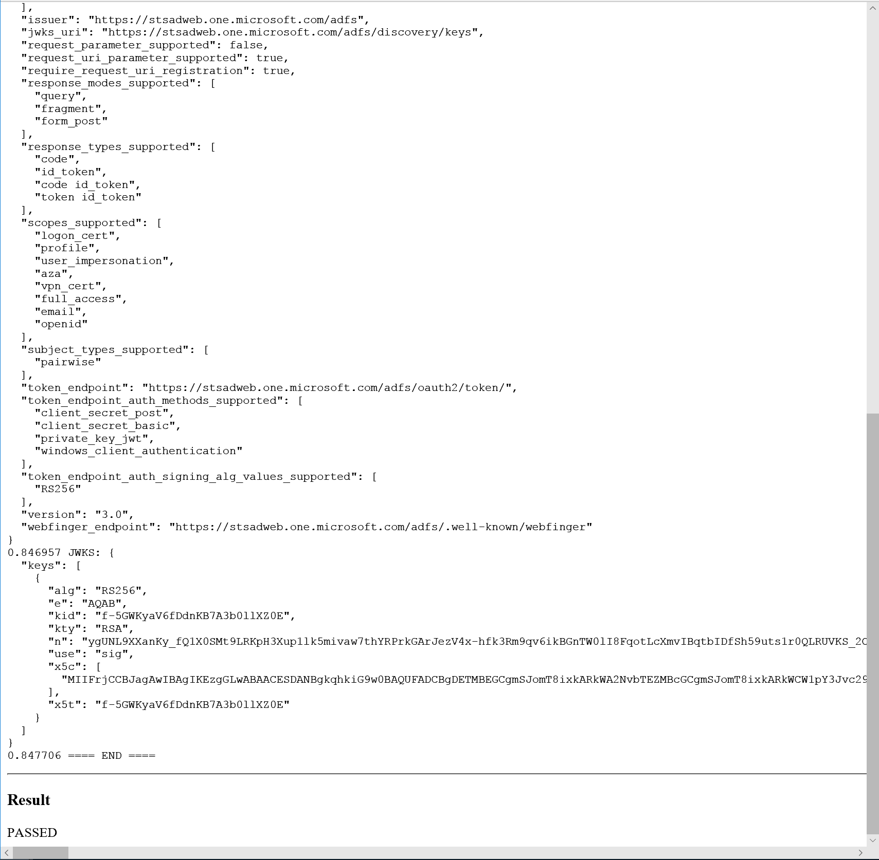
Log from a Conformance Test

Slide 41
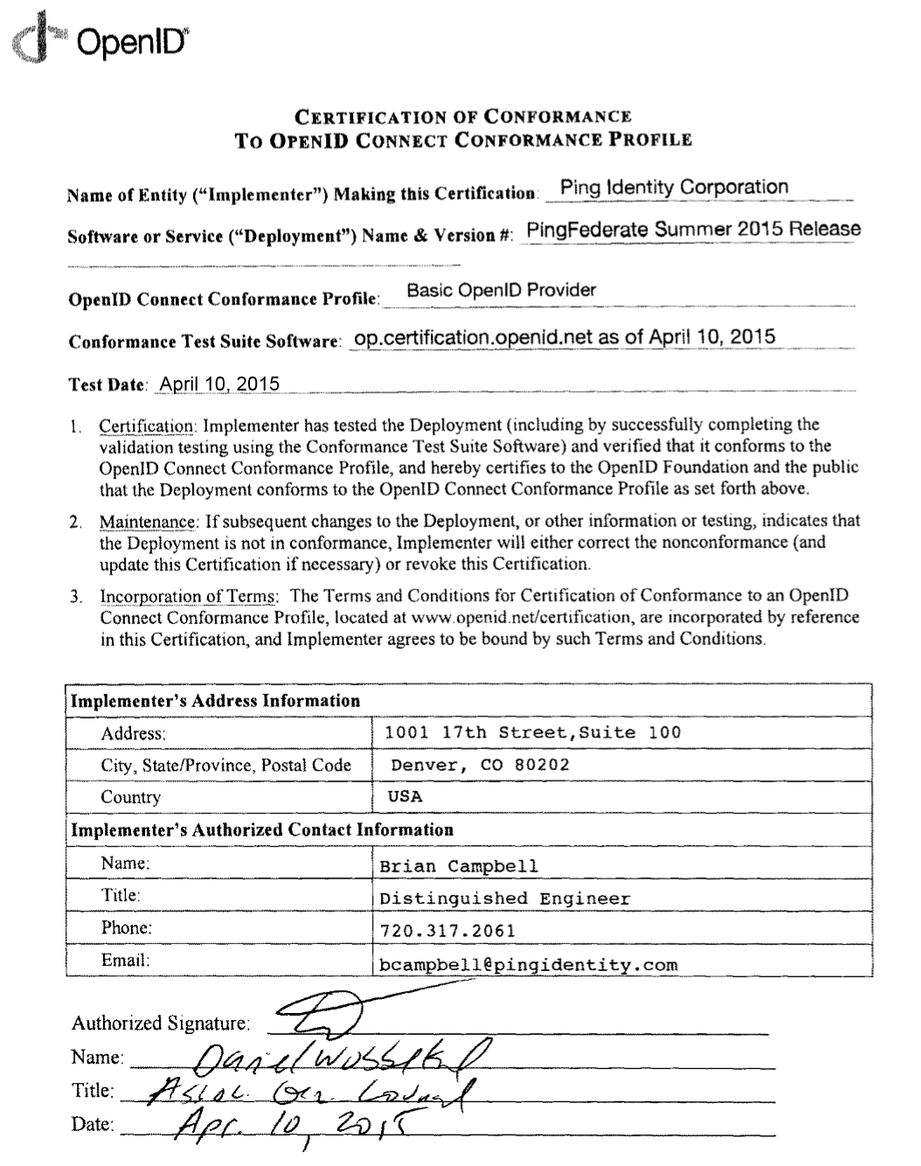
Certification of Conformance
Legal statement by certifier stating:
  Who is certifying
  What software
  When tested
  Profile tested
Commits reputation of certifying organization to validity of results

Slide 42
Aggregated Claims
Data Source
Data Source
Signed Claims
Identity Provider
Claim Values
Relying
Party

Slide 43
Distributed Claims
Data Source
Data Source
Signed Claims
Identity Provider
Claim Refs
Relying
Party

Slide 44
Basic Client Implementer’s Guide
Single, simple, self-contained Web client spec
    For clients using OAuth “code” flow
All you need for Web server-based RP
  Using pre-configured set of OPs
http://openid.net/specs/openid-connect-basic-1_0.html

Slide 45
Implicit Client Implementer’s Guide
Single, simple, self-contained Web client spec
    For clients using OAuth “implicit” flow
All you need for user agent-based RPs
  Using pre-configured set of OPs
http://openid.net/specs/openid-connect-implicit-1_0.html

Slide 46
Discovery & Registration
Enables dynamic configurations in which sets of OPs and RPs are not pre-configured
  Necessary for open deployments
Discovery enables RPs to learn about OP endpoints
Dynamic registration enables RPs to use OPs they don’t have pre-existing relationships with
http://openid.net/specs/openid-connect-discovery-1_0.html
http://openid.net/specs/openid-connect-registration-1_0.html

Slide 47
Core Specification
Defines data formats and messages used for OpenID Connect authentication and claims
http://openid.net/specs/openid-connect-core-1_0.html

Slide 48
Session Management
For OPs and RPs needing session management capabilities
  Enables logout functionality
  Enables account switching
http://openid.net/specs/openid-connect-session-1_0.html

Slide 49
OAuth Response Types
Defines and registers additional OAuth response types:
  id_token
  none
And also defines and registers combinations of code, token, and id_token response types
http://openid.net/specs/oauth-v2-multiple-response-types-1_0.html

Slide 50
Form Post Response Mode
Defines how to return OAuth 2.0 Authorization Response parameters using HTML form values auto-submitted by User Agent using HTTP POST
http://openid.net/specs/oauth-v2-form-post-response-mode-1_0.html

