Slide 1
OpenID Connect: News, Overview, Certification, and Action Items
June 24, 2018
Michael B. Jones
Identity Standards Architect – Microsoft

Slide 2
Working Together
OpenID Connect

Slide 3
What is OpenID Connect?
Simple identity layer on top of OAuth 2.0
Enables relying parties to verify identity of end-user
Enables relying parties to obtain basic profile info
REST/JSON interfaces → low barrier to entry
See http://openid.net/connect/

Slide 4
You’re Probably Already Using OpenID Connect
If you log in at AOL, Deutsche Telekom, France Connect, Google, Microsoft, mixi, NEC, NTT, Salesforce, Softbank, Symantec, Verizon, or Yahoo! Japan or have an Android phone, you’re already using OpenID Connect
Many other sites and apps large and small use OpenID Connect
OpenID Connect “brand” typically not exposed to end-users

Slide 5
Design Philosophy
Keep Simple Things Simple
Make Complex Things Possible

Slide 6
OpenID Connect Range
Spans use cases, scenarios
Internet, Enterprise, Mobile, Cloud
Spans security & privacy requirements
From non-sensitive information to highly secure
Spans sophistication of claims usage
From basic default claims to specific requested claims to collecting claims from multiple sources
Maximizes simplicity of implementations
Uses existing IETF specs: OAuth 2.0, JWT, etc.
Lets you build only the pieces you need

Slide 7
Numerous Awards
OpenID Connect won 2012 European Identity Award for Best Innovation/New Standard
OAuth 2.0 won in 2013
JSON Web Token (JWT) & JOSE won in 2014
OpenID Certification program won 2018 Identity Innovation Award at IDnext
OpenID Certification program won 2018 European Identity Award for Best Innovation
See blog posts at http://openid.net/

Slide 8
New OpenID Connect Projects Hot Off the Presses and with Action Items!

Slide 9
JWTConnect RP Libraries
Google is commissioning creation of high-quality RP libraries
Intended to be full-functioned and pass OpenID Certification
Libraries are being donated to OpenID Connect working group
Initial languages:
Python: Finished, certified, and contributed to working group
Java: Work in progress
JavaScript: Work in progress
Not the first software projects of the Connect working group
The AppAuth libraries are also working group projects

Slide 10
Structure of JWTConnect Libraries
Each language structures the RP library as four components
CryptoJWT
JSON Web Token (JWT) implementation and underlying cryptography
OidcMsg
Serializing, deserializing, and verifying messages + key handling
OidcService
OpenID Connect request/response pattern, client authentication, binding messages to service endpoints
OidcRP
OpenID Connect Relying Party (RP) API, bringing all the parts together

Slide 11
Python JWTConnect Implementation
Python JWTConnect implementation uses 4 GitHub projects
https://github.com/openid/JWTConnect-Python-CryptoJWT
https://github.com/openid/JWTConnect-Python-OidcMsg
https://github.com/openid/JWTConnect-Python-OidcService
https://github.com/openid/JWTConnect-Python-OidcRP

Slide 12
Python JWTConnect Instructions
See the documentation
http://oidcrp.readthedocs.io/en/latest/
See sample RPs
https://github.com/openid/JWTConnect-Python-OidcRP/tree/master/chrp
Has example configurations for Facebook, GitHub, Google, LinkedIn, Microsoft, Okta, Ping Federate, and Salesforce
Action Item: Give Python JWTConnect a try!

Slide 13
Form Post Response Mode Certification
New pair of OpenID Certification profiles being launched at Identiverse
OpenID Provider supporting Form Post Response Mode
Relying Party supporting Form Post Response Mode
Tests OP and RP support for
OAuth 2.0 Form Post Response Mode
http://openid.net/specs/oauth-v2-form-post-response-mode-1_0.html

Slide 14
What the Form Post Tests Do
The conformance tests verify that
when response_mode=form_post parameter used
responses are returned as HTML form parameters using HTTP POST
Instead of as fragments or query parameters
Tests cover both success replies and error replies

Slide 15
Testing the Tests
Form Post Response Mode certification tests are ready to test
These profiles currently in pilot mode
OpenID Foundation members can certify against them for free
There’s a checkbox to add these tests to your OP testing config
See the testing instructions at http://openid.net/certification/
Action Item: Test the tests and certify your implementations!

Slide 16
OpenID Connect Specifications

Slide 17
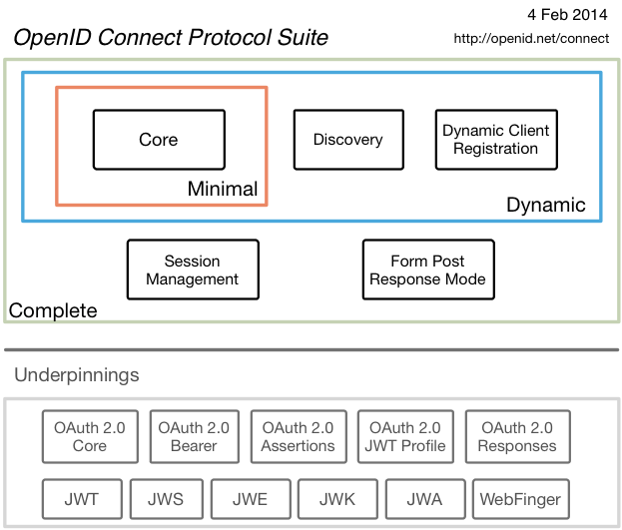
Specifications when finalized in 2014

Slide 18
Session Management / Logout (work in progress)
Three approaches being pursued by the working group:
Session Management
http://openid.net/specs/openid-connect-session-1_0.html
Uses HTML5 postMessage to communicate state change messages between OP and RP iframes
Front-Channel Logout
http://openid.net/specs/openid-connect-frontchannel-1_0.html
Uses HTTP GET to load image or iframe, triggering logout (similar to SAML, WS-Federation)
Back-Channel Logout
http://openid.net/specs/openid-connect-backchannel-1_0.html
Server-to-communication not using the browser
Can be used by native applications, which have no active browser
Unfortunately, no one approach best for all use cases
Can be used separately or in combination
Recent decision made that it’s time for them to become Final Specifications
Action item: Review these specifications now before we vote them to Final status!

Slide 19
Federation Specification (work in progress)
OpenID Connect Federation specification
http://openid.net/specs/openid-connect-federation-1_0.html
Enables establishment and maintenance of multi-party federations using OpenID Connect
Defines hierarchical JSON-based metadata structures for federation participants
In 45-day review period to become an Implementer’s Draft
http://openid.net/2018/06/08/public-review-period-for-openid-connect-federation-specification-started/
Action item: Review the Federation specification!

Slide 20
Second Errata Set (work in progress)
Errata process corrects typos, etc. discovered
Makes no normative changes
Edits under way for second errata set
See http://openid.net/specs/openid-connect-core-1_0-23.html for current Core errata draft
Waiting for OAuth Authorization Server Metadata spec draft-ietf-oauth-discovery to be final
So we can register OpenID Discovery metadata values
In Auth48 with the RFC Editor, so should finish any day now
Expect to see a request for review of errata changes shortly

Slide 21
OpenID Certification

Slide 22
OpenID Certification
OpenID Certification enables OpenID Connect implementations to be certified as meeting requirements of defined conformance profiles
Mature OP and RP certification profiles for:
Basic OP and Basic RP
Implicit OP and Implicit RP
Hybrid OP and Hybrid RP
OP Publishing and RP Using Configuration Information
Dynamic OP and Dynamic RP
Be among the first to test these new Certification profiles!
Form Post Response Mode for OP and RP
See http://openid.net/certification/ and http://openid.net/certification/faq/

Slide 23
What value does certification provide?
Technical:
Certification testing gives confidence that things will “just work”
No custom code required to integrate with implementation
Better for all parties
Relying parties explicitly asking identity providers to get certified
Business:
Enhances reputation of organization and implementation
Shows that organization is taking interop seriously
Customers may choose certified implementations over others

Slide 24
Use of Self-Certification
OpenID Certification uses self-certification
Party seeking certification does the testing
(rather than paying a 3rd party to do the testing)
Simpler, quicker, less expensive, more scalable than 3rd party certification
Results are nonetheless trustworthy because
Testing logs are made available for public scrutiny
Organization puts its reputation on the line by making a public declaration that its implementation conforms to the profile being certified to

Slide 25
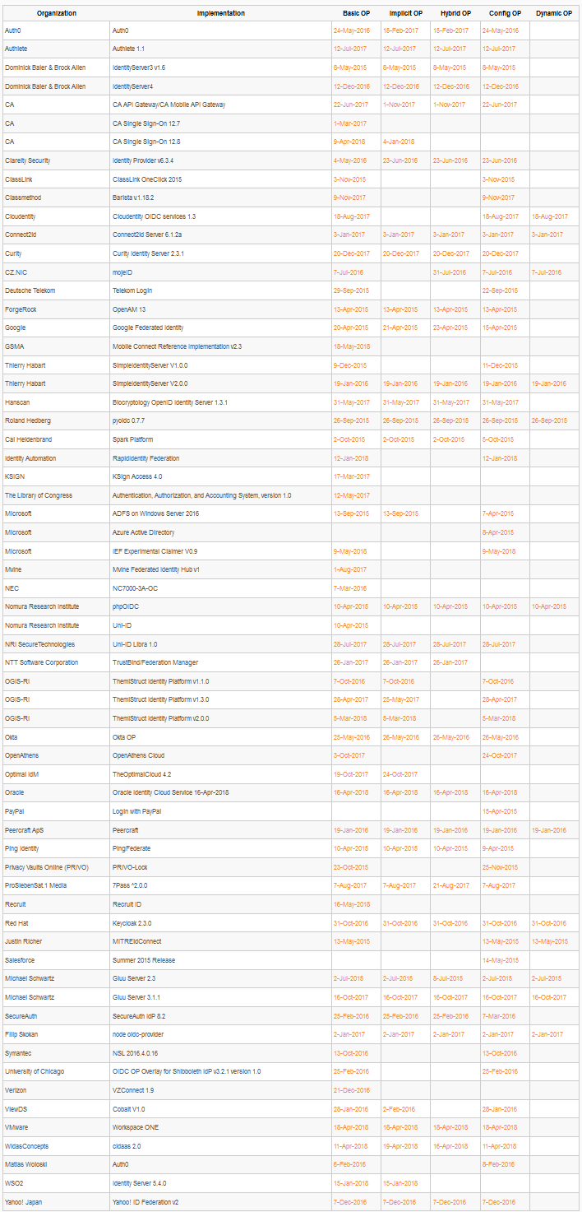
Who has achieved OP Certification?
OpenID Provider certifications at http://openid.net/certification/#OPs
189 profiles certified for 63 implementations by 53 organizations
Recent additions:
CA, GSMA, Identity Automation, Microsoft, OGIS-RI, Oracle, Recruit, VMware, WidasConcepts, WSO2
Each entry link to zip file with test logs and signed legal statement
Test results available for public inspection

Slide 26
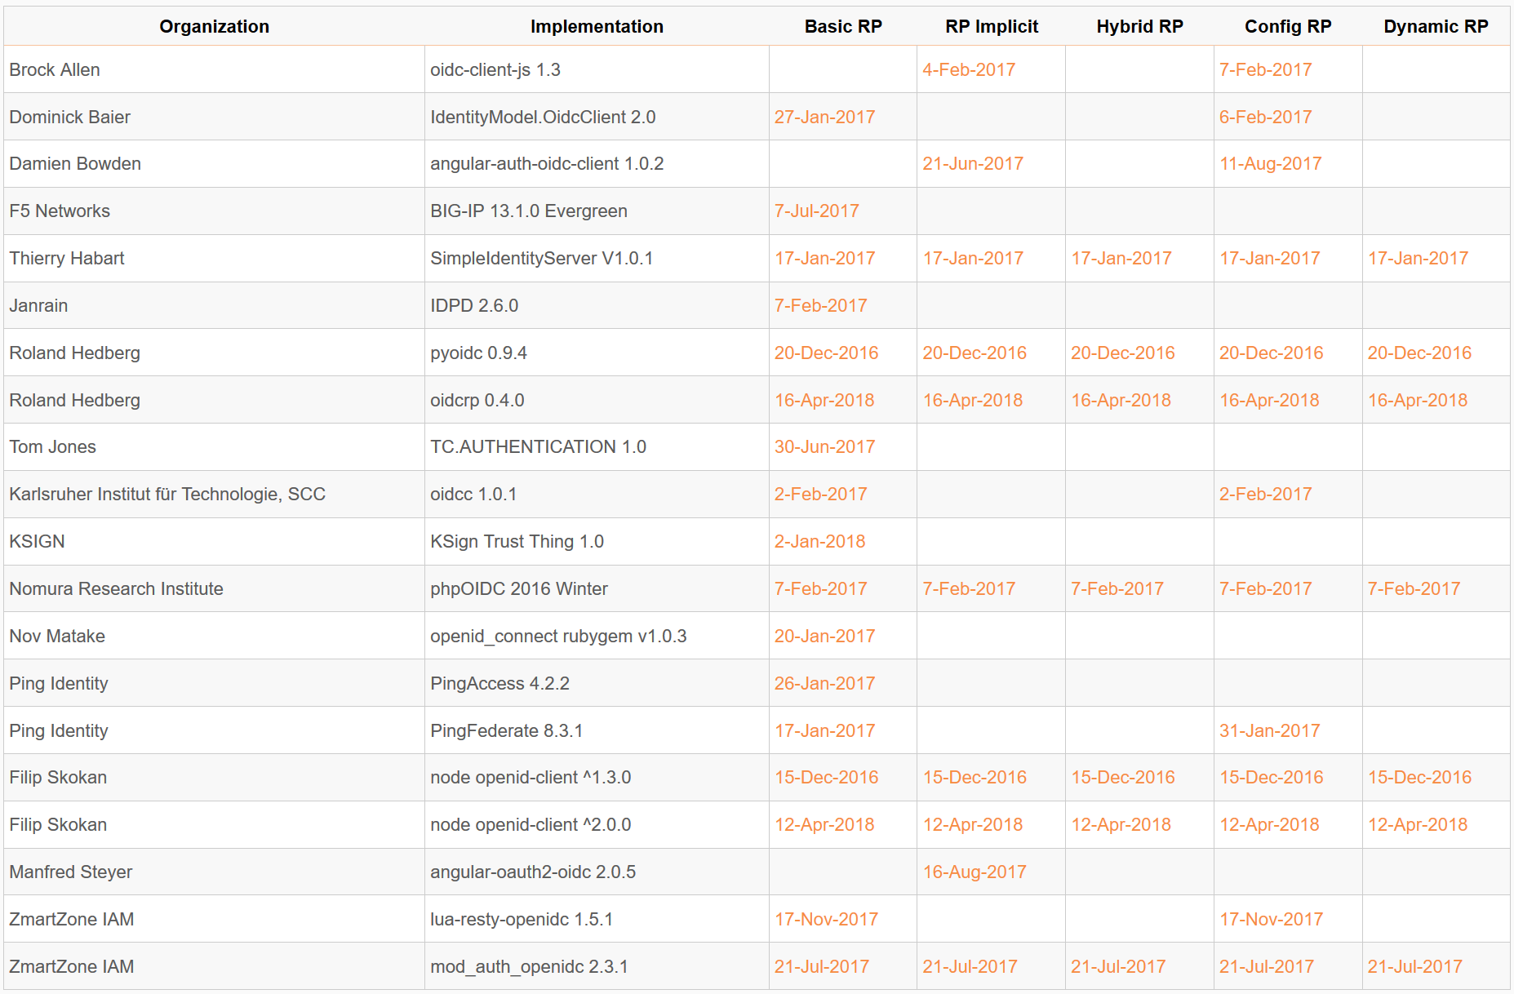
Who has achieved RP Certification?
Relying Party certifications at http://openid.net/certification/#RPs
54 profiles certified for 20 implementations by 16 organizations
Recent additions:
Roland Hedberg (for Python JWTConnect), KSIGN, Filip Skokan

Slide 27
What does certification cost?
Not a profit center for the OpenID Foundation
Fees there to help cover costs of operating certification program
Member price
$200 per new deployment
Non-member price
$999 per new deployment
$499 per new deployment of an already-certified implementation
Covers as many profiles as you submit within calendar year
New profiles in pilot mode are available to members for free
Costs described at http://openid.net/certification/fees/

Slide 28
New Work by Related Working Groups

Slide 29
MODRNA Working Group
Mobile Operator Discovery, Registration & authentication (MODRNA)
http://openid.net/wg/mobile/
OpenID Connect profile for Mobile Network Operators (MNOs)
Lets you easily sign in from your phone
Currently 4 Implementer’s Drafts + 2 other drafts
Specs used by GSMA’s Mobile Connect deployments

Slide 30
HEART Working Group
Health Relationship Trust (HEART)
http://openid.net/wg/heart/
Profiles for healthcare data exchange
Currently 5 Implementer’s Drafts

Slide 31
iGov Working Group
International Government Profile (iGov)
http://openid.net/wg/igov/
Profile for government & high-value commercial applications
Currently two drafts
International Government Assurance Profile (iGov) for OpenID Connect 1.0
International Government Assurance Profile Use Cases
Implementer’s Draft coming soon

Slide 32
EAP Working Group
Enhanced Authentication Profile (EAP)
http://openid.net/wg/eap/
Two drafts:
Token Binding for ID Tokens
Integration with phishing-resistant authentication such as FIDO
Implementers drafts coming soon

Slide 33
FAPI Working Group
Financial-grade API (FAPI)
http://openid.net/wg/fapi/
Enables secure access to financial information
Currently two Implementer’s Drafts
read-only access
read-write access
3 more specs in 5 part series being worked on

Slide 34
RISC Working Group
Risk and Incident Sharing and Coordination (RISC)
http://openid.net/wg/risc/
Voting to approve three Implementer’s Drafts under way
OpenID RISC Profile of IETF Security Events 1.0
OpenID RISC Event Types 1.0
OAuth Event Types 1.0
Action Item: Participate in the members vote before Friday at https://openid.net/foundation/members/polls/141
Can join OIDF for $25 at https://openid.net/foundation/members/

Slide 35
Where can I participate & learn more?
OpenID Blog
http://openid.net/
OpenID Connect Page
http://openid.net/connect/
OpenID Working Groups
http://openid.net/wg/
OpenID Certification
http://openid.net/certification/
OpenID Twitter Feed
@openid
My Blog
http://self-issued.info/
My Twitter Feed
@selfissued
E-mail me
mbj@microsoft.com

