Slide 1
Standards are the Nuts and Bolts of the Identity Engine*
* Warning: Some assembly required

Slide 2

Michael B. Jones
Principal, Self-Issued Consulting

Slide 3
Standards are about making choices

Slide 4

Phillip Hallam-Baker observed to me at an IETF meeting:
Standards make the choices that don’t matter.
What an odd thing to say,
but there’s a deep truth there.
Standards are about making choices

Slide 5
0x0800 is the EtherType value for IPv4 packets
6 is the IP protocol number for TCP packets
443 is the TCP port number for HTTPS octet streams
Choices that don’t matter
It doesn’t
matter that...
“GET” is the identifier for an HTTP request method
“HTTP/1.1 200 OK” indicates that an HTTP request succeeded
“application/json” is the Content-Type for JSON-encoded messages
65 is the number for the letter “A” in ASCII and Unicode
“{” and “}” delimit
JSON objects
“iss” and “sub” are identifiers in JSON objects for JWT claims

Slide 6


Making choices deeply matters!
Interoperability requires implementations making
the same choices
  Text can be input and displayed
  because everyone uses 65 for “A”
  HTTPS works because everyone
  uses TCP port 443
Standards are where those choices are written down
It’s our job as standards professionals to make
those choices

Slide 7
Standards are the nuts and bolts of the Identity Engine
When building machines, we take for granted having standard parts
Nuts, bolts, wires, light bulbs, and countless
other parts
  All conforming to applicable standards
  Enables a marketplace of interoperable parts
  from multiple suppliers
  Without these standards, every part would be
  custom machined
The same is true of the identity and security standards we use to build the Identity Engine

Slide 8
Some Assembly Required
Our identity and security standards vary wildly in the degree to which they make choices
  Some define one way to do things, resulting in interoperability
  Others leave critical choices unmade, passing them on to implementers
  Your mileage may vary!

Slide 9
Naming Names & Taking Prisoners
Next, I’ll critique existing and emerging identity and security standards through this lens
I’ll give each my personal grade on choices made
A
B
C
D
F
BEST
WORST

Slide 10


X.509 is a decades-old widely-deployed
digital certificate format
There are interoperable profiles of X.509
  Especially for TLS certificates
But choices have evolved over time
  Domain names used to be in the commonName field
  Now in Subject Alternate Name (SAN) field
Multiple revocation mechanisms
  Certificate Revocation Lists (CRLs)
  Online Certificate Status Protocol (OCSP)
X.509
Notes:
https://www.rfc-editor.org/rfc/rfc8392.html

Slide 11

SAML is the original single-sign-on protocol standard
There are interoperable SAML 2.0 ecosystems
  Each made many profiling choices to achieve this
SAML NameID contents vary
  Can be transient, persistent, unspecified, emailAddress, X509SubjectName, WindowsQualifiedDomainName, Kerberos, Entity
Multiple protocol flows
  Browser profile, Artifact Binding, Enhanced Client Proxy (ECP)
Multiple logout mechanisms
Dependent upon brittle XML Canonicalization
SAML 2.0
Notes:
https://www.oasis-open.org/standard/saml/

Slide 12


OAuth 2.0 enables limited access to
resources in controlled fashion
OAuth 2.0 is not interoperable without a profile
Different response_type values with different security properties
  code, token, and others defined by extensions
  scope values completely unspecified
Multiple token_type possibilities
  Bearer and others
RFC 6750 defines three ways to pass access token
  Header, Body Parameter, Query Parameters
OAuth 2.0: RFC 6749 & RFC 6750
Notes:
https://www.rfc-editor.org/rfc/rfc6749.html and https://www.rfc-editor.org/rfc/rfc6750.html

Slide 13

OpenID Connect is a widely-used sign-in standard
Interoperable ecosystem enabled because of choices made
  For instance, chose exact redirect_uri matching
  Interoperability evidence: 754 OpenID Connect certifications to date!
Building on OAuth 2.0 introduced more choices than ideal
  Six response types, each with different security properties
Three IdP-initiated logout mechanisms
  Two using browser features, one using server-to-server communication
OpenID Connect
Notes:
https://openid.net/specs/openid-connect-core-1_0.html

Slide 14
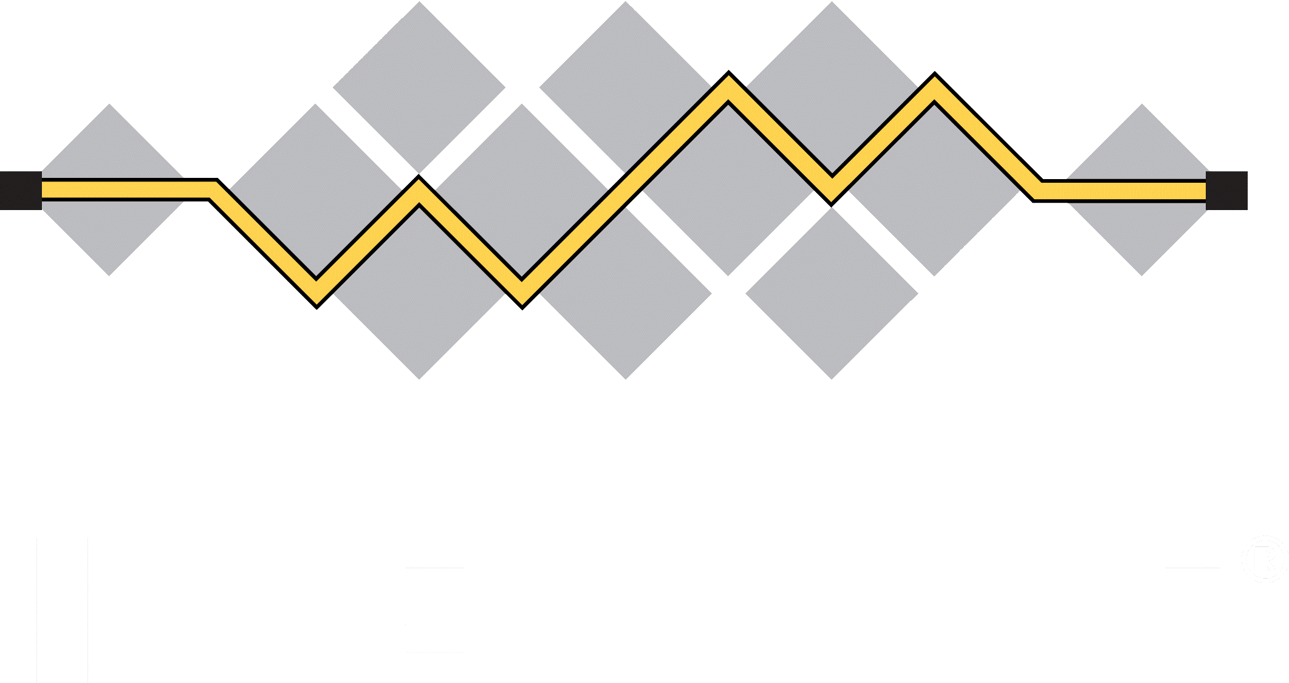
JWS is a widely-used JSON-based digital signature format
Compact serialization is the most used
JSON serialization was added late to satisfy vocal constituency
  JSON serialization also includes unprotected headers
Other than serialization choice, most choices made by spec
“alg” choice is needed to support cryptographic agility
JSON Web Signature (JWS)
Notes:
https://www.rfc-editor.org/rfc/rfc7515.html

Slide 15


JWT is a widely-used JSON-based digital token format in which secured claims are made about a subject
Requires JWS compact serialization be used
Yes, all claims are optional at the JWT level
Leaves room for profiles such as ID Token to specify claims used
JWT BCP [RFC 8725] further tightens choices made
Many interoperable implementations in different languages
JSON Web Token (JWT)
Notes:
https://www.rfc-editor.org/rfc/rfc7519.html

Slide 16
COSE is a widely-used binary signing and encryption format
COSE makes similar degree of choices
as JOSE (JWS, etc.)
Includes both protected and unprotected headers
Has some bells and whistles that JOSE doesn’t
  Such as countersignatures
Enough choices made to enable interoperability
CBOR Object Signing and Encryption (COSE)
Notes:
https://www.rfc-editor.org/rfc/rfc9052.html

Slide 17
CWT is a widely-used binary digital token format in which secured claims are made about a subject
CWT makes largely parallel choices to JWT
But does not narrow COSE features used (unlike JWT)
  Does not mandate using COSE_Sign1 over COSE_Sign
  Does not mandate that only protected headers be used
Same claims extensibility model as JWT
CBOR Web Token (CWT)
Notes:
https://www.rfc-editor.org/rfc/rfc8392.html

Slide 18

WebCrypto defines Web API for in-browser cryptographic operations
Only one way to perform any operation
Limited number of key formats using existing standards
  enum KeyFormat { "raw", "spki", "pkcs8", "jwk" };
Intentionally excludes functionality some wanted
  Use of platform keys
  Has led to non-standard extensions
WebCrypto
Notes:
https://www.w3.org/TR/WebCryptoAPI/

Slide 19

WebAuthn/FIDO 2 is deployed unphishable login infrastructure supported by all modern browsers
Evolved from and replaces U2F/CTAP 1
  Resulted in multiple signature formats, some X.509-based, some bare
Multiple and evolving attestation formats
Numerous extensions with varying degree of implementation
  Which extensions will be ubiquitously supported is still TBD
WebAuthn/
FIDO 2
Notes:
https://www.w3.org/TR/2021/REC-webauthn-2-20210408/ and https://fidoalliance.org/specs/fido-v2.1-ps-20210615/fido-client-to-authenticator-protocol-v2.1-ps-errata-20220621.html

Slide 20
VCs represent cryptographically secured claims by an issuer about a subject
VC 1.0, 1.1, and 2.0 made different choices
  VC 2.0 not backwards compatible with previous versions
Two ways of signing VCs, each with
sub-variants
  VC-JOSE-COSE supports JWS, COSE, and SD-JWT signatures over JSON-LD payload
  VC-DATA-INTEGRITY canonicalizes JSON-LD payload, converts it to RDF N-Quads, and signs over the RDF (or can use JCS [RFC 8785])
W3C Verifiable Credentials
Notes:
https://www.w3.org/TR/vc-data-model-2.0/, https://www.w3.org/TR/vc-jose-cose/, https://www.w3.org/TR/vc-data-integrity/, https://www.rfc-editor.org/rfc/rfc8785.html

Slide 21

DIDs are a framework for identifiers about subjects not dependent upon central authorities
Each kind of DID has its own DID method and algorithms
DID spec defines operations that DID Methods must implement
As of this writing, there are 193 registered
DID Methods!
  None are mandatory to implement, giving no interop guarantee
  DID Methods are out of scope for the newly rechartered DID WG!
Decentralized Identifiers (DIDs)
Notes:
https://www.w3.org/TR/did-core/ and https://w3c.github.io/did-spec-registries/#did-methods

Slide 22


Defines multiplicity of encodings for binary data
The Multibase spec defines 23 equivalent and non-interoperable representations for the same data!
  base64*, base58*, base36*, base32* , hex*, decimal, base8, base2, binary
  Interop requires either implementing them all or profiles choosing some
Multiformats institutionalize the failure to make a choice!
Warning: Multiformats are used by VC-DATA-INTEGRITY and DIDs
So bad, I wrote “Multiformats Considered Harmful” post!
Multiformats
Notes:
https://datatracker.ietf.org/doc/html/draft-multiformats-multibase-03#appendix-D.1

Slide 23
Closing Remarks on Choices

Slide 24
Enabling layered protocols
is a choice
Ethernet packet types are identified by EtherType
IPv4 protocols are identified by protocol number
TCP protocols are identified by port number
JWT types are identified by the “typ” header parameter
These all enable higher-level protocols to be layered over them

Slide 25
Planning for evolution
is a choice
Sometimes it’s necessary for choices to change over time
Particularly as the security threat landscape evolves
For instance, enabling cryptographic agility is a must
Which algorithms are secure changes over time
Only supporting a fixed algorithm would be a bad choice!

Slide 26
Extensibility is a choice
All the specifications I’ve discussed have extensibility points
  Extensibility enables new features to be added
    Such as adding DPoP to OAuth 2.0
  Extensibility enables new layered applications and protocols
    Such as adding an ID Token to OAuth 2.0 for OpenID Connect
Use extension methods that don’t break existing deployments
  For instance, the “If you don’t understand it, you MUST ignore it” logic for OAuth 2.0 request parameters and JWT claims has served us well

Slide 27
Standards are about making choices,
so make good ones!

Slide 28

Thank you
This presentation and more are available at: https://self-issued.info

