Slide 1
Celebrating Ten Years of OpenID Connect
Michael B. Jones
Self-Issued Consulting

Slide 2
Looking Back and Looking Forward
OpenID Connect became final in February 2014
Today I’ll briefly share my thoughts on
How we created OpenID Connect
What we achieved together
Lessons learned

Slide 3
In the Beginning
Artifact Binding for OpenID 2.0 started in 2010
Hence the openid-specs-ab@lists.openid.net mailing list name
But developers were choosing JSON/REST over XML/SOAP
Pivoted to instead create JSON/REST protocol over OAuth 2.0
Result branded “OpenID Connect” at IIW in May 2011
Five rounds of interop testing between 2011 and 2013!
Specifications refined after each round of interop testing
Early developer feedback was priceless

Slide 4
Design Philosophy
Keep simple things simple
Make complex things possible

Slide 5
The Nov Matake Test
As we considered new features, we’d ask ourselves:
Would Nov want to add it to his implementation?
Is it simple enough that he could build it in a few hours?

Slide 6
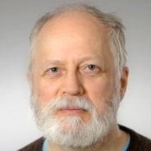
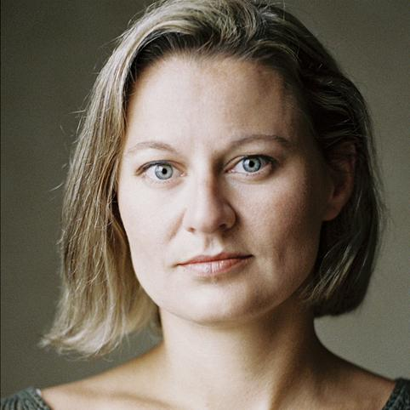
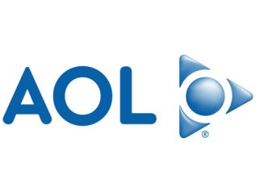
Broad Participation
OpenID Connect

Slide 7
Learning from the Past
Architects had extensive SAML and OpenID 2.0 experience
Borrowed ideas that already worked well
Metadata
Authentication Contexts
Added useful things that were previously hard or missing
Support for native applications
Encrypted claims
Signed requests

Slide 8
Extensible by Design
Successful systems have to adapt and grow
Always specified that “additional values may be used”
And specified that not-understood values don’t cause errors
Enables adding things without breaking existing deployments
Indeed, many successful Connect (and OAuth) extensions have been created and deployed
Including logout and identity assurance

Slide 9
Built using Modular Components
Created components and features we needed in parallel
JSON Web Signature (JWS)
JSON Web Encryption (JWE)
JSON Web Key (JWK)
JSON Web Token (JWT)
WebFinger
ID Token

Slide 10
What We Achieved
Most used identity protocol
Thousands of interoperable implementations
In every conceivable language
Certification Program making interop a reality
ISO accepted our submission for republication

Slide 11
Innumerable OpenID Connect Deployments
Android, AOL, Apple, AT&T, Auth0, Deutsche Telekom, ForgeRock, Google, GrabTaxi, GSMA Mobile Connect, IBM, KDDI, Microsoft, NEC, NRI, NTT, Okta, Oracle, Orange, Ping Identity, Red Hat, Salesforce, Softbank, Symantec, Telefónica, Verizon, Yahoo, Yahoo! Japan, all use OpenID Connect
And many MANY more!

Slide 12
Lessons Learned
Developers choose things that are simple
Developer choice critical to adoption
Interoperability and security require rigorous testing
OpenID Certification program was essential to Connect’s success
Extensibility is critical to long-term success
Deployments have to be easy to use (or they won’t be used)
Most RPs limited IdP choice as a simplification
Even though Connect was designed to give users complete choice
Not everything works out the way you planned
Developer and deployer feedback is gold!

Slide 13
OpenID and the Enterprise
Chuck Mortimore
Disney (Salesforce at the time)

Slide 14
Cloud Identity
Summit
2011

Slide 17
What I think I was saying:
Canonicalization is hard regardless of serialization
We are unwilling to implement WS-* and need an objection handler.
What actually happened:
Simplicity won: WS-* was replaced*
We created the Basic Implementors draft
*and almost all of the same patterns exist in our current standards stack

Slide 19
What I think I was saying:
Enterprises are adopting iPhones and we’re not ready
We need fine grained control over app and data access
We need to federate with mobile apps
What actually happened:
Application frameworks for contextual policy
Embedded WebView in mobile apps == reuse of web federation

Slide 21
What I think I was saying:
The firewall is moving around and loosing importance
Core services, including identity, will move to the cloud
What actually happened:
Artifact profiles that actually scale
SSO get tokens
Applications become composites

Slide 23
What I think I was saying:
Cloud adoption is just-in-time for certain users/companies
SAML JIT works but integration heavy
I miss LDAP and it’s standard yet extensible schema
What actually happened:
Standardized schema
SCIM

Slide 27
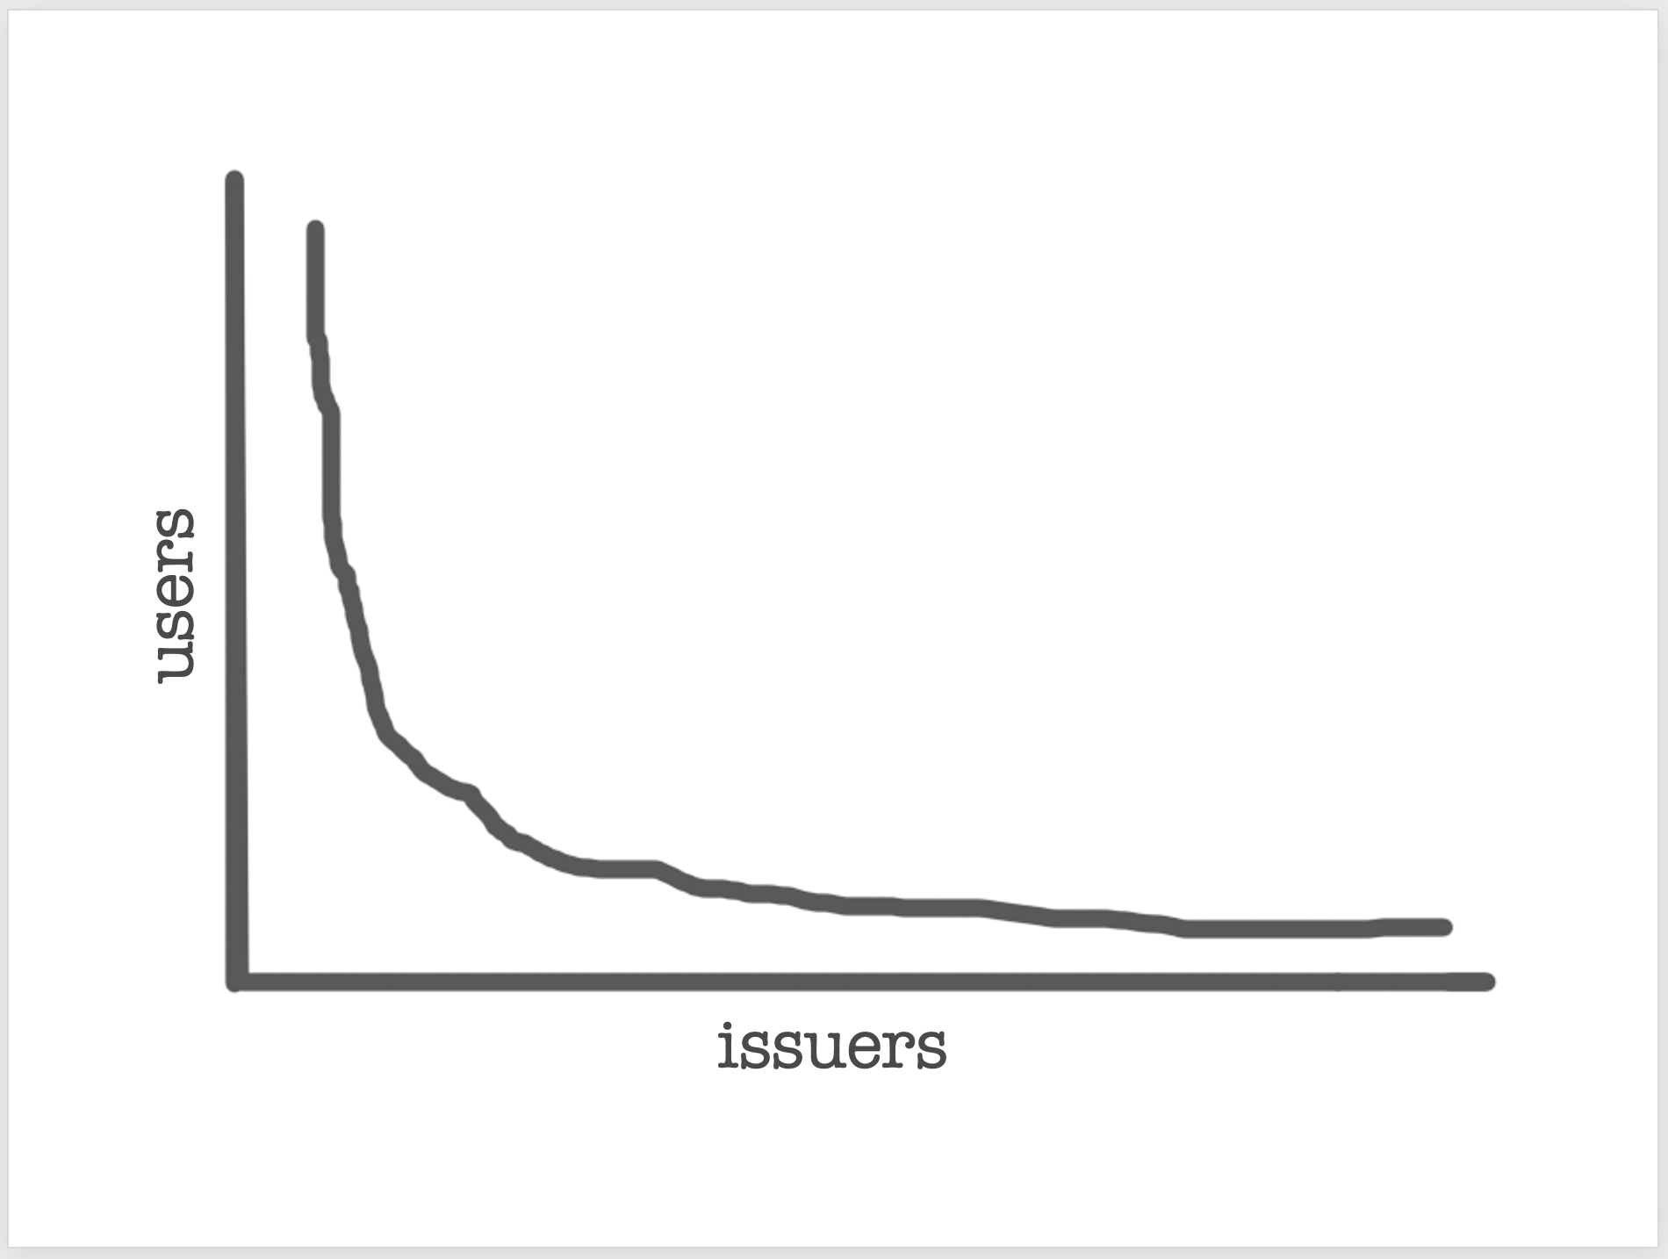

Slide 28
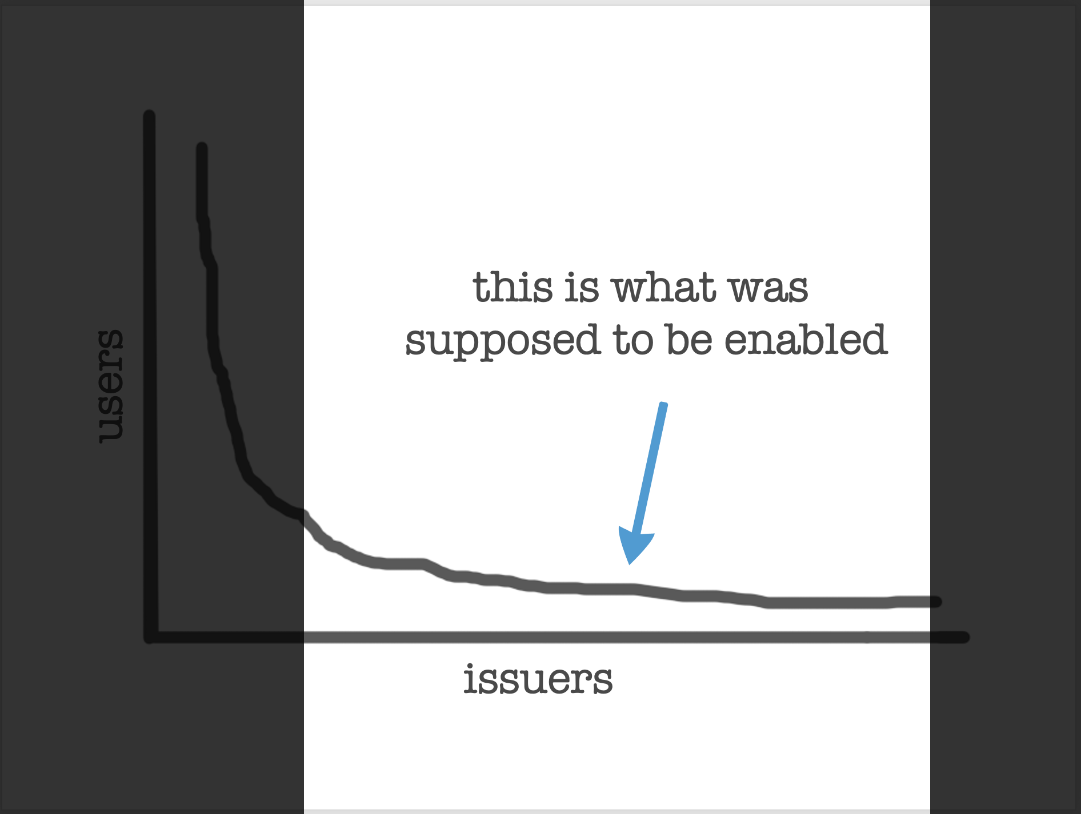

Slide 29
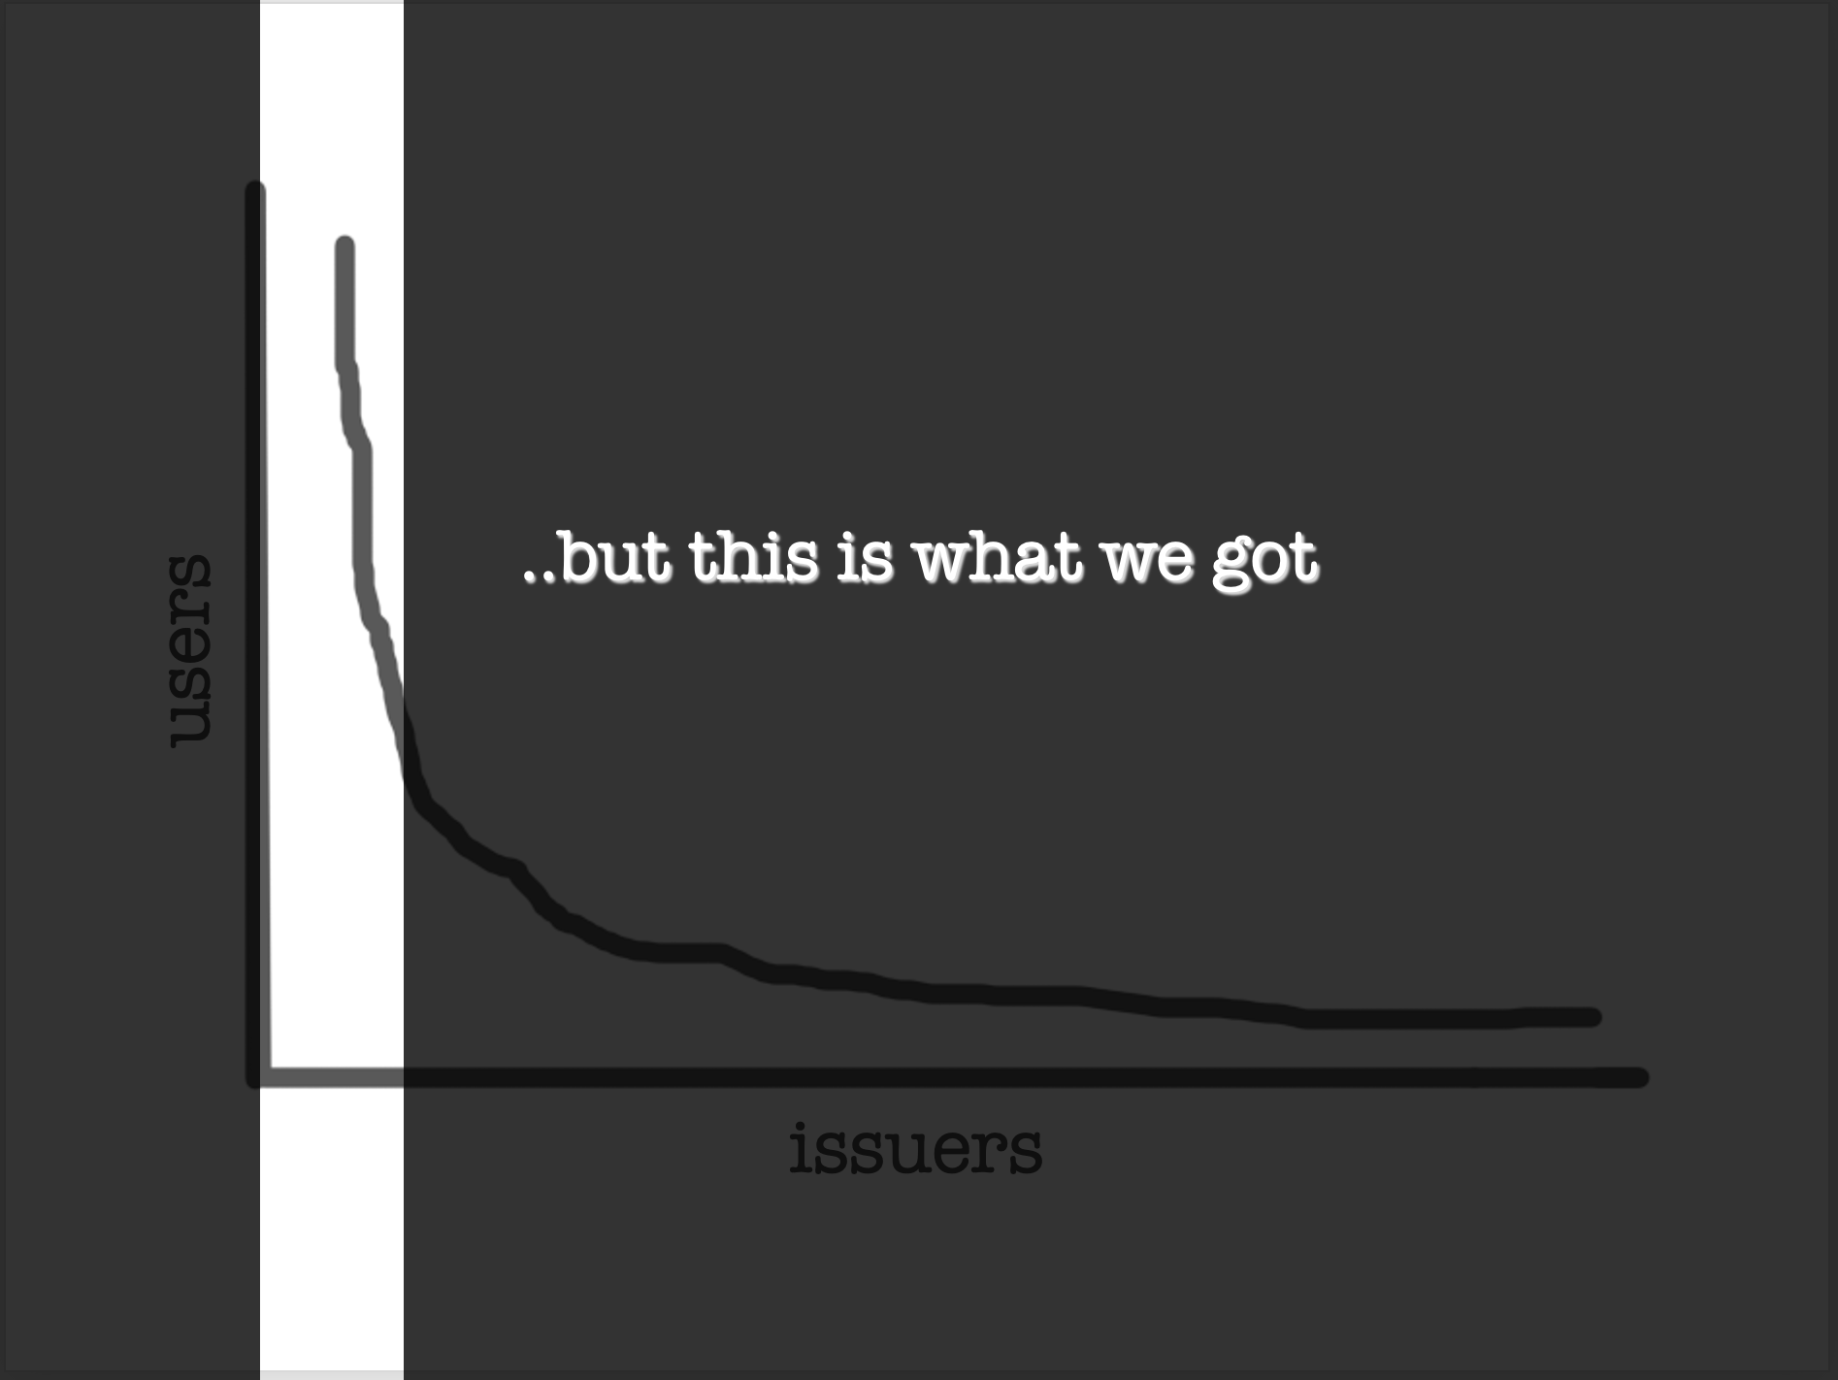

Slide 31
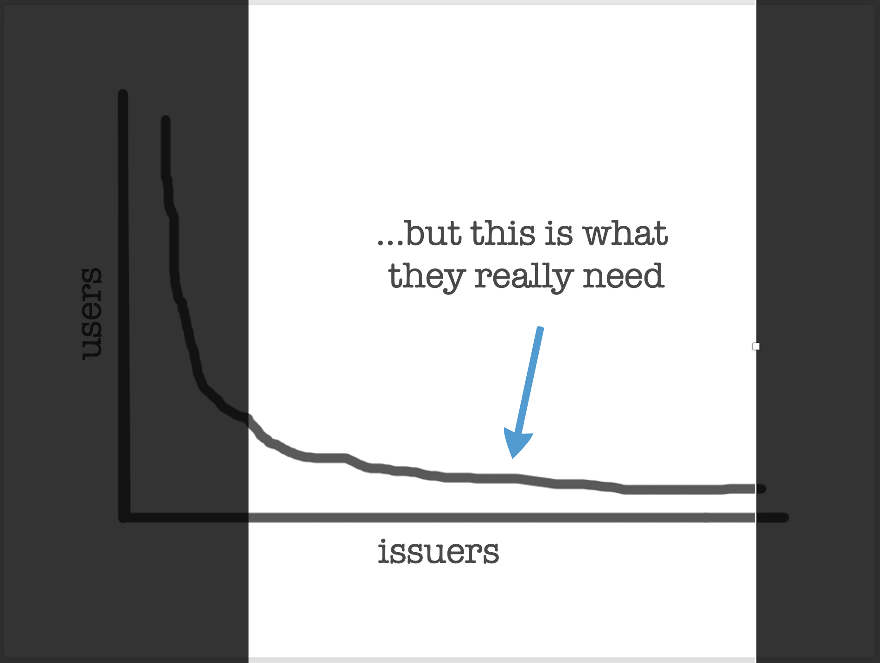

Slide 32
What I think I was saying:
Enterprises are complex ecosystems and 1 IDP doesn’t cut it
Despite empirical lack of success, user-centric is important
What actually happened:
Cloud IDPs
New Types of Identity Discovery
User-centric becomes SSI and it still seeking scale

Slide 33
25 years of OpenID
~ at the 10th Anniversary of the OpenID Connect Final
_nat
https://www.sakimura.org
Nat Sakimura
Chairman of the board, OpenID Foundation
https://youtube.com/@55id
https://www.linkedin.com/in/natsakimura

Slide 34
OpenID 1.0
Brad Fitzpatrick et al.
1999
2001
2007
2014
OpenID.net
David Lehn
OpenID 2.0
David Recordon et al.
OpenID Connect
Nat Sakimura et al.
Notes:
2002 which evolved to SAML 2.0 in 2005. It leveraged XML, XML Signature, and SOAP.
Independent of it, OpenID 1.1, which tried to use one’s weblog address as his identifier came in 2006 and quickly evolved to OpenID 2.0.
It was based on key=value pairs.
Many people disapproved it as insecure but it gained popularity never-the-less. In fact, many of you are still using it and that is for payment.
How many of you use Amazon to buy things? Amazon’s check-out is still using OpenID Authentication 2.0.
Also, it was December 4 at the Computer History Museum, that OAuth 1.0 was agreed upon.
In the beginning of the same year, a very important event in the computer history happened.

Slide 35
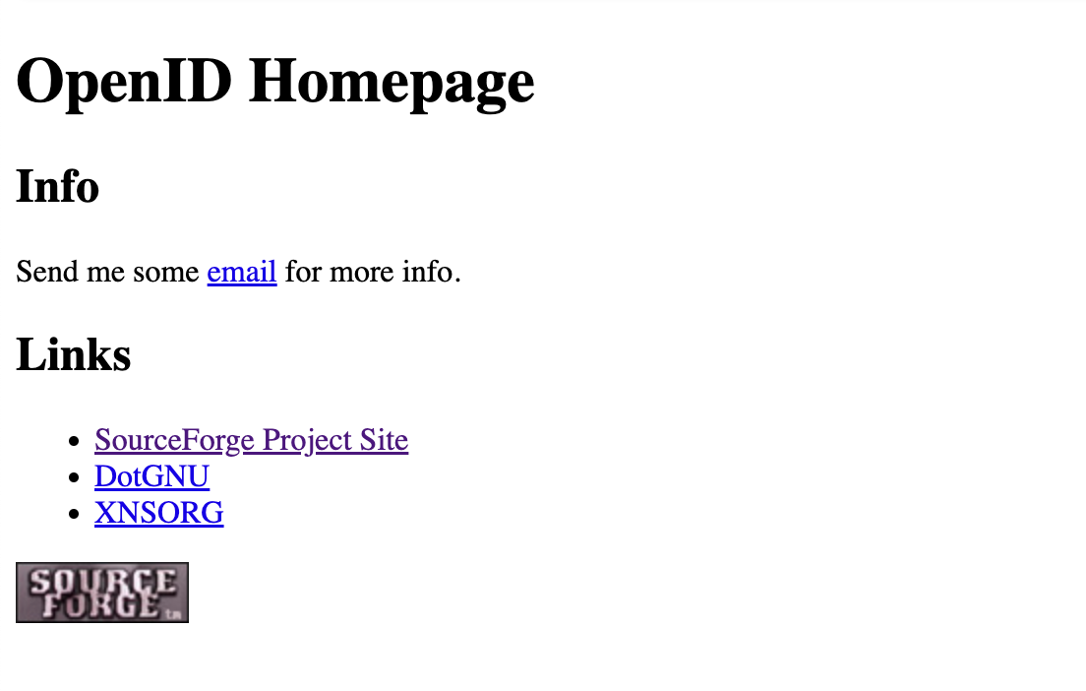
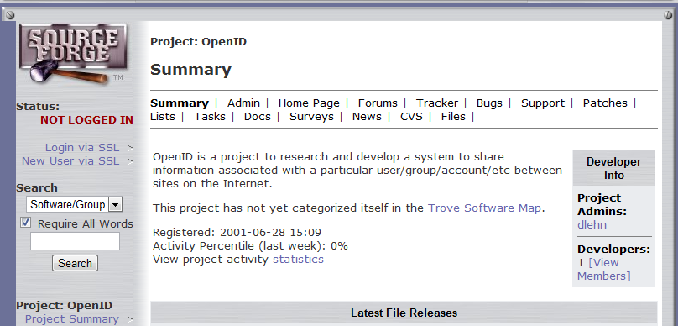

Slide 36
XNS.org
Drummond Reed et al.
OpenID 1.0
Brad Fitzpatrick et al.
1999
2001
2007
2014
OpenID.net
David Lehn
OpenID 2.0
David Recordon et al.
OpenID Connect
Nat Sakimura et al.
Notes:
2002 which evolved to SAML 2.0 in 2005. It leveraged XML, XML Signature, and SOAP.
Independent of it, OpenID 1.1, which tried to use one’s weblog address as his identifier came in 2006 and quickly evolved to OpenID 2.0.
It was based on key=value pairs.
Many people disapproved it as insecure but it gained popularity never-the-less. In fact, many of you are still using it and that is for payment.
How many of you use Amazon to buy things? Amazon’s check-out is still using OpenID Authentication 2.0.
Also, it was December 4 at the Computer History Museum, that OAuth 1.0 was agreed upon.
In the beginning of the same year, a very important event in the computer history happened.

Slide 37
OpenID Authentication 2.0
(key=value)
Brad Fitzpatrick
David Recordon
Josh Hoyt
XNS.org
Drummond Reed et al.
SAML 1.0
OpenID 1.0
Brad Fitzpatrick
1999
2001
2002
2005
2007
2014
OpenID.net
David Lehn
SAML 2.0
(XML, XML DSIG, SOAP)
Notes:
2002 which evolved to SAML 2.0 in 2005. It leveraged XML, XML Signature, and SOAP.
Independent of it, OpenID 1.1, which tried to use one’s weblog address as his identifier came in 2006 and quickly evolved to OpenID 2.0.
It was based on key=value pairs.
Many people disapproved it as insecure but it gained popularity never-the-less. In fact, many of you are still using it and that is for payment.
How many of you use Amazon to buy things? Amazon’s check-out is still using OpenID Authentication 2.0.
Also, it was December 4 at the Computer History Museum, that OAuth 1.0 was agreed upon.
In the beginning of the same year, a very important event in the computer history happened.

Slide 38
OpenID Authentication 2.0
(key=value)
Brad Fitzpatrick
David Recordon
Josh Hoyt
XNS.org
Drummond Reed
SAML 1.0
OpenID 1.0
Brad Fitzpatrick
OpenID AX
Dick Hardt
1999
2001
2002
2005
2007
2008
2012
2014
OpenID.net
David Lehn
SAML 2.0
(XML, XML DSIG, SOAP)
OAuth 1.0
(Key=value)
E. Hammer-Lahav
OpenID TX/CX Proposal
Nishitani/Sakimura
Notes:
2002 which evolved to SAML 2.0 in 2005. It leveraged XML, XML Signature, and SOAP.
Independent of it, OpenID 1.1, which tried to use one’s weblog address as his identifier came in 2006 and quickly evolved to OpenID 2.0.
It was based on key=value pairs.
Many people disapproved it as insecure but it gained popularity never-the-less. In fact, many of you are still using it and that is for payment.
How many of you use Amazon to buy things? Amazon’s check-out is still using OpenID Authentication 2.0.
Also, it was December 4 at the Computer History Museum, that OAuth 1.0 was agreed upon.
In the beginning of the same year, a very important event in the computer history happened.

Slide 39
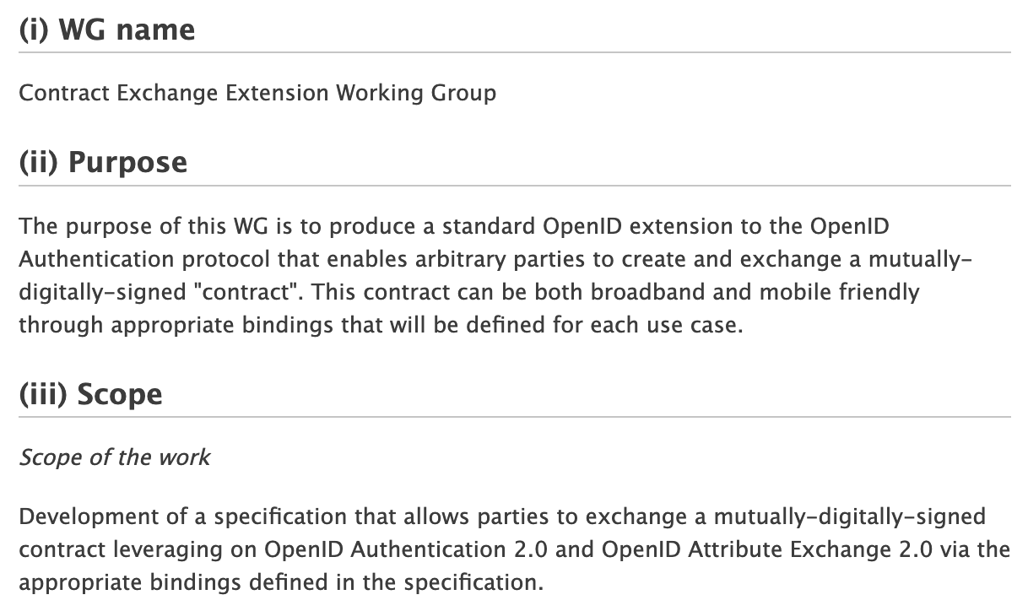

Slide 40
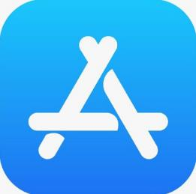
2007
2008
Notes:
Introduction of iPhone.
In the subsequent year, another game changing event, possibly even more important than the iPhone itself emerged.
AppStore Ecosystem.

Slide 41
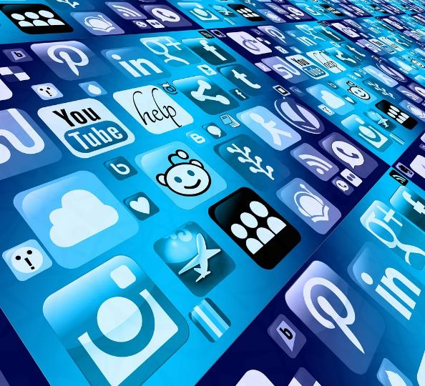
Untrusted Apps
Notes:
Suddenly, we were faced with gazzilion of potentially mis-behaved untrusted apps that needed to
Identify the user, and access APIs.

Slide 42
Give passwords (full right) to all of them?
Notes:
Should we then give passwords to them? Giving password to them mean that they will be able to impersonate you. Should we?

Slide 43
Bad Idea
Notes:
Noooo. That’s a bad idea.

Slide 44
Audienced identity & Minimum access authorization
Notes:
What we should do instead is to give were the “audienced identity” so that it cannot be reused against other party,
And the minimum access authorization for the app to function.

Slide 45
ID Token & Access Token
Notes:
They turned into ID Token & Access Token eventually.

Slide 46
Problems of SAML, OpenID Authentication 2.0, OAuth 1.0
Notes:
Given the situation, either using SAML or OpenID 2.0 for conveying audience identity and OAuth to convey the access authorization seemed to be the right way to do.
However, all of them shared same problems. They were brittle. By the year 2009, developer feedback was loud and clear.

Slide 47
OpenID Authentication 2.0
(key=value)
Brad Fitzpatrick
David Recordon
Josh Hoyt
XNS.org
Drummond Reed
SAML 1.0
OpenID 1.0
Brad Fitzpatrick
OpenID AX
Dick Hardt
1999
2001
2002
2005
2007
2008
2009
2012
2014
OpenID.net
David Lehn
SAML 2.0
(XML, XML DSIG, SOAP)
OAuth 1.0
(Key=value)
E. Hammer-Lahav
OpenID TX/CX Proposal
Nishitani/Sakimura
FAPI
Notes:
2002 which evolved to SAML 2.0 in 2005. It leveraged XML, XML Signature, and SOAP.
Independent of it, OpenID 1.1, which tried to use one’s weblog address as his identifier came in 2006 and quickly evolved to OpenID 2.0.
It was based on key=value pairs.
Many people disapproved it as insecure but it gained popularity never-the-less. In fact, many of you are still using it and that is for payment.
How many of you use Amazon to buy things? Amazon’s check-out is still using OpenID Authentication 2.0.
Also, it was December 4 at the Computer History Museum, that OAuth 1.0 was agreed upon.
In the beginning of the same year, a very important event in the computer history happened.

Slide 48
OpenID Authentication 2.0
(key=value)
Brad Fitzpatrick
David Recordon
Josh Hoyt
OpenID AB WG
(Key=value?)
XNS.org
Drummond Reed
SAML 1.0
OpenID 1.0
Brad Fitzpatrick
OpenID AX
Dick Hardt
1999
2001
2002
2005
2007
2008
2009
2010
2012
2014
OpenID.net
David Lehn
SAML 2.0
(XML, XML DSIG, SOAP)
OAuth 1.0
(Key=value)
E. Hammer-Lahav
OpenID TX/CX Proposal
Nishitani/Sakimura
Notes:
2002 which evolved to SAML 2.0 in 2005. It leveraged XML, XML Signature, and SOAP.
Independent of it, OpenID 1.1, which tried to use one’s weblog address as his identifier came in 2006 and quickly evolved to OpenID 2.0.
It was based on key=value pairs.
Many people disapproved it as insecure but it gained popularity never-the-less. In fact, many of you are still using it and that is for payment.
How many of you use Amazon to buy things? Amazon’s check-out is still using OpenID Authentication 2.0.
Also, it was December 4 at the Computer History Museum, that OAuth 1.0 was agreed upon.
In the beginning of the same year, a very important event in the computer history happened.

Slide 49
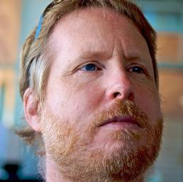
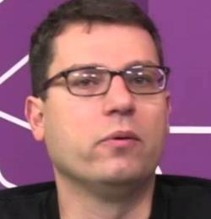
Nat Sakimura
(NRI [当時])
John Bradley
(Mercenary working for NRI [当時])
Breno de Madeiros
(Google)
Notes:
There, I, John Bradley, and Breno de Madiros of Google sat down together and started designing a new protocol that could unify both SAML and OpenID 2.0.
There were a few early design decisions. They were

Slide 50
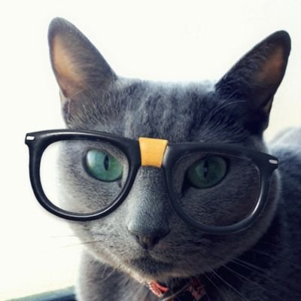
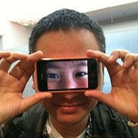
Nat Sakimura
(NRI [当時])
John Bradley
(Mercenary working for NRI [当時])
Breno de Madeiros
(Google)
Ryo Ito
(Yahoo! Japan [当時])
Hideki Nara
(Tact [当時])
Notes:
There, I, John Bradley, and Breno de Madiros of Google sat down together and started designing a new protocol that could unify both SAML and OpenID 2.0.
There were a few early design decisions. They were

Slide 51
Early design decisions:
No canonicalization
ASCII Armoring
JSON
REST
JSON Simple
Signature (JSS)
& Encryption (JSE)
Notes:
No canonicalization, ASCII Armoring, JSON, REST
This meant that we needed to have a new Signature and Encryption format.
So, <click> we created JSS & JSE.

Slide 52
Then, there was a parallel work Magic Signature & JSON Token
Dirk Balfanz
John Panzer
Notes:
Then, there was a parallel work called Magic Signature & JSON Token by two goolgers: Dirk Balfanz and John Panzer.

Slide 53
And there came Mike Jones
“You guys should come together and standardize it at IETF. Don’t worry. I can take care of the editing!”
JSON Simple
Signature (JSS)
& Encryption (JSE)
JWx
Magic Signature & JSON Tokens
Notes:
And there came Mike Jones saying:
“You guys should come together and standardize it at IETF. Don’t worry. I can take care of the politics and editing!”
That resulted in JWx series of specification such as:

Slide 54
JWx
JWS: JSON Web Signature
JWE: JSON Web Encryption
JWT: JSON Web Token etc.
Notes:
JWS, JWE, and JWT.

Slide 55
Early design decisions:
No canonicalization
ASCII Armoring
JSON
REST
JWx
Notes:
So, we decided to base the signature and tokenization on JWx.
The 6th decision came somewhat later.
For our point of view, Oauth 1.0 had unnecessary overhead: it had key=value based signature and had the same problem with OpenID 2.0.
Then <click>Dick Hart and Alan Tom came up with

Slide 56
Early design decisions:
No canonicalization
ASCII Armoring
JSON
REST
JWx
Base on OAuth WRAP
Dick Hardt
2.0
Allen Tom
Notes:
OAUth WRAP, which had no intrinsic signature in it. That was a perfect building block for us.
That, later, became Oauth <click> 2.0

Slide 57
OpenID Authentication 2.0
(key=value)
Brad Fitzpatrick
David Recordon
Josh Hoyt
OpenID AB WG
(Key=value?)
XNS.org
Drummond Reed
OpenID Connect 1.0
SAML 1.0
OpenID 1.0
Brad Fitzpatrick
OpenID AX
Dick Hardt
1999
2001
2002
2005
2007
2008
2009
2010
2012
2014
OpenID.net
David Lehn
SAML 2.0
(XML, XML DSIG, SOAP)
OAuth 1.0
(Key=value)
E. Hammer-Lahav
OAuth 2.0
(Key=value)
Dick Hardt
OpenID TX/CX Proposal
Nishitani/Sakimura
Notes:
2002 which evolved to SAML 2.0 in 2005. It leveraged XML, XML Signature, and SOAP.
Independent of it, OpenID 1.1, which tried to use one’s weblog address as his identifier came in 2006 and quickly evolved to OpenID 2.0.
It was based on key=value pairs.
Many people disapproved it as insecure but it gained popularity never-the-less. In fact, many of you are still using it and that is for payment.
How many of you use Amazon to buy things? Amazon’s check-out is still using OpenID Authentication 2.0.
Also, it was December 4 at the Computer History Museum, that OAuth 1.0 was agreed upon.
In the beginning of the same year, a very important event in the computer history happened.

Slide 58
What we have achieved

Slide 59
A protocol that defines for a client how to request and for the server to provide the ID Token
ID Token
JWS/JWE/JWKS
OAuth 2.0
HTTPS
Notes:
A modular, layered protocol that defines for a client how to request and for the server to provide the ID Token.

Slide 60
That is perfectly fit for modern identity and access control frameworks
Policy
PAP
Admin
PDP
metadata
Entity
Authentication Server
Authenticated Identity
PEP
Provides Claims
username
password
Geo-location
Device info
Etc.
Resource
AuthN
Real Name
Employee number
Professional
qualification
PEP2
Identity Register
department
Geo-location
Audit
Anomaly
Detection
ID Token
Log
Notes:
Enterprise access control but use-case is not limited for that.

Slide 61
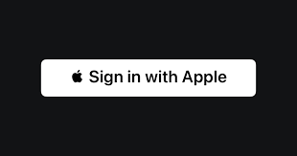
The mainstream federated identity system
Social Login
National Identity

Slide 62
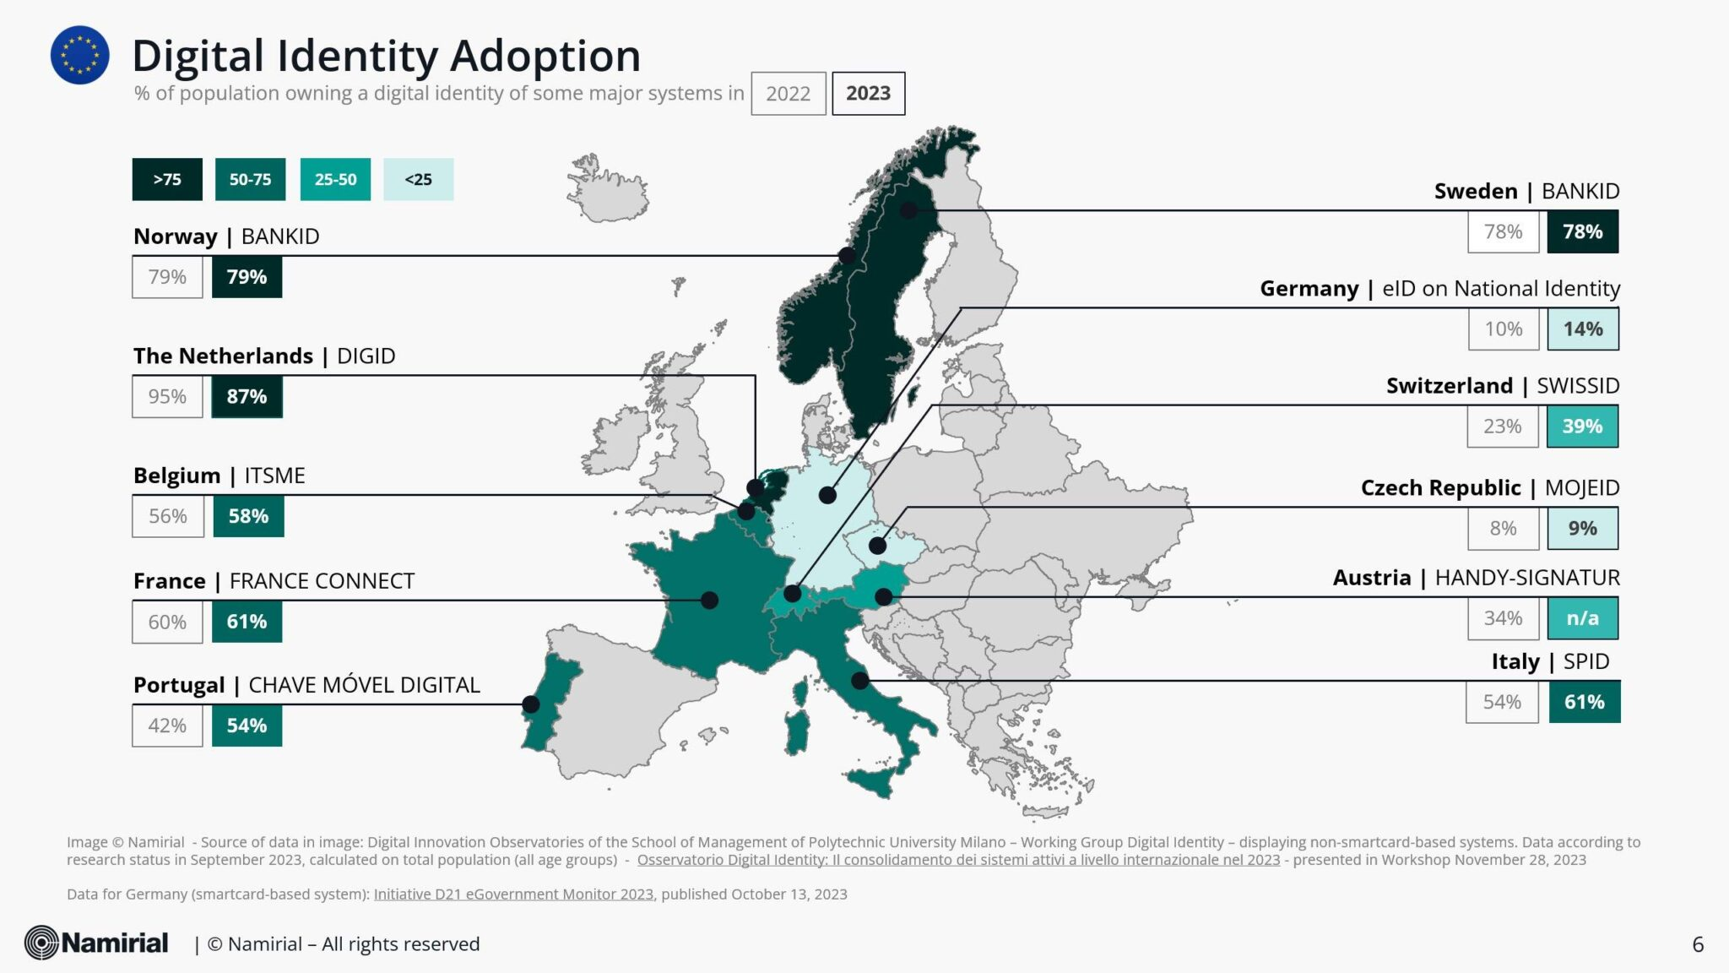
The mainstream federated identity system
Social Login
National Identity
(Source) Based on https://www.namirial.com/en/news/state-of-play-on-adoption-of-digital-identity-in-italy-2023-all-roads-lead-to-the-wallets/

Slide 63
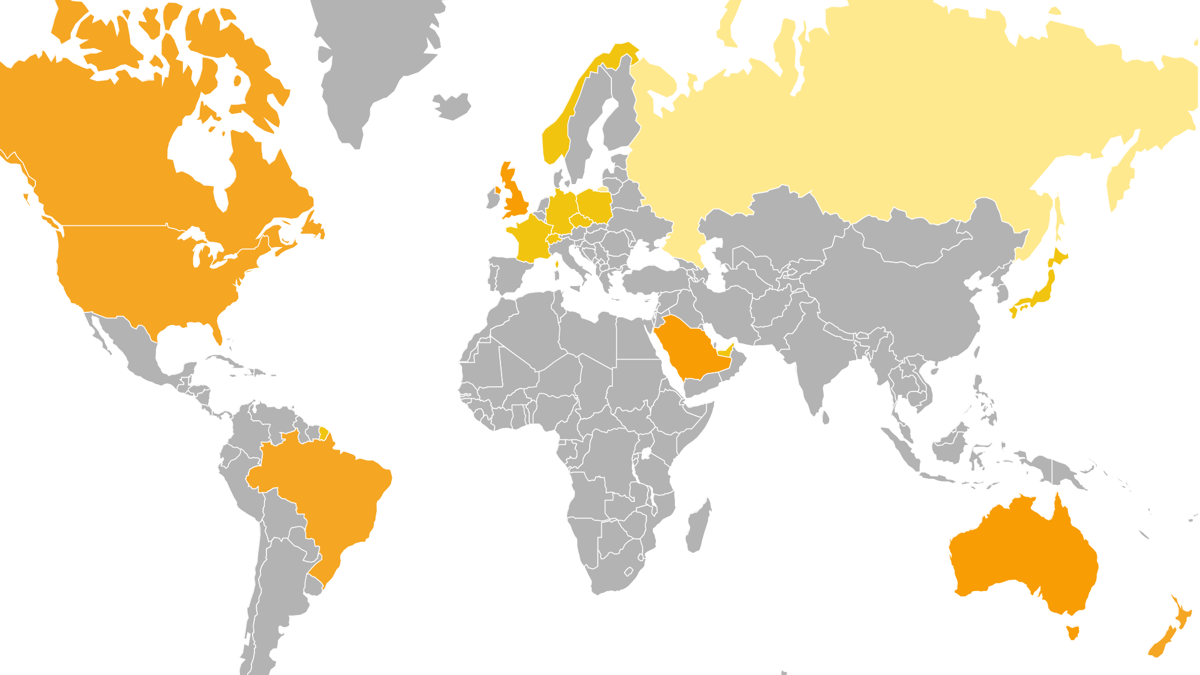
Formed the basis of Open Finance
FAPI 1.0 ID2 with GOST crypto algorithm
HelseID
Open Banking UK
live 2019
yes/Verimi
FDX
Minna No Ginko + recommendation by banking association
Open Banking
OpenFinance OpenInsurance live July 2021
Consumer Data Right live July 2020
ConnectID

Slide 64
How we achieved it
Listening to developer feedback
Solve what was not solved
No Canonicalisation
Dead Simple for simple use-cases
Security and Privacy Facilities

Slide 65
What lessons we learned that could apply to other initiatives
Learn from History
Make it simple to read, simple to implement for the minimum viable case
Find the developer pain and solve it

Slide 66
OpenID: there is no spoon

Slide 67
John
Bradley
Principal Architect
Yubico
AKA Mercenary

Slide 68
OpenID is more than a single specification or Idea
Insert inciteful comment….

