Slide 1
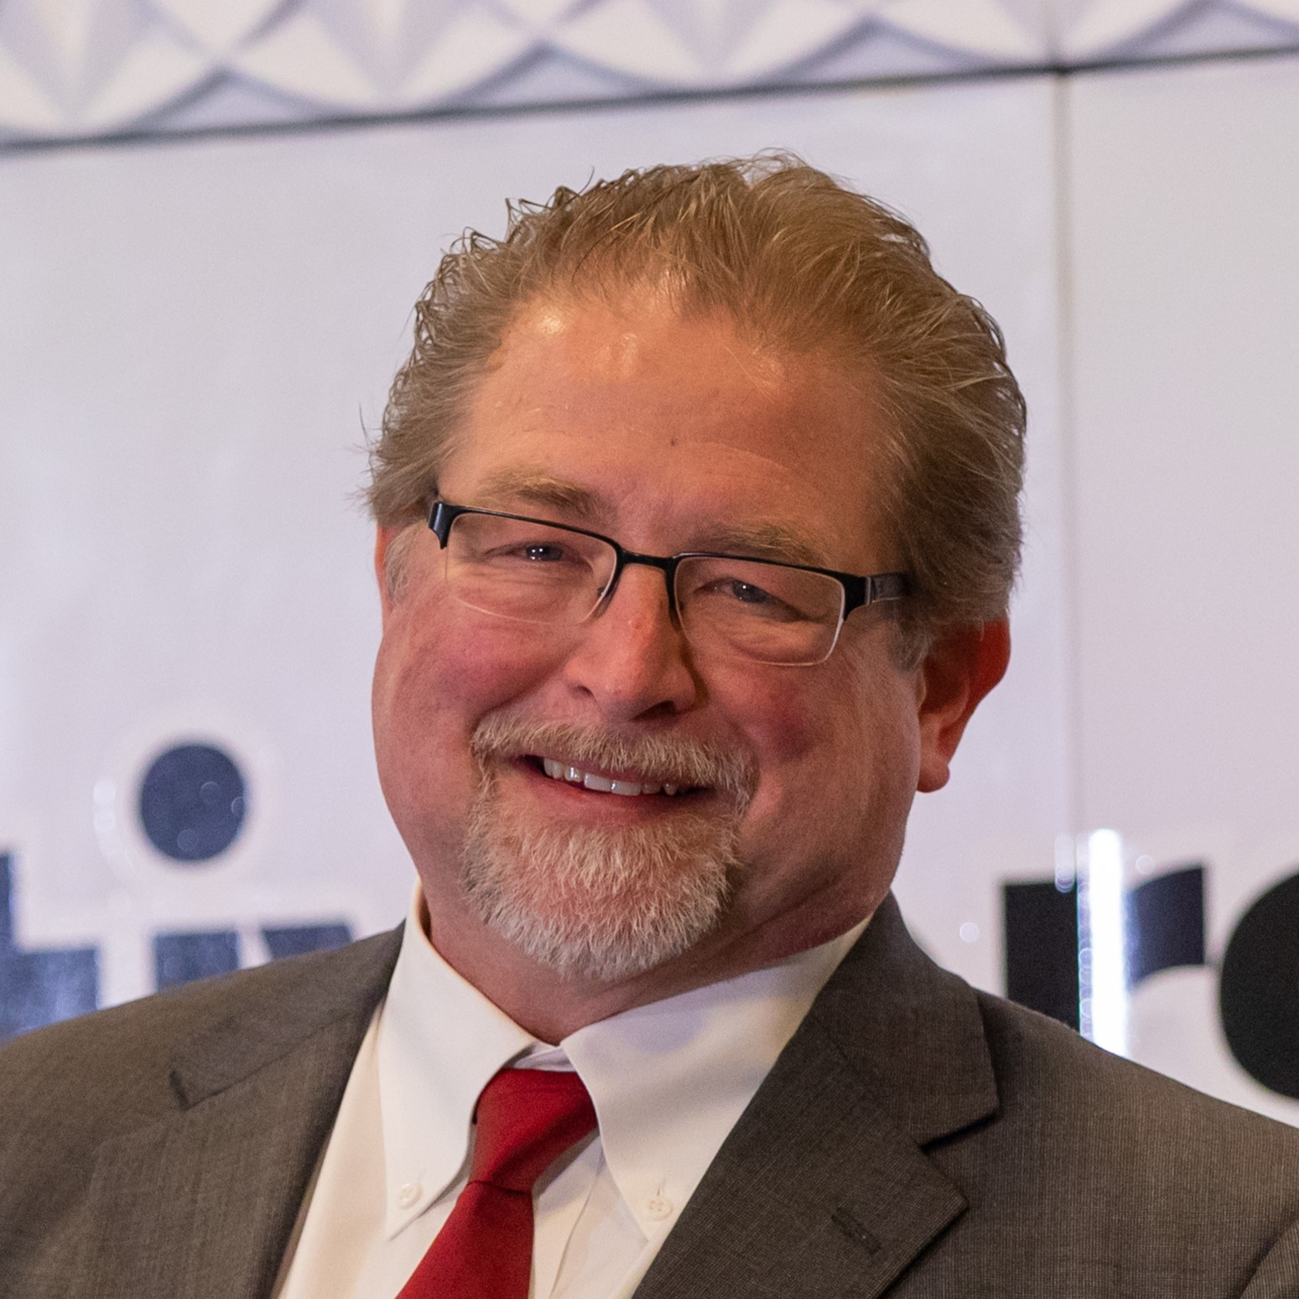
So you want to use Digital Credentials?
You’re now facing a myriad of choices!
Dr. Michael B. Jones
Principal, Self-Issued Consulting

Slide 2
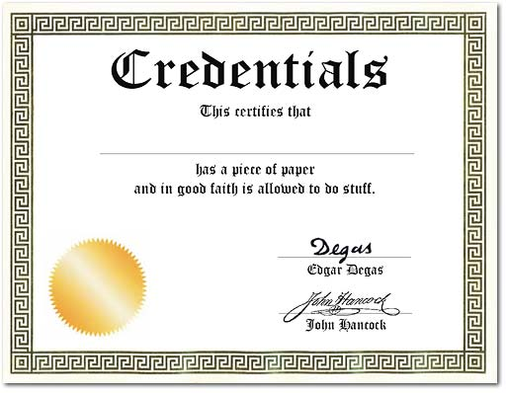
The Promise of Digital Credentials
An identity innovation facilitating user control and choice
You decide when and where to use credentials you control
Like your physical driver’s license or ID card, the issuer doesn’t know where you’ve used it
Unlike your physical driver’s license or ID card, you can reveal only the subset of information you choose to the recipient

Slide 3
The myriad of choices you’re now facing…

Slide 4
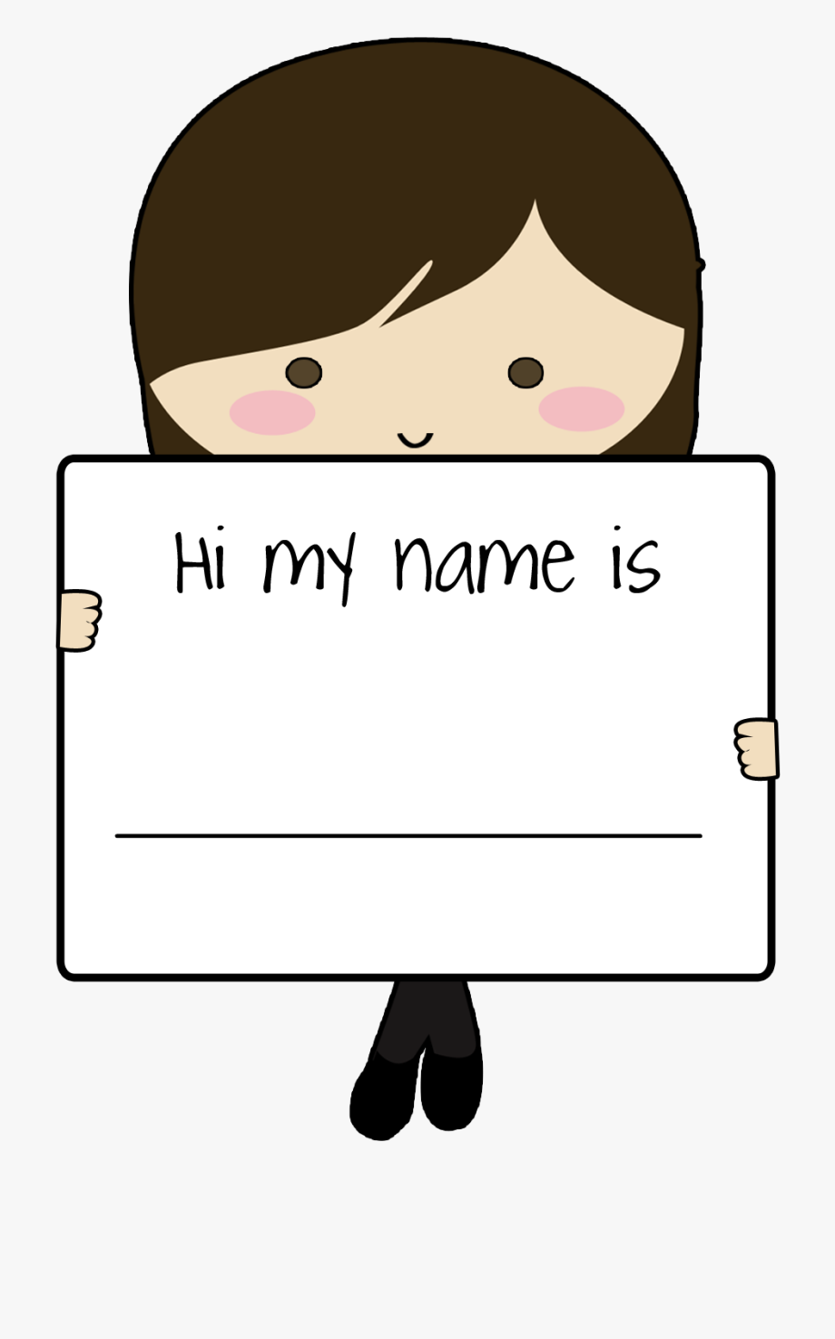
What are they called?
For starters, we don’t even agree on what to call them!
Do you call them?
  Digital Credentials
  Verifiable Credentials
  Verifiable Digital Credentials
  Credentials
  Tokens
  Assertions
  Certificates
  …
Take your pick!

Slide 5
What kind(s) of digital credentials to use?

Slide 6
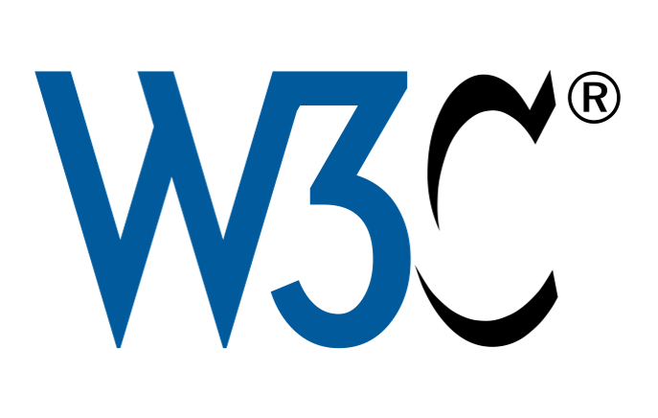
W3C Verifiable Credentials
The original
JSON-based credentials using JSON-LD
  As Markus said yesterday, developers tend to get @context values wrong
Three variants: VC Data Model 1.0, 1.1, and 2.0
  2.0 not compatible with 1.0 and 1.1 but arguably an improvement
Two classes of signing methods
  VC-JOSE-COSE – Signs using IETF-defined signing mechanisms
  VC-DATA-INTEGRITY – Custom representation signing over N-Quads or canonicalized JSON
A myriad of choices just within this credential format!

Slide 7

ISO mDOC
CBOR-based credential format
Supports salted hash-based selective disclosure of claims
mDOC is base structure other credential formats based on
  In particular, mDLs (Mobile Driving License)
Claims have a namespace component
  mDL namespace is org.iso.18013.5.1.mDL
Claim names defined within mDL namespace
  family_name
  portrait
  age_over_NN

Slide 8
ISO mDOC
mDOCs also used for credentials other than mDLs
Personal Identifier Documents (PIDs)
  EU PID namespace is eu.europa.ec.eudi.pid.1
  German PID namespace is eu.europa.ec.eudi.pid.de.1
Health Certificates
  Mobile International Certificate of Vaccination (micov) namespace is org.micov.medical.1

Slide 9

Selective Disclosure JWT (SD-JWT)
JSON-based credential format
Supports salted hash-based selective disclosure of claims
Claims not namespaced
Claims from IANA JWT Claims Registry
  family_name, etc.
SD-JWT VC based on SD-JWT
  Adds validation and processing rules
Both in development in the IETF OAuth working group

Slide 10
Selective Disclosure CWT (SD-CWT)
CBOR-based credential format
Supports salted hash-based selective disclosure of claims
Claims not namespaced
Claims from IANA CWT Claims Registry
  Claim identifiers are small binary integers, rather than strings
In development in the IETF SPICE working group

Slide 11
JSON Web Proof (JWP)
Credential format supporting zero-knowledge proofs
  For instance, enables proof of age-over-21 derived from birthdate without disclosing birthdate
BBS signatures one proof mechanism supported
  In development in the IRTF CFRG working group
Two serializations – JSON and CBOR
  JSON claims from IANA JWT Claims Registry
  CBOR claims from IANA CWT Claims Registry
In development in the IETF JOSE working group

Slide 12

X.509 Certificate
ASN.1-based certificate format
Does not support selective disclosure of attributes
Attribute names are Object IDentifiers (OIDs)
  Subject Alternative Name OID is 2.5.29.17
  Birth Family Name OID is 2.23.42.2.3
Many different certificate profiles
  TLS certificates
  Covid Vaccination certificates

Slide 13
How to communicate them?

Slide 14
Issuance and Presentation
Credential Issuance
  An issuer communicating a digital credential to the person’s wallet
Credential Presentation
  A wallet presenting a digital credential to a verifier
  May involve selective disclosure or zero-knowledge proofs
Multiple mechanisms to do each

Slide 15

Credential Issuance Mechanisms
Bespoke issuance mechanisms common
  For instance, custom mechanisms for adding mDLs to Apple, Google wallets
Some are credential-format specific
  What might work for mDLs might not work for SD-JWTs
OpenID for Verifiable Credential Issuance
  Credential format independent issuance protocol

Slide 16
Credential Presentation Mechanisms
Two kinds of presentation mechanisms
  In-person presentation
  Remote (Internet) presentation
In-person presentation uses proximate communication
  Near-Field Communication (NFC)
  Bluetooth Low Energy (BLE)
Remote presentation uses Internet communication or APIs
  OpenID for Verifiable Presentation
    Credential format independent presentation protocol
    Both OAuth-based protocol and browser API defined
  18013-7 Annex C is AustRoads mechanism
    mDOC specific

Slide 17
More Credential Communication Options
W3C Digital Credentials API (DC API)
  Uses OpenID4VP
W3C Verifiable Credentials API (VC API)
  (no, they’re not the same!)
DIDComm

Slide 18
How do you choose credentials?

Slide 19

Query Languages
Multiple query languages for selecting credentials in use
  Presentation Exchange (PE)
  Digital Credential Query Language (DCQL)

Slide 20
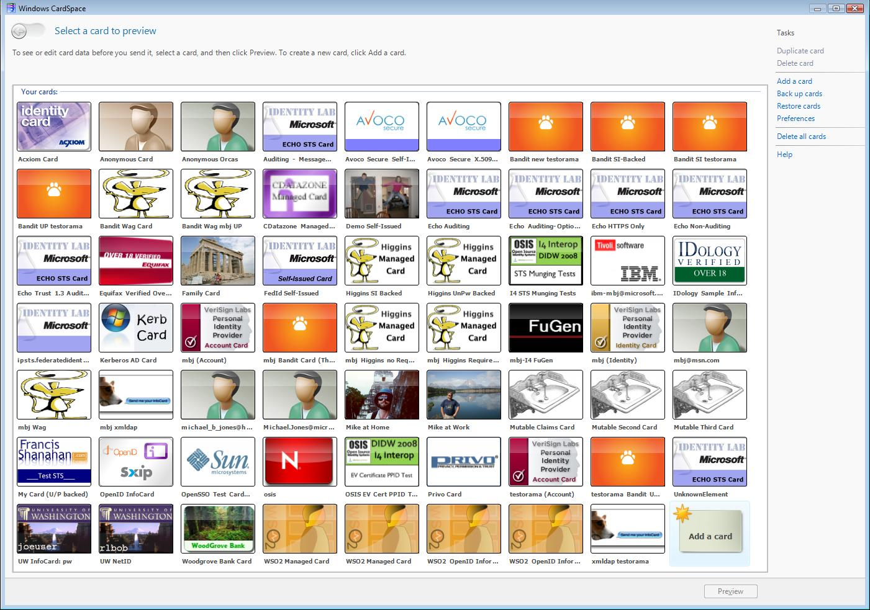
Credential Choice User Interfaces
Wallets implement user experiences for choosing credentials
Platforms implement user experiences for choosing wallets
Best practices and usability a work in progress!

Slide 21
Establishing Trust
Deciding whether to interact with a party (or not)

Slide 22
Multiple Different Ways to Establish Trust
Trusted Lists of Participants
  Simple – doesn’t scale
X.509 Certificates and Certificate Chains
  Requires custom certificate issuance & update mechanisms
  Requires maintaining list of trusted certificate authorities
Federations
  Trust a party when you and they share a common trust anchor
  OpenID Federation model
  Scalable

Slide 23

Thought Experiment on Trust Establishment
Let’s assume the EU digital wallet projects wildly succeed
People in Portugal will have become accustomed to using their credentials in Spain and Germany and Greece and Estonia
But then they’ll want to use their credentials in exotic places like Canada and Singapore and Kenya and the UK
How will we make that happen?

Slide 24
Usability is Everything

Slide 25

Will people be able to use it and want to?
InfoCards enabled
  Wallet with credentials you choose when and where to use
  Passwordless login
  Sound familiar? ;-)
InfoCard usability a cautionary tale
  Most people had no idea how to use them or why they would want to
  The few who succeeded asked
  “How could I have logged in? – I didn’t type a password”
Usability lessons still apply today

Slide 26
Building Ecosystems is Hard

Slide 27

Must be compelling value for all parties
Building ecosystems requires all necessary parties to voluntarily and incrementally adopt system
They will only adopt if there is value for them doing so now
Visions of how great things will be once everyone does it won’t get the job done
Getting from zero to ubiquitous is hard!

Slide 28
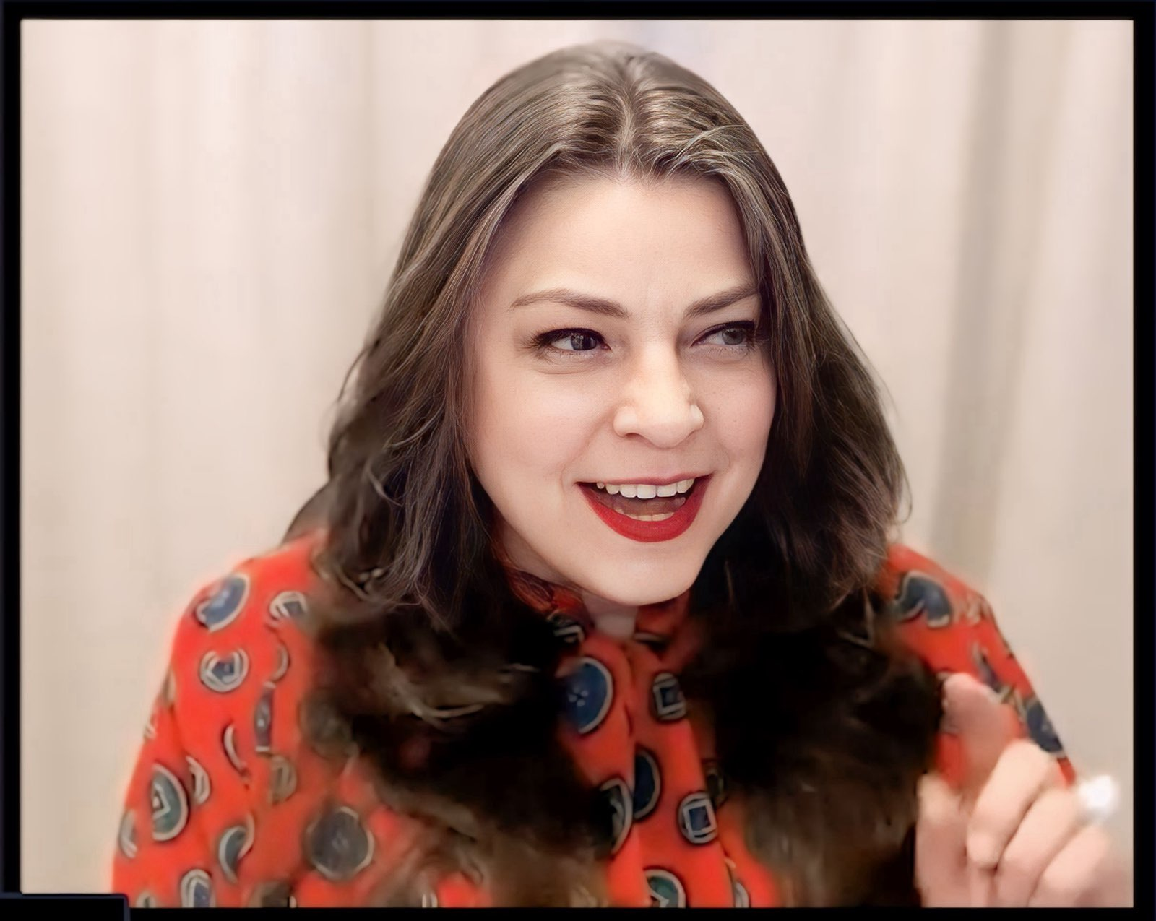
Katryna Dow on Building Ecosystems
As global citizens, we are constantly crossing borders
Borders are digital but identity is local
Pillars of Ecosystem Success
  Trust Frameworks
  Open Standards
  Governance Models
  Public/Private Collaboration
  User-Centric Design
How do you build trust at scale?
  Mutual Recognition
  Shared Assurance Levels
  Transparent Verification

Slide 29
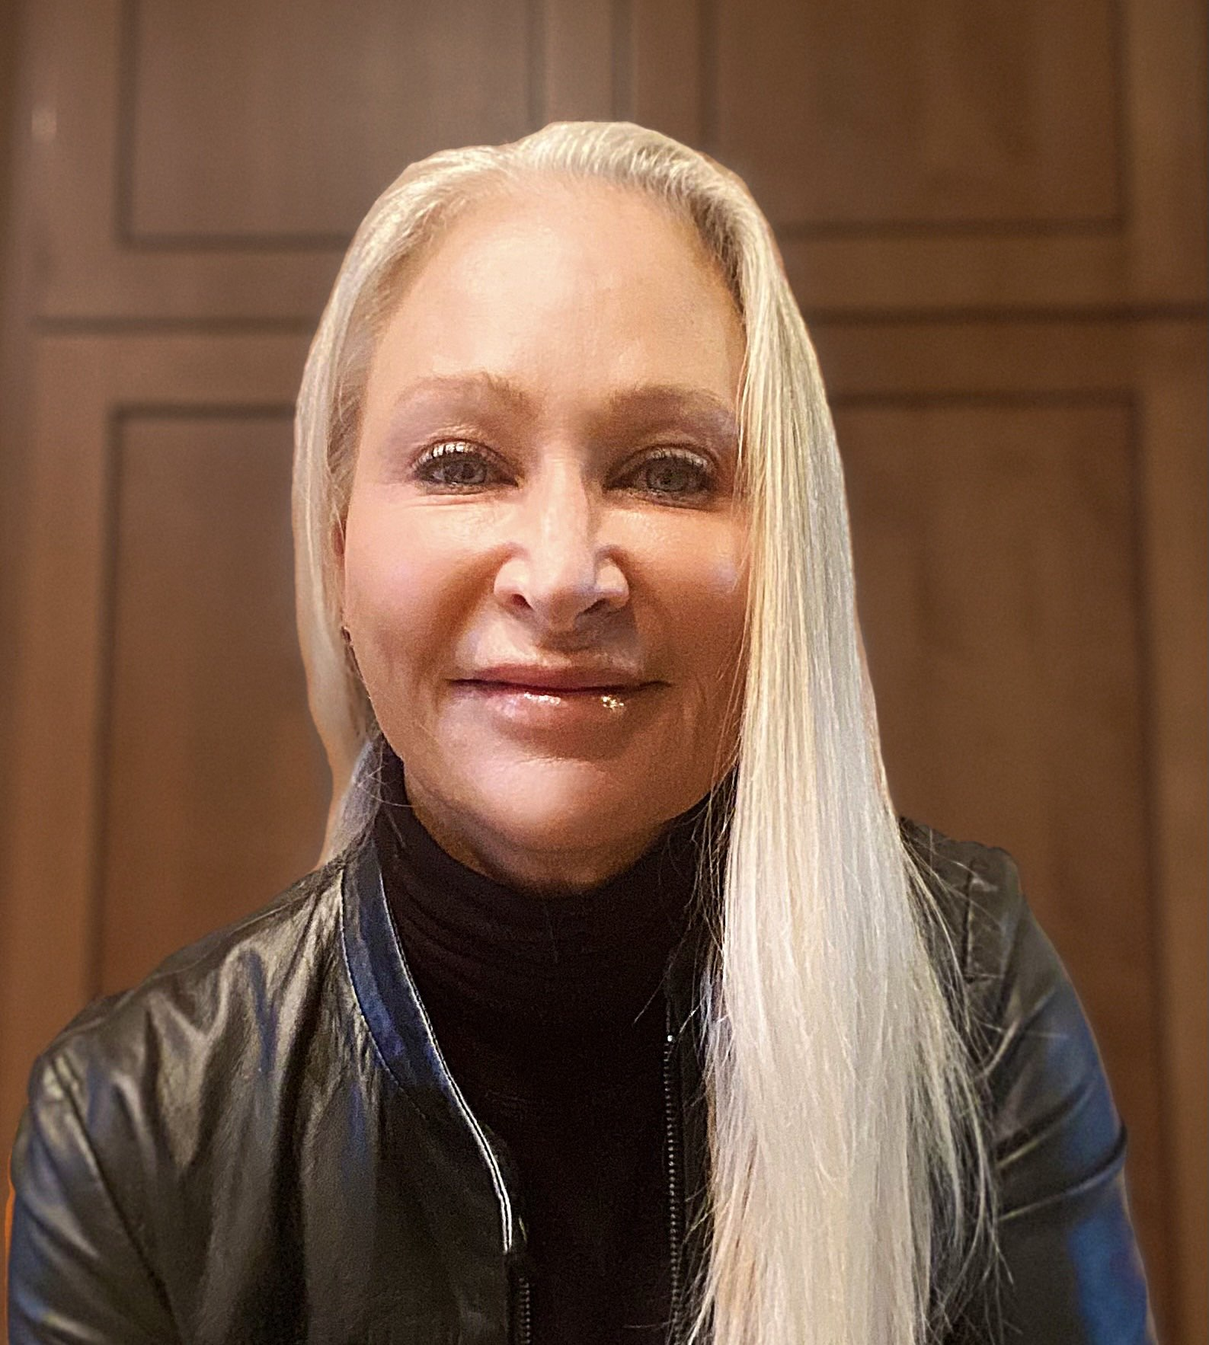
Juliana Cafik on Digital Credentials
Use digital credentials to solve unsolved real-world problems
  For instance, reducing online fraud a worthy objective
The Verifier is not the journey’s end
  Verified credential is an input to a business process
Winning will take doing all the hard work to make it easy and safe
The protocols and data formats are not the point
  Solving real problems is the point

Slide 30
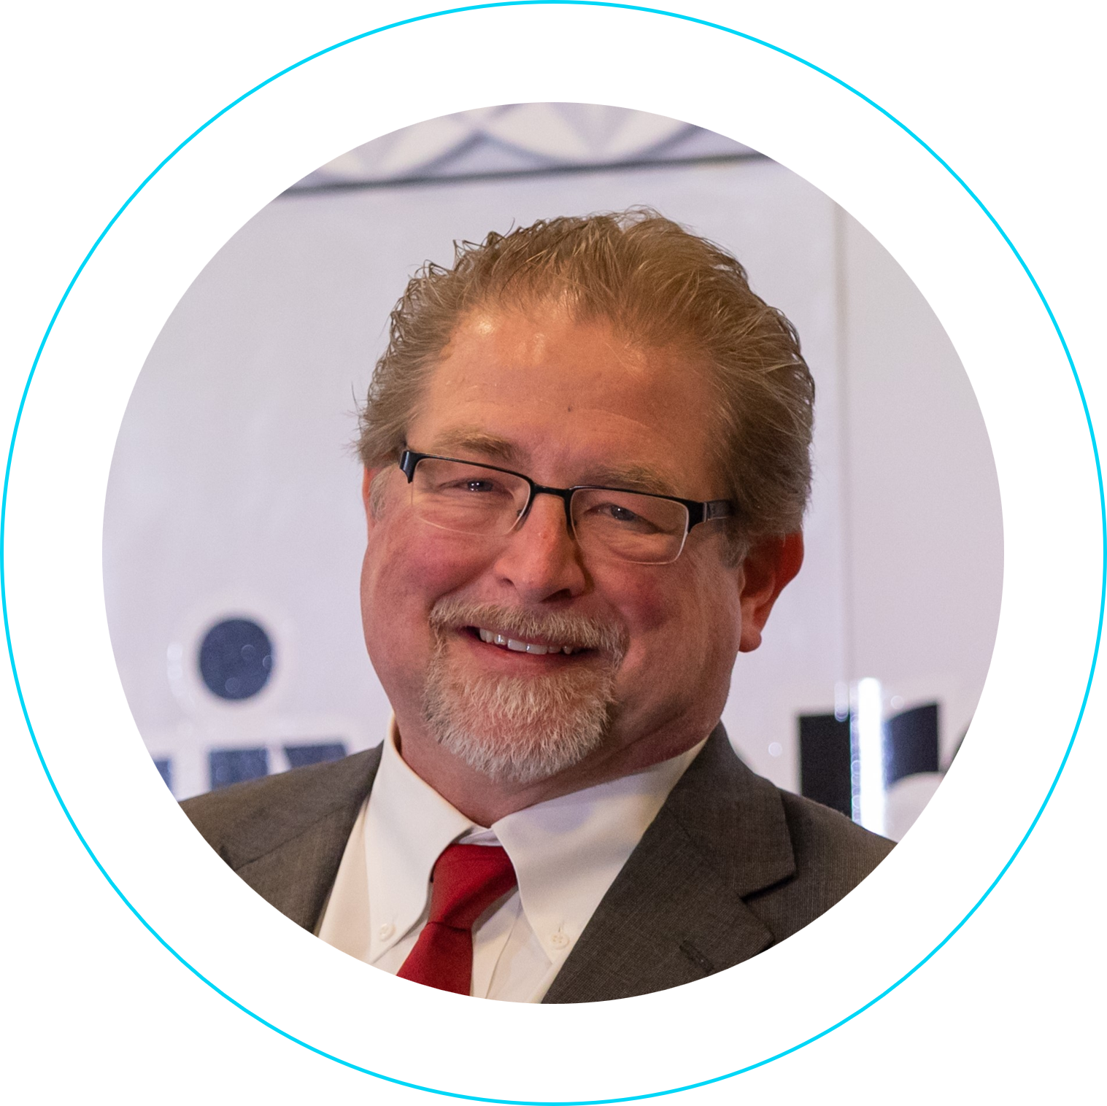
Standards are about making choices
The subject of my talk last year
Applies to digital credentials
Interoperability requires that the same choices be made by interacting participants
  No substitute for working together with others to make the right choices
So make good ones together!

Slide 31

Thank You!
The people behind wwWallet
This presentation available at
https://self-issued.info/

