Slide 1
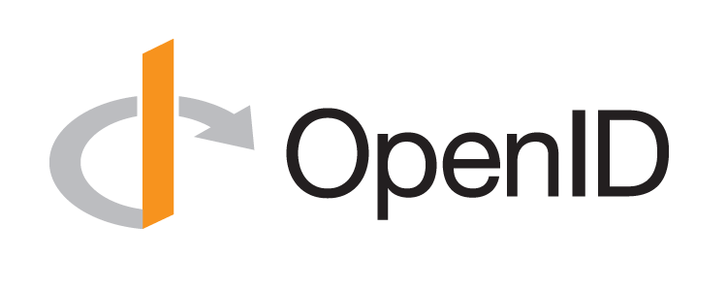
Lessons Learned from OpenID Connect
Torsten Lodderstedt
SPRIND, OWF

Slide 2
What can people in standardization learn from the success of OpenID Connect?
Easy to use - for developers but also for users
However, OpenID Connect can also be used for complex scenarios - up to LOA High, FAPI
Cooperation - OpenID Connect was built on top of OAuth and JWT ( IETF)
Amazing interoperability
Connect OP: 575, Connect RP: 112
conformance testing is standard now at OIDF
Outstanding security through formal security analysis
Systematic and formal security analysis are standard now at OIDF
Open Standard
Approachable community

Slide 3
Celebrating Ten Years of OpenID Connect
June 7, 2024
Michael B. Jones
Self-Issued Consulting

Slide 4
Looking Back and Looking Forward
OpenID Connect became final in February 2014
Today I’ll briefly share my thoughts on
How we created OpenID Connect
What we achieved together
Lessons learned

Slide 5
In the Beginning
Artifact Binding for OpenID 2.0 started in 2010
Hence the openid-specs-ab@lists.openid.net mailing list name
But developers were choosing JSON/REST over XML/SOAP
Pivoted to instead create JSON/REST protocol over OAuth 2.0
Result branded “OpenID Connect” at IIW in May 2011
Five rounds of interop testing between 2011 and 2013!
Specifications refined after each round of interop testing
Early developer feedback was priceless

Slide 6
Design Philosophy
Keep simple things simple
Make complex things possible

Slide 7
The Nov Matake Test
As we considered new features, we’d ask ourselves:
Would Nov want to add it to his implementation?
Is it simple enough that he could build it in a few hours?

Slide 8
Broad Participation
OpenID Connect

Slide 9
Learning from the Past
Architects had extensive SAML and OpenID 2.0 experience
Borrowed ideas that already worked well
Metadata
Authentication Contexts
Added useful things that were previously hard or missing
Support for native applications
Encrypted claims
Signed requests

Slide 10
Extensible by Design
Successful systems have to adapt and grow
Always specified that “additional values may be used”
And specified that not-understood values don’t cause errors
Enables adding things without breaking existing deployments
Indeed, many successful Connect (and OAuth) extensions have been created and deployed
Including logout and identity assurance

Slide 11
Built using Modular Components
Created components and features we needed in parallel
JSON Web Signature (JWS)
JSON Web Encryption (JWE)
JSON Web Key (JWK)
JSON Web Token (JWT)
WebFinger
ID Token

Slide 12
What We Achieved
Most used identity protocol
Thousands of interoperable implementations
In every conceivable language
Certification Program making interop a reality
ISO accepted our submission for republication

Slide 13
Innumerable OpenID Connect Deployments
Android, AOL, Apple, AT&T, Auth0, Deutsche Telekom, ForgeRock, Google, GrabTaxi, GSMA Mobile Connect, IBM, KDDI, Microsoft, NEC, NRI, NTT, Okta, Oracle, Orange, Ping Identity, Red Hat, Salesforce, Softbank, Symantec, Telefónica, Verizon, Yahoo, Yahoo! Japan, all use OpenID Connect
And many MANY more!

Slide 14
Lessons Learned
Developers choose things that are simple
Developer choice critical to adoption
Interoperability and security require rigorous testing
OpenID Certification program was essential to Connect’s success
Extensibility is critical to long-term success
Deployments have to be easy to use (or they won’t be used)
Most RPs limited IdP choice as a simplification
Even though Connect was designed to give users complete choice
Not everything works out the way you planned
Developer and deployer feedback is gold!

Slide 15
Oh, Its Damn Complex?!
Nat Sakimura
NAT Consulting ETC
_nat
https://www.sakimura.org
_nat_en
https://nat.sakimura.org
https://youtube.com/@NatSakimura
https://www.linkedin.com/in/natsakimura

Slide 16
OpenID Connect:
Online Selective Claims Disclosure Protocol
Claims on-the-fly
1. Me
User AuthN
Grant (Consent)
Claims
Which also forms
Basis for ABAC.
Claims on-the-fly
ID Token
Claims
AT/RT
Etc.
Static
Claims
RP
OP/SIOP
Claim Sources
Notes:
Not two parties. Not centralised.
No checkbox these days because of data minimization.

Slide 17
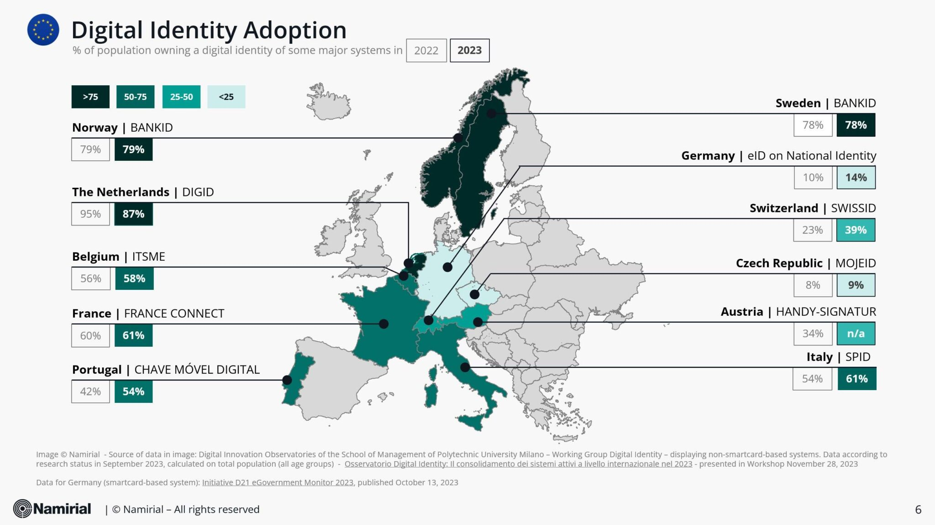
Used in wide array of use cases
acct:
openid://
(Source) Based on https://www.namirial.com/en/news/state-of-play-on-adoption-of-digital-identity-in-italy-2023-all-roads-lead-to-the-wallets/
Notes:
Social login, National Identity.
Acct URI feature not used. SIOP (openid://) not used.

Slide 18
Learning from the history
OpenID Authentication 2.0
(key=value)
David Recordon et al.
OpenID AB WG
(Key=value?)
XNS.org
Drummond Reed
OpenID Connect 1.0
SAML 1.0
OpenID AX
Dick Hardt
OpenID 1.0
Brad Fitzpatrick
1999
2001
2002
2005
2007
2008
2009
2010
2012
2014
OpenID.net
David Lehn
SAML 2.0
(XML, XML DSIG, SOAP)
OAuth 1.0
(Key=value)
E. Hammer-Lahav
OAuth 2.0
(Key=value)
Dick Hardt
OpenID TX/CX Proposal
Nishitani/Sakimura
Notes:
Standing on the achievements of preceding initiatives

Slide 19
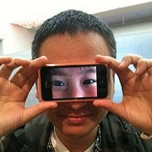
Early design decisions:
No Canonicalization
ASCII Armoring
REST
JSON

Slide 20
Early design decisions:
No Canonicalization
ASCII Armoring
REST
JSON
JWx

Slide 21
Early design decisions:
No Canonicalization
ASCII Armoring
REST
JSON
JWx
Base on OAuth WRAP
Dick Hardt
2.0

Slide 22
Features not widely used or seen
Aggregated and Distributed Claims
Granular Claims Request
Essential/Optional Claims
AcctURI
policy_url
Request Object (Started to see this only after FAPI)
Oh,
It’s
Damn
Complex

Slide 23
What lessons we learned that could apply to other initiatives
Be persistent - till you succeed
Learn from history
Fix what was not done well
Find the developer pain and solve it
Make it simple to read, simple to implement for the minimum viable case

Slide 24
OpenID: There is no spoon
John Bradley
Principal Architect, Yubico
a.k.a. Mercenary

Slide 25
OpenID is more than a single specification or Idea
Insert insightful comment….

