Slide 1
Current Work and Future Trends in Selective Disclosure
Thursday, May 11, 2023

Slide 2
Agenda
Mike Jones – Introductory remarks
Daniel Fett – SD-JWT
Kristina Yasuda – ISO mdoc
Tobias Looker – Zero-Knowledge Proofs and BBS
David Waite – JSON Web Proofs and JOSE
All – Closing Remarks and Discussion

Slide 3
Selective Disclosure
A lot of foundational work happening in Selective Disclosure right now
Enables you to have a token with many claims and only release the claims necessary to the interaction
For instance, disclose your birthdate but not your home address
Selective Disclosure enables Minimal Disclosure
Sometimes uses Zero Knowledge Proofs (ZKPs) but not always necessary
Real deployments under way
For instance, ISO Mobile Driving Licenses use Selective Disclosure

Slide 4
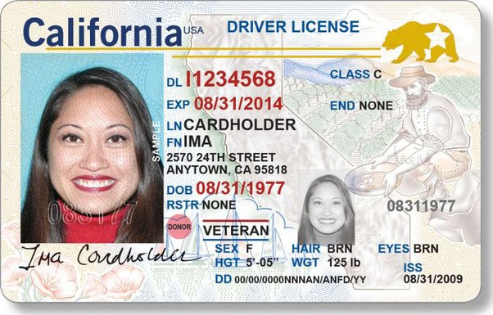
Issuer / Holder / Verifier Model​
Verifiable Credential
Holder (Wallet)
Issuer
Person
Verifier

Slide 5
SD-JWT
draft-ietf-oauth-selective-disclosure-jwt-03

Slide 6
‘Simple’ is a feature.

Slide 7
Design Principles
 | SD-JWT
Complexity | Selective disclosure, as simple as possible
Algorithms | Standard cryptography: JWS Signature + Hash function
Format | JWT & JSON
Security | Security-by-design Easy to understand & verify Hardware binding possible Cryptographic agility
Availability | Widely-available JWT libraries can be leveraged Already six independent implementations
Use Cases | Universal (beyond identity use cases)

Slide 8
SD-JWT in 5 Simple Steps
Step 1: Prepare User Data
{
"iss": "https://example.com",
"type": "IdentityCredential",
"cnf": {"jwk": {"kty": "RSA","n": "0vx....Kgw","e": "AQAB" } },
"credentialSubject": {
"given_name": "Max",
"family_name": "Mustermann",
"email": "mustermann@example.com",
"address": {
"street_address": "Musterstr. 23",
"locality": "Berlin",
"country": "DE"
}
}
}

Slide 9
SD-JWT in 5 Simple Steps
Step 2: Create Disclosures
{
"iss": "https://example.com",
"type": "IdentityCredential",
"cnf": {"jwk": {"kty": "RSA","n": "0vx....Kgw","e": "AQAB" } },
"credentialSubject": {
"given_name": "Max",
"family_name": "Mustermann",
"email": "mustermann@example.com",
"address": {
"street_address": "Musterstr. 23",
"locality": "Berlin",
"country": "DE"
}
}
}
············································· ["GO0r26nO-iW50ZcAoOilFw", "given_name", "Max"]
············································· ["cSlbR135i0NjhsouMxrjjg", "family_name", "Mustermann"]
············································· ["oHDt43Vwuhpo8mzaprgCcw", "email", "mustermann@example.com"]
············································· ["rGc0KtY6WmflywTTKEWIEQ", "street_address", "Musterstr. 23"]
············································· ["pGQMQx-2tH2XwC_eQCFn4g", "locality", "Berlin"]
············································· ["TI15M8G5UIxPiWNZ-VLYBA", "country", "DE"]
salt claim name claim value

Slide 10
SD-JWT in 5 Simple Steps
Step 3: Hash Disclosures & Replace Original Claims
{
"iss": "https://example.com",
"type": "IdentityCredential",
"cnf": {"jwk": {"kty": "RSA","n": "0vx....Kgw","e": "AQAB" } },
"credentialSubject": {
"address": {
}
}
}
"_sd": [ "EW1o0egqa5mGcbytT5S-kAubcEjYEUwRkXlu2vC5l20", ← ["GO0r26nO-iW50ZcAoOilFw", "given_name", "Max"]
"FEx-ITHt41I8_cn0SS-hvoLneX_RGlJo_8o2xRNhfdk", ← ["cSlbR135i0NjhsouMxrjjg", "family_name", "Mustermann"]
"igg7H5fn2eBEMIEkE5Ckbm23QuwDJlTYoKRip08dYIc" ], ← ["oHDt43Vwuhpo8mzaprgCcw", "email", "mustermann@example.com"]
"_sd": [ "gqB5kmAwyry88aHjaAeO-USX6JOMaojukKsheo38O0c", ← ["rGc0KtY6WmflywTTKEWIEQ", "street_address", "Musterstr. 23"]
"w8InvxsPXdKoowuVpyBMgl1b9_R2b6Xpa3OYOIjgQro", ← ["pGQMQx-2tH2XwC_eQCFn4g", "locality", "Berlin"]
"vOnlYtcjr872fP3Wa75Ozl7c-6_MOVdIUNtwLKKxZw0" ] ← ["TI15M8G5UIxPiWNZ-VLYBA", "country", "DE"]

Slide 11
SD-JWT in 5 Simple Steps
Step 4: Sign SD-JWT & Encode for Transport
{
"iss": "https://example.com",
"type": "IdentityCredential",
"cnf": {"jwk": {"kty": "RSA","n": "0vx....Kgw","e": "AQAB" } },
"credentialSubject": {
"address": {
},
}
}
_sd[ "EW1o0egqa5mGcbytT5S-kAubcEjYEUwRkXlu2vC5l20", ← ["GO0r26nO-iW50ZcAoOilFw", "given_name", "Max"]
"FEx-ITHt41I8_cn0SS-hvoLneX_RGlJo_8o2xRNhfdk", ← ["cSlbR135i0NjhsouMxrjjg", "family_name", "Mustermann"]
"igg7H5fn2eBEMIEkE5Ckbm23QuwDJlTYoKRip08dYIc" ] ← ["oHDt43Vwuhpo8mzaprgCcw", "email", "mustermann@example.com"]
_sd[ "gqB5kmAwyry88aHjaAeO-USX6JOMaojukKsheo38O0c", ← ["rGc0KtY6WmflywTTKEWIEQ", "street_address", "Musterstr. 23"]
"w8InvxsPXdKoowuVpyBMgl1b9_R2b6Xpa3OYOIjgQro", ← ["pGQMQx-2tH2XwC_eQCFn4g", "locality", "Berlin"]
"vOnlYtcjr872fP3Wa75Ozl7c-6_MOVdIUNtwLKKxZw0" ] ← ["TI15M8G5UIxPiWNZ-VLYBA", "country", "DE"]
eyJhbGciOiAiUlMyNTYiLCAia2lkIjogImNBRUlVcUowY21MekQxa3pHemhlaUJhZzBZ
UkF6VmRsZnhOMjgwTmdIYUEifQ.eyJpc3MiOiAiaHR0cHM6Ly9leGFtcGxlLmNvbS9pc
3N1ZXIiLCAiY25mIjogeyJqd2siOiB7Imt0eSI6ICJSU0EiLCAibiI6ICIwdng3YWdvZ
WJHY1FTdS4uLi4tY3NGQ3VyLWtFZ1U4YXdhcEp6S25xREtndyIsICJlIjogIkFRQUIif
X0sICJ0eXBlIjogIklkZW50aXR5Q3JlZGVudGlhbCIsICJjcmVkZW50aWFsU3ViamVjd
CI6IHsiX3NkIjogWyJFVzFvMGVncWE1bUdjYnl0VDVTLWtBdWJjRWpZRVV3UmtYbHUyd
kM1bDIwIiwgIkZFeC1JVEh0NDFJOF9jbjBTUy1odm9MbmVYX1JHbEpvXzhvMnhSTmhmZ
GsiLCAiUXhKVi0yVjFIOG1jbHRSNnZWQzRtM3JlVTVhTkg5d2RKejJVZG1Sb0kxRSIsI
CJhdFVuMVRZd1JBbDRHUTdQZUV0WGFNdzJmNHVJVGlKclg0ODV3TTh2NjdFIiwgImZUT
XczdmtrRUx3TDFYTnVZSzhIN3pCS0NIdV91aWY2MFNsRzFweVhJVVEiLCAiaWdnN0g1Z
m4yZUJFTUlFa0U1Q2tibTIzUXV3REpsVFlvS1JpcDA4ZFlJYyIsICJ0cFV0bDcwaHBVX
3hucnZaaTBHaEdvUlIxam10MXpZZ3Z2NUlZMEF4N0tjIl0sICJhZGRyZXNzIjogeyJfc
2QiOiBbImdxQjVrbUF3eXJ5ODhhSGphQWVPLVVTWDZKT01hb2p1a0tzaGVvMzhPMGMiL
CAidk9ubFl0Y2pyODcyZlAzV2E3NU96bDdjLTZfTU9WZElVTnR3TEtLeFp3MCIsICJ3O
EludnhzUFhkS29vd3VWcHlCTWdsMWI5X1IyYjZYcGEzT1lPSWpnUXJvIl19fSwgImlhd
CI6IDE1MTYyMzkwMjIsICJleHAiOiAxNTE2MjQ3MDIyLCAic2RfZGlnZXN0X2Rlcml2Y
XRpb25fYWxnIjogInNoYS0yNTYifQ.1UHEPtLLUXOT51jH3gg-3C-ZidWzsB9Un-VxmM
VdQtTbLLhwDTB6HJtt15p43yCXTzdpiZxtDI6fr07Tp0Dy_Umg3Q5_FxFj4WHnsVuVzu
ASU8cFlGPi6xgH9D3w1G2hqepBS8DyQ5bA_p5kN_tKJVoP1xWhcQujRJ8kkEKQsRia4F
hrBldl8f41wgu_ipPqh1Ix4BVI7GJClZNx94nWPT7JUFkI6Y6JkahLf3S6gB0MxtmLAe
Y0qkuz8VeOZNfl_CDog55kVTkArorfoL6D6TEjI__-w6YyU0PnIRJXJ0wrYfoyhNl8LK
AP38QYMpdR7z_rsvHpQHzFAPTmevnHDg

Slide 12
SD-JWT in 5 Simple Steps
Step 5: Base64url-encode Disclosures for Transport
{
"iss": "https://example.com",
"type": "IdentityCredential",
"cnf": {"jwk": {"kty": "RSA","n": "0vx....Kgw","e": "AQAB" } },
"credentialSubject": {
"address": {
},
}
}
_sd[ "EW1 o0egqa5mGcbytT5S-kAubcEjYEUwRkXlu2vC5l20", ← ["GO0r26nO-iW50ZcAoOilFw", "given_name", "Max"]
"FEx-ITH t41I8_cn0SS-hvoLneX_RGlJo_8o2xRNhfdk", ← ["cSlbR135i0NjhsouMxrjjg", "family_name", "Mustermann"]
"igg7H5fn2eB EMIEkE5Ckbm23QuwDJlTYoKRip08dYIc" ] ← ["oHDt43Vwuhpo8mzaprgCcw", "email", "mustermann@example.com"]
_sd[ "gqB5kmAwyry88aHjaAeO-USX6JOMaojukKsheo38O0c", ← ["rGc0KtY6WmflywTTKEWIEQ", "street_address", "Musterstr. 23"]
"w8InvxsPXdKoowuVpyBMgl1b9_R2b6Xpa3OYOIjgQro", ← ["pGQMQx-2tH2XwC_eQCFn4g", "locality", "Berlin"]
"vOnlYtcjr872fP3Wa75Ozl7c-6_MOVdIUNtwLKKxZw0" ] ← ["TI15M8G5UIxPiWNZ-VLYBA", "country", "DE"]
eyJhbGciOiAiUlMyNTYiLCAia2lkIjogImNBRUlVcUowY21MekQxa3pHemhlaUJhZzBZ
UkF6VmRsZnhOMjgwTmdIYUEifQ.eyJpc3MiOiAiaHR0cHM6Ly9leGFtcGxlLmNvbS9pc
3N1ZXIiLCAiY25mIjogeyJqd2siOiB7Imt0eSI6ICJSU0EiLCAibiI6ICIwdng3YWdvZ
WJHY1FTdS4uLi4tY3NGQ3VyLWtFZ1U4YXdhcEp6S25xREtndyIsICJlIjogIkFRQUIif
X0sICJ0eXBlIjogIklkZW50aXR5Q3JlZGVudGlhbCIsICJjcmVkZW50aWFsU3ViamVjd
CI6IHsiX3NkIjogWyJFVzFvMGVncWE1bUdjYnl0VDVTLWtBdWJjRWpZRVV3UmtYbHUyd
kM1bDIwIiwgIkZFeC1JVEh0NDFJOF9jbjBTUy1odm9MbmVYX1JHbEpvXzhvMnhSTmhmZ
GsiLCAiUXhKVi0yVjFIOG1jbHRSNnZWQzRtM3JlVTVhTkg5d2RKejJVZG1Sb0kxRSIsI
CJhdFVuMVRZd1JBbDRHUTdQZUV0WGFNdzJmNHVJVGlKclg0ODV3TTh2NjdFIiwgImZUT
XczdmtrRUx3TDFYTnVZSzhIN3pCS0NIdV91aWY2MFNsRzFweVhJVVEiLCAiaWdnN0g1Z
m4yZUJFTUlFa0U1Q2tibTIzUXV3REpsVFlvS1JpcDA4ZFlJYyIsICJ0cFV0bDcwaHBVX
3hucnZaaTBHaEdvUlIxam10MXpZZ3Z2NUlZMEF4N0tjIl0sICJhZGRyZXNzIjogeyJfc
2QiOiBbImdxQjVrbUF3eXJ5ODhhSGphQWVPLVVTWDZKT01hb2p1a0tzaGVvMzhPMGMiL
CAidk9ubFl0Y2pyODcyZlAzV2E3NU96bDdjLTZfTU9WZElVTnR3TEtLeFp3MCIsICJ3O
EludnhzUFhkS29vd3VWcHlCTWdsMWI5X1IyYjZYcGEzT1lPSWpnUXJvIl19fSwgImlhd
CI6IDE1MTYyMzkwMjIsICJleHAiOiAxNTE2MjQ3MDIyLCAic2RfZGlnZXN0X2Rlcml2Y
XRpb25fYWxnIjogInNoYS0yNTYifQ.1UHEPtLLUXOT51jH3gg-3C-ZidWzsB9Un-VxmM
VdQtTbLLhwDTB6HJtt15p43yCXTzdpiZxtDI6fr07Tp0Dy_Umg3Q5_FxFj4WHnsVuVzu
ASU8cFlGPi6xgH9D3w1G2hqepBS8DyQ5bA_p5kN_tKJVoP1xWhcQujRJ8kkEKQsRia4F
hrBldl8f41wgu_ipPqh1Ix4BVI7GJClZNx94nWPT7JUFkI6Y6JkahLf3S6gB0MxtmLAe
Y0qkuz8VeOZNfl_CDog55kVTkArorfoL6D6TEjI__-w6YyU0PnIRJXJ0wrYfoyhNl8LK
AP38QYMpdR7z_rsvHpQHzFAPTmevnHDg
~WyJHTzByMjZuTy1pVzUwWmNBb09pbEZ3IiwgImdpdmVuX25hbWUiLCAiTWF4Il0
~WyJjU2xiUjEzNWkwTmpoc291TXhyampnIiwgImZhbWlseV9uYW1lIiwgIk11c3Rlcm1hbm4iXQ
~WyJvSER0NDNWd3VocG84bXphcHJnQ2N3IiwgImVtYWlsIiwgIm11c3Rlcm1hbm5AZXhhbXBsZS5jb20iXQ
~WyJyR2MwS3RZNldtZmx5d1RUS0VXSUVRIiwgInN0cmVldF9hZGRyZXNzIiwgIk11c3RlcnN0ci4gMjMiXQ
~WyJwR1FNUXgtMnRIMlh3Q19lUUNGbjRnIiwgImxvY2FsaXR5IiwgIkJlcmxpbiJd
~WyJUSTE1TThHNVVJeFBpV05aLVZMWUJBIiwgImNvdW50cnkiLCAiREUiXQ
→ Done!

Slide 13
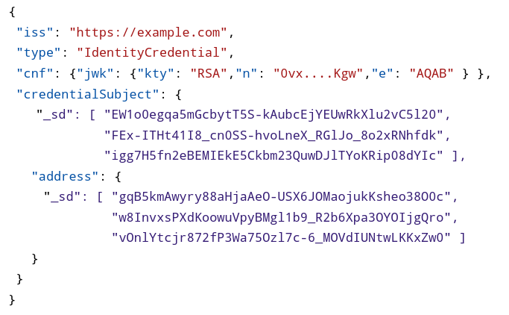
Issuer
SD-JWT
plain-text claims + hashed Disclosures
Disclosures salt + claim name + claim value
Issuance
✓ signed by Issuer
End-User (Holder)
Presentation
Verifier

Slide 14
Issuer
SD-JWT
plain-text claims + hashed Disclosures
Disclosures salt + claim name + claim value
Issuance
✓ signed by Issuer
End-User (Holder)
SD-JWT
plain-text claims + hashed Disclosures
Selected Disclosures salt + claim name + claim value
Presentation
✂
✓ signed by Issuer
Verifier

Slide 15
Issuer
SD-JWT
plain-text claims + hashed Disclosures
Disclosures salt + claim name + claim value
Issuance
✓ signed by Issuer
End-User (Holder)
SD-JWT
plain-text claims + hashed Disclosures
Selected Disclosures salt + claim name + claim value
Holder- Binding JWT
nonce audience etc.
Presentation
✂
✓ signed by Issuer
✓ signed by Holder
holder’s public key
Verifier

Slide 16
Verification
Verify SD-JWT signature
Hash over disclosed Disclosures
Find hash digests in SD-JWT
Replace disclosed claims in SD-JWT
Check holder binding, if required.
Done!
Verification requires hash check!

Slide 17
SD-JWT with JWS using JSON serialization (proposal)
Payload as in SD-JWT
{
"payload": "eyJpc3MiOiAiaHR0cHM6L...Z0NGpUOUYySFpRIn19fQ",
"protected": "eyJhbGciOiAiRVMyNTYifQ",
"header": {
"kid": "e9bc097a-ce51-4036-9562-d2ade882db0d"
},
"signature": "mcndQ15m-4FbIzyfB...U2ZX7g",
"disclosures": [
"WyJkcVR2WE14UzBHYTNEb2FHbmU5eDBRIiwgInN1YiIsICJqb2huX2RvZV80MiJd",
"WyIzanFjYjY3ejl3a3MwOHp3aUs3RXlRIiwgImdpdmVuX25hbWUiLCAiSm9obiJd",
"WyJxUVdtakpsMXMxUjRscWhFTkxScnJ3IiwgImZhbWlseV9uYW1lIiwgIkRvZSJd"
]
}
Disclosures
Notes:
Option 2: use JWS instead of JSON object
<JSON serialized SD-JWT>~<Disclosure 1>~...~<Disclosure n>

Slide 18
Compatibility
Can be used with any JSON-based data format
JSON-LD
W3C-VC Data Model
OpenID Connect for Identity Assurance (OIDC4IA)
Flexibility regarding holder binding
External signature
Key distribution
Makes no assumptions on the transport protocol
E.g., OIDC4VC

Slide 19
Available, Testable, Auditable
All examples in specification generated via reference implementation: oauthstuff/draft-selective-disclosure-jwt (Python)
Independent open-source implementations:
Kotlin: IDunion/SD-JWT-Kotlin
Rust: kushaldas/sd_jwt
TypeScript: christianpaquin/sd-jwt
TypeScript: chike0905/sd-jwt-ts
Typescript: OR13/vc-sd-jwt NEW
Java: authlete/sd-jwt NEW
### Produce SD-JWT
sdjwt = SDJWT(
user_claims,
issuer,
ISSUER_KEY,
HOLDER_KEY,
iat,
exp,
)
tooling might be separated into another GH repo in the future

Slide 20
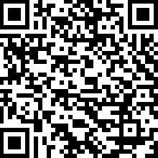
IETF OAuth WG Draft
https://datatracker.ietf.org/doc/draft-fett-oauth-selective-disclosure-jwt/
Daniel Fett
Authlete
Kristina Yasuda
Microsoft
Brian Campbell
Ping
Notes:
https://datatracker.ietf.org/doc/draft-fett-oauth-selective-disclosure-jwt/

Slide 21
mdoc
with one small caveat…

Slide 22
mdoc/MSO basics
Defined in the ISO/IEC 18013-5 (https://www.iso.org/standard/69084.html)
focuses on mobile driving licence scenarios but can be used in other use-cases, too, in theory
Includes a selective disclosure mechanism based on the salted hash values
Expressed in CBOR
because NFC/BLE, “be happy it’s not ASN.1”
mdoc is defined as “document or application that resides on a mobile device or requires a mobile device as part of the process to gain access to the mdoc”.
Not originally defined as a “credential format”.
Mobile Security Object (MSO) is the issuer-signed object, contains digests
Notes:
https://datatracker.ietf.org/doc/draft-fett-oauth-selective-disclosure-jwt/

Slide 23
MSO (mobile security object) structure
MobileSecurityObject = {
"digestAlgorithm" : tstr, ; Message digest algorithm used
"valueDigests" : ValueDigests, ; Array of digests of all data elements
"deviceKey" : DeviceKey, ; Device key in COSE_Key as defined in RFC 8152
"docType" : tstr, ; DocType as used in Documents
"validityInfo" : validity of the MSO and its signature
}
Blinds claim name by using “digestID”
Notes:
https://datatracker.ietf.org/doc/draft-fett-oauth-selective-disclosure-jwt/

Slide 24
mdoc response (presentation)
IssuerSignedItem = {
"digestID" : uint, ; Digest ID for issuer data authentication
"random" : bstr, ; Random value for issuer data authentication
"elementIdentifier" : DataElementIdentifier, ; Data element identifier
"elementValue" : DataElementValue ; Data element value
}
Issuance is entirely out of scope.
How to send this mapping of direstID, random (salt), claim name and claim value during issuance is not defined.
there is also DeviceSigned. again how the issuer communicates IssuerSigned vs DeviceSigned is not defined.
Notes:
https://datatracker.ietf.org/doc/draft-fett-oauth-selective-disclosure-jwt/

Slide 25
mdocs: other facts
predicates: `age_over_NN` claim
unlinkability: issue the same copy of the credential with different User public key that can be used per verifier (to prevent RP-RP’ unlinkability)
refresh: can be only the issuer’s signature over hashes, or the entire “mdoc”
Notes:
https://datatracker.ietf.org/doc/draft-fett-oauth-selective-disclosure-jwt/

Slide 26
Zero-Knowledge Proofs and BBS

Slide 27
Overview of ZKPs
ZKPs refer to a family of cryptographic algorithms and techniques which allow a proving party to prover a given statement is true without revealing any additional information.
ZKPs have a variety of possible applications including with verifiable credentials.
The BBS Signature scheme is one such algorithm that meets these properties.

Slide 28
How does BBS work?
Issuer
The Signer can sign multiple messages and a header with a constant size signature.
The prover can generate a (randomized) proof for a subset of the signed messages.
The verifier can validate that proof on those messages and header with the issuers public key.
The header must always be disclosed by the Prover (intended to contain things like the algorithm identifier).
Signature
Prover
Proof
Verifier

Slide 29
Some deeper details on BBS
Issuer
Based on pairing based cryptography
Leverages curves like BLS 12-381
Scheme is currently a work item of the IRTF CFRG
Multiple independent interoperable implementations
MATTR pairing_crypto
https://github.com/Wind4Greg/grotto-bbs-signatures
https://github.com/dyne/zenroom
https://github.com/christianpaquin/bbs-signature
https://github.com/hyperledger/aries-bbssignatures-rs
Note - There are several more implementations that haven’t aligned to the latest draft
Signature
Prover
Proof
Verifier

Slide 30
Key Properties of interest from ZKPs for Verifiable Credentials
Selective Disclosure: The ability to sign multiple messages/payloads and enable an intermediary (holder/prover) to selectively reveal messages from the set, while proving integrity back to the issuer.
Unlinkable Proofs: Ability to generate proofs that are unlinkable from a cryptographic perspective. A property that is impossible to achieve with existing digital signature schemes.
Private Holder Binding: Ability to bind a credential/signature to a key pair managed by the holder/verifier in a manner such that the public key isn’t revealed during proof presentation to a verifier. A property that is impossible to achieve with existing digital signature schemes.

Slide 31
JSON Web Proofs and JOSE

Slide 32
What is JOSE?
JOSE is an abbreviation for JSON Object Signing and Encryption
It is an IETF working group which has defined representations of various security systems as JSON
Digital Signatures
Encryption
Message Authentication Codes
Cryptographic Key representations
The content being signed/encrypted does not need to be JSON, but often is.

Slide 33
Some Places that JOSE is Leveraged
JOSE aids applications in defining interoperable data protections, such as:
Cross-domain single sign (profiled under OpenID Connect and FAPI)
Supporting automation of retrieving/renewing TLS certificates (as ACMEv2)
Signaling a security event happened, such as email account compromise (OpenID RISC/SSF)
Allowing VOIP systems to interface across networks (SIP/STIR)
Representing identity credentials about a person or other entity (W3C Verifiable Credentials)

Slide 34
Why are Identity Credentials Different?
Identity Credentials often have active participation by a user agent
They may hold significantly more sensitive and identifying information
They may be used multiple times over an extended lifetime, creating new risks of correlation
This user agent (e.g. wallet) is an important stakeholder in the security system.
It needs additional capabilities and controls to limit the information being shared

Slide 35
JSON Web Proofs
A new work item in the reanimated JOSE Working Group
Goal to support newer cryptographic techniques for controlling information sharing, and supply features such as:
Selective Disclosure
Unlinkability
Pseudonymity
Computed answers (predicates)
Some of these may be achievable using existing techniques, while others may require new technologies like zero-knowledge proofs or even verifiable compute

Slide 36
JSON Web Proof work
New containers representing information facets as individual payloads
Issued/presented forms, analogous to credentials and presentations
JSON Proof Algorithms
Describe how existing algorithms (and emerging ones like BBS) can be used
What capabilities they provide for limiting information disclosure
How to represent cryptographic material using JSON Web Keys
JSON Proof Tokens
A token format comparable to JWTs for representing claims built on top

Slide 37
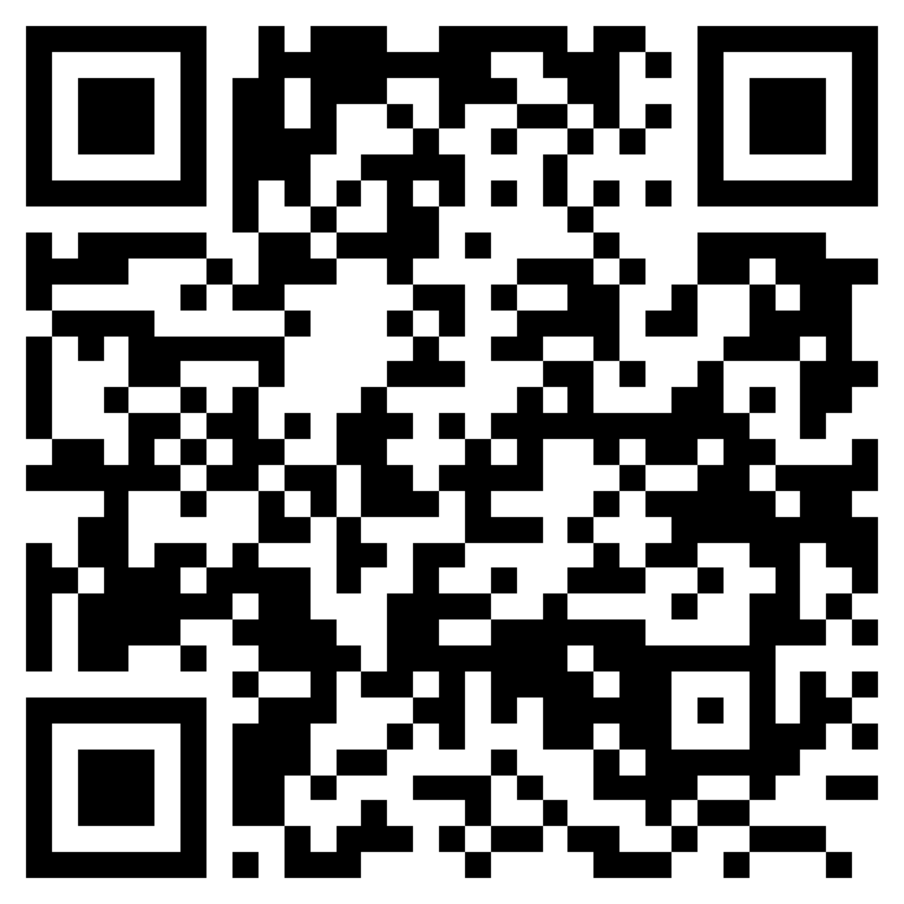
Conclusion
JSON Web Proofs are meant to aid in privacy-critical use cases
Target needs of future credential adoption
long-lived credentials
rich records like medical/educational transcripts
Early draft stage, welcome comments and assistance
Some early prototypes, further implementations welcomed
Draft Specifications

Slide 38
Closing Remarks and Discussion

