Slide 1
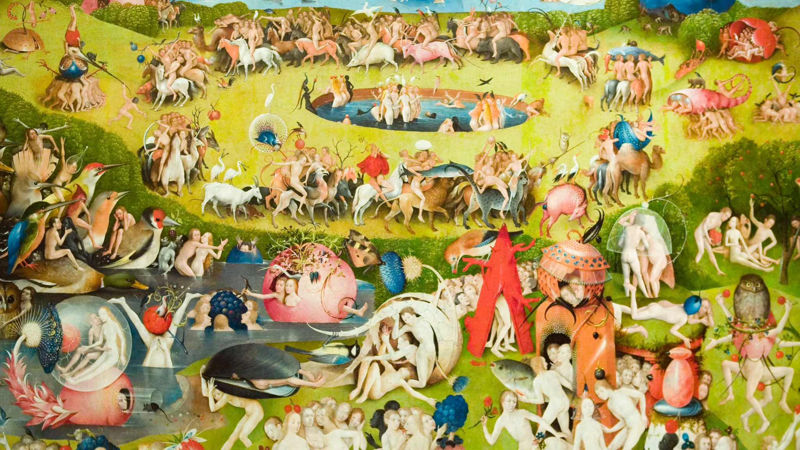
How do you know who to trust?
Trust establishment at scale with OpenID Connect Federation 1.0
Dr. Michael B. Jones OpenID Foundation
Giuseppe De Marco Department for Digital Transformation of the Presidency of the Council of the Minister, Italian Government

Slide 2
This is an Apple ..
THE KEY QUESTION
How do you know who to trust?
It’s important to know who the
party is that you’re interacting with AND whether that party complies with terms and conditions shared
by both parties
IDENTITY
COMPLIANCE
https://identitadigitale.gov.it/

Slide 3
WE ESTABLISH THE TRUST WITH SIMPLE RULES
Equation for a relationship
PROOF of IDENTITY
+
PROOF of COMPLIANCE to requirements
=
TRUST
It is periodically renewed, just like human relationships!
https://identitadigitale.gov.it/
Picture by best5.it

Slide 4
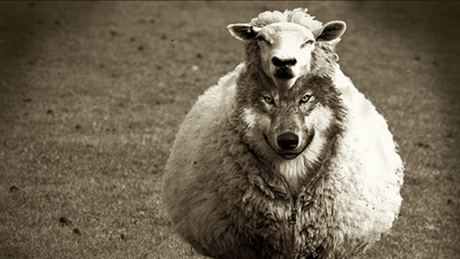
KNOWING WHO IT IS DOESN'T MEAN YOU CAN TRUST THEM
TLS offers us confidentiality and integrity over the transport by proving who we are talking to TLS doesn't tell us if it is compliant to the rules and if it will respect them “ TLS IS NOT ENOUGH FOR TRUST RELATIONSHIPS”

Slide 5
DETAILS MATTERS, ESPECIALLY WHEN THEY ARE MORE THAN DETAILS
OpenID Connect 1.0
Enables identities of participants to be securely established Doesn’t answer the question of whether a participant is trusted to access a resource, such as your personal data
A complementary mechanism is needed for Trust establishment
https://identitadigitale.gov.it/
Photo by Trae Nguyen from Burst
Notes:
positiveroutines.comCredits: Rosalia Galeano

Slide 6
REQUIREMENTS FOR LARGE SCALE AND DYNAMIC DEPLOYMENTS
Trust that scales
In small-scale and static deployments, it’s possible to keep a list of the trusted participants and their metadata
However, in large-scale and dynamic deployments, that doesn’t scale
This needs multilateral relationships, rather than bilateral
https://identitadigitale.gov.it/
Public domain picture: Dreamstime.com

Slide 7
TODAY WE TALK ABOUT
OpenID Connect Federation 1.0
Enables scalable multilateral trust establishment
Determining that parties are both in a federation
Meaning that they both agree to the federation’s legal agreements
Enables policies to be applied
For instance, constraining participants to a particular set of signing algorithms
Enables parties to be in multiple federations
https://identitadigitale.gov.it/

Slide 8
EXAMPLE FEDERATION HIERARCHY
Trust Anchor
OP
Organization
Organization
Department
RP
OP
RP
RP
OP
OP
RP
RP
OP

Slide 9
PORTRAIT OF MULTIPLE PARTICIPANTS OVER MULTIPLE FEDERATIONS OR TRUST SCOPES
Trust Anchor X
Trust Anchor Y
OP
OP
OP
Organization
Organization
Organization
RP
RP
OP
RP
RP
RP
OP
RP
Notes:
In this picture we have a representation of how the SPID and CIE identity federations cohexists. each RPs have been registered through the Federation intermediaries or directly to the Trust Anchors. In this implementation the OPs can’t have intermediaries between them and the TA Every single RP can join on both the two Federations, without changing its OIDC metadata, because OIDC Federation gave to us a way to dynamically get a modified metadata, on the base of the Trust chain where it has been resolved, and the consequent application of the metadata policies of the superiors federation entities

Slide 10
FEDERATION SPECIFICATION FEATURE
Trust Establishment
Enables scalable multilateral trust establishment
Trust established by demonstrating that participants share a trust anchor
Participants host public statements about themselves
Chain of signed statements about participants used to demonstrate trust anchor in common
Chains part of a hierarchy of signed statements
https://identitadigitale.gov.it/

Slide 11
THE PATH OF THE TRUST ESTABLISHMENT
serves public keys and policies
self signed
serves public keys and policies
Entity Configuration published by Trust Anchor
Entity Statement related to its Intermediate issued by Trust Anchor
Entity Statement related to the leaf issued by Intermediate
authority hint
self signed
Entity Configuration self issued by Intermediate
self signed
Entity Configuration self issued by Leaf
authority hint

Slide 12
THE TRUST CHAIN
It expires; it must be renewed periodically
It carries the policies used to produce the final metadata for the participant
All you need is the public keys of the Trust Anchor to verify it at any time, even in the future
What it attests is not repudiated over time, even if the keys change
The compromise of a single node in the chain (Statement Issuer) invalidates the entire Chain

Slide 13
CRYPTOGRAPHICALLY VERIFIABLE ATTESTATIONS OF TRUST
TRUST CHAIN
A sequence of signed JWTs concatenated together
The first element is self-signed by a subject (Leaf)
From the second onwards, each JWT contains the JWK needed to verify the signature of the previous
Issuer, subject, signature and public key bindings
trust_chain = [
$EntityConfiguration-as-SignedJWT-selfissued-byLeaf,
$EntityStatement-as-SignedJWT-issued-byTrustAnchor,
$EntityConfiguration-as-SignedJWT-issued-byTrustAncor
]

Slide 14
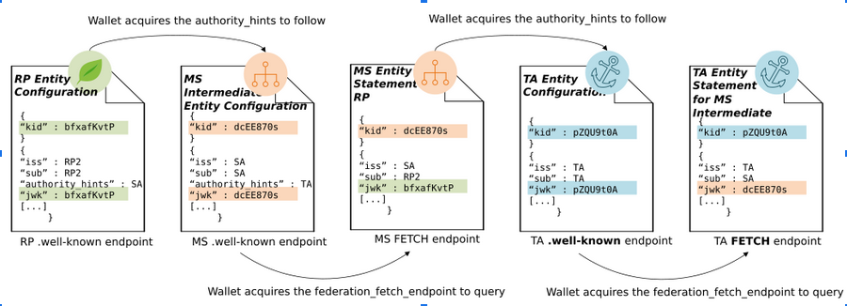
BUILDING A TRUST CHAIN
Colored elements show the cryptographic bindings
* NOTE: only the Key ID of the JWK is shown

Slide 15
FEDERATION SPECIFICATION FEATURE
Applying Policies
Superior entities can apply policies to superiors
Trust roots can apply policies to all federation members
Organizations can apply policies to members
Policies can be applied to any metadata values
For instance, algorithms used
https://identitadigitale.gov.it/

Slide 16
FEDERATION SPECIFICATION FEATURE
Optimizations and Persistence
REST API to evaluate entity relationships in real time
Rather than having to dynamically retrieve entity statements to make every trust decision
Historical keys can be retained
Enables non-repudiation of long-lived assertions
https://identitadigitale.gov.it/

Slide 17
The Italian OpenID Connect Federation
SPID and CIE id, the Italian eID systems
Why Italy uses OIDC Federation 1.0 and how She uses it

Slide 18
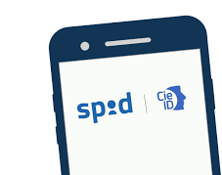
NATIONAL DIGITAL IDENTITY SCHEMES THAT LOOK TO THE FUTURE OF the EUROPEAN electronic IDentification, Authentication and trust Services
SPID
CIE id
Public Digital Identity System
Over 34.9 millions of identity provided to citizens
Over 72 million accesses per month
11 Private Service Identity Providers
More than 14600 Service Providers
Electronic Identity Card
Over 35 millions of identity provided to citizens
Over 2 million accesses per month
1 Public Service Identity Provider
More than 7000 Service Providers
Born in 2014 and made operational in 2016 with SAML 2 OpenID Connect iGov implementation profile preview published in 2019
Implementation profile adopted in 2022 with OpenID Connect Federation 1.0
https://identitadigitale.gov.it/

Slide 19
STARTING FROM THE REQUIREMENTS RATHER THAN FROM THE TECHNOLOGICAL EQUIPMENT
What were we looking for
A way for all participants to publish their metadata online … not only for Identity Providers
An accreditation mechanism across different organizations … to scale the accreditation bodies
Safe and certifiable flows and attestations over time … no one can repudiate a request or data, for years
Photo by Matthew Henry from Burst

Slide 20
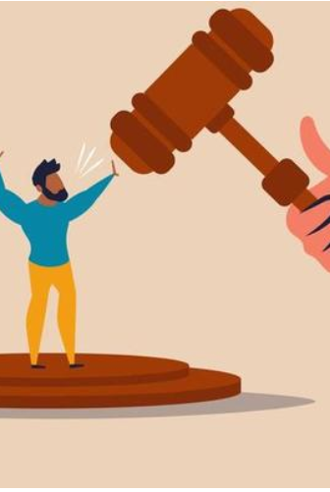
A STORY OF NON-REPUDIABILITY
The fate of long-lived attestations
Let’s imagine a request signed and issued by a RP to an OP
and an ID Token issued and signed by an OP
After years, neither party can deny having asked for or received the data The Trust Chain carries proof of metadata and keys
The Trust Anchor publishes the history of its revoked and expired keys, historical Trust Chain are always verifiable
https://identitadigitale.gov.it/

Slide 21
AN OPEN SPECIFICATION, IN AN OPEN STANDARDIZATION PROCESS
What did we find
.well-known/openid-federation endpoint … signed multiple metadata for multiple roles
Intermediates … a standard way of delegating accreditation functions across multiple organizations… delegation of trust!
Trust Marks … Custom definitions of compliance profiles according to our trust framework, without touching protocols metadata
https://identitadigitale.gov.it/
Photo by Farah from Burst

Slide 22
WHAT DID WE FIND
… And more …
Metadata Policy allow us to apply security countermeasures on a large scale, automatically and with certainty of adoption within a configurable period of time
Freedom for the participants … to change their protocols metadata without having to re-submit anything to the accreditation authorities. A dynamic infrastructure which reconfigures itself automatically, periodically
https://identitadigitale.gov.it/
Photo by crescita-personale.it

Slide 23
IS OPENID FEDERATION A PKI? NOT ONLY, BUT YES.
x509 and OpenID Federation 1.0
{ “x5c”: [ … ] } | { “trust_chain”: [ … ] }
Sequence of x509 Certificates | Sequence of signed JWTs
Verifiable with the sole Trust Anchor public key | Verifiable with the sole Trust Anchor public key
Extended with CRL and OCSP | Revocation mechanisms are built in, as also Trust Marks, Metadata Policies, Constraints, REST API
It’s x509! | JWT costs less and it’s developer friendly … It can publish even x509!
https://identitadigitale.gov.it/

Slide 24
WHAT ARE WE WORKING ON
It’s Time To Go … eIDAS 2.0
Revision of the regulation has started by European Parliament
Technological, market and legal developments in relation to the paradigms of Decentralised Identity and Self-Sovereign Identity
Ongoing work for the development of the European digital identity Wallet, the EUDI Wallet
The user-centered paradigm exposes this to great dangers, trust mechanisms require automatic checks. We really can’t leave the users alone is establish the trust with third parties.
https://identitadigitale.gov.it/
Photo by Farah from Burst

Slide 25
Thank you
If you have any question please ask … Mike Jones <michael_b_jones at hotmail.com>
Giuseppe De Marco <demarcog83 at gmail.com>
… Who you know you can trust !
Image by Zigmars Berzins from Pixabay

